Slide 1
Novogene May 2026 Mouse Samples Analysis
Ravi

Slide 2
1. Original tumor (2026) with PIP5K1A WT & KO

Slide 3
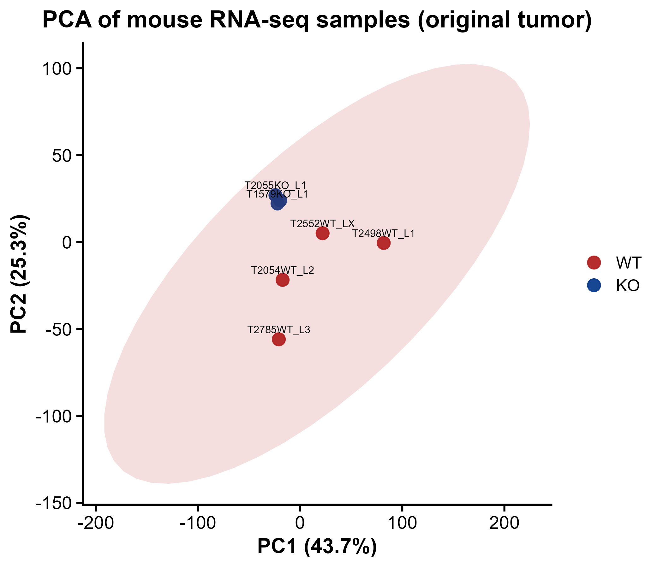
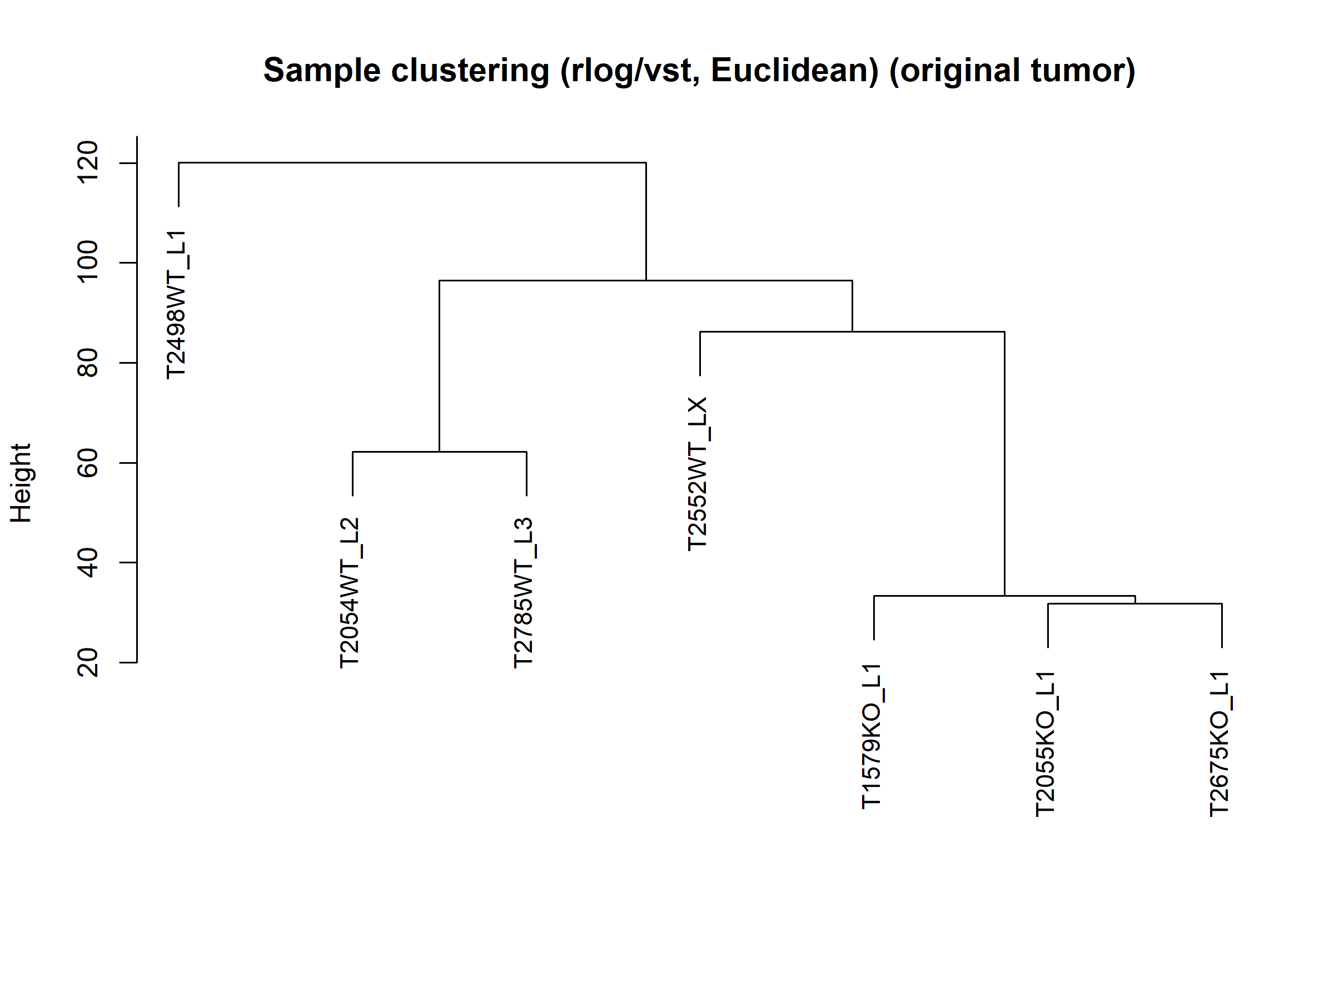
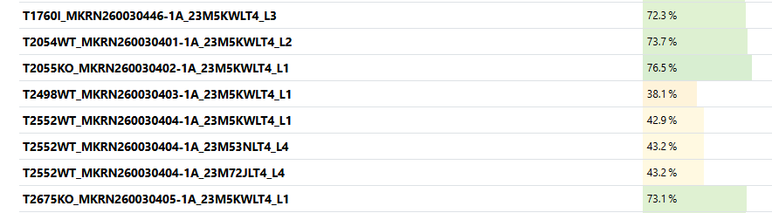


Slide 4
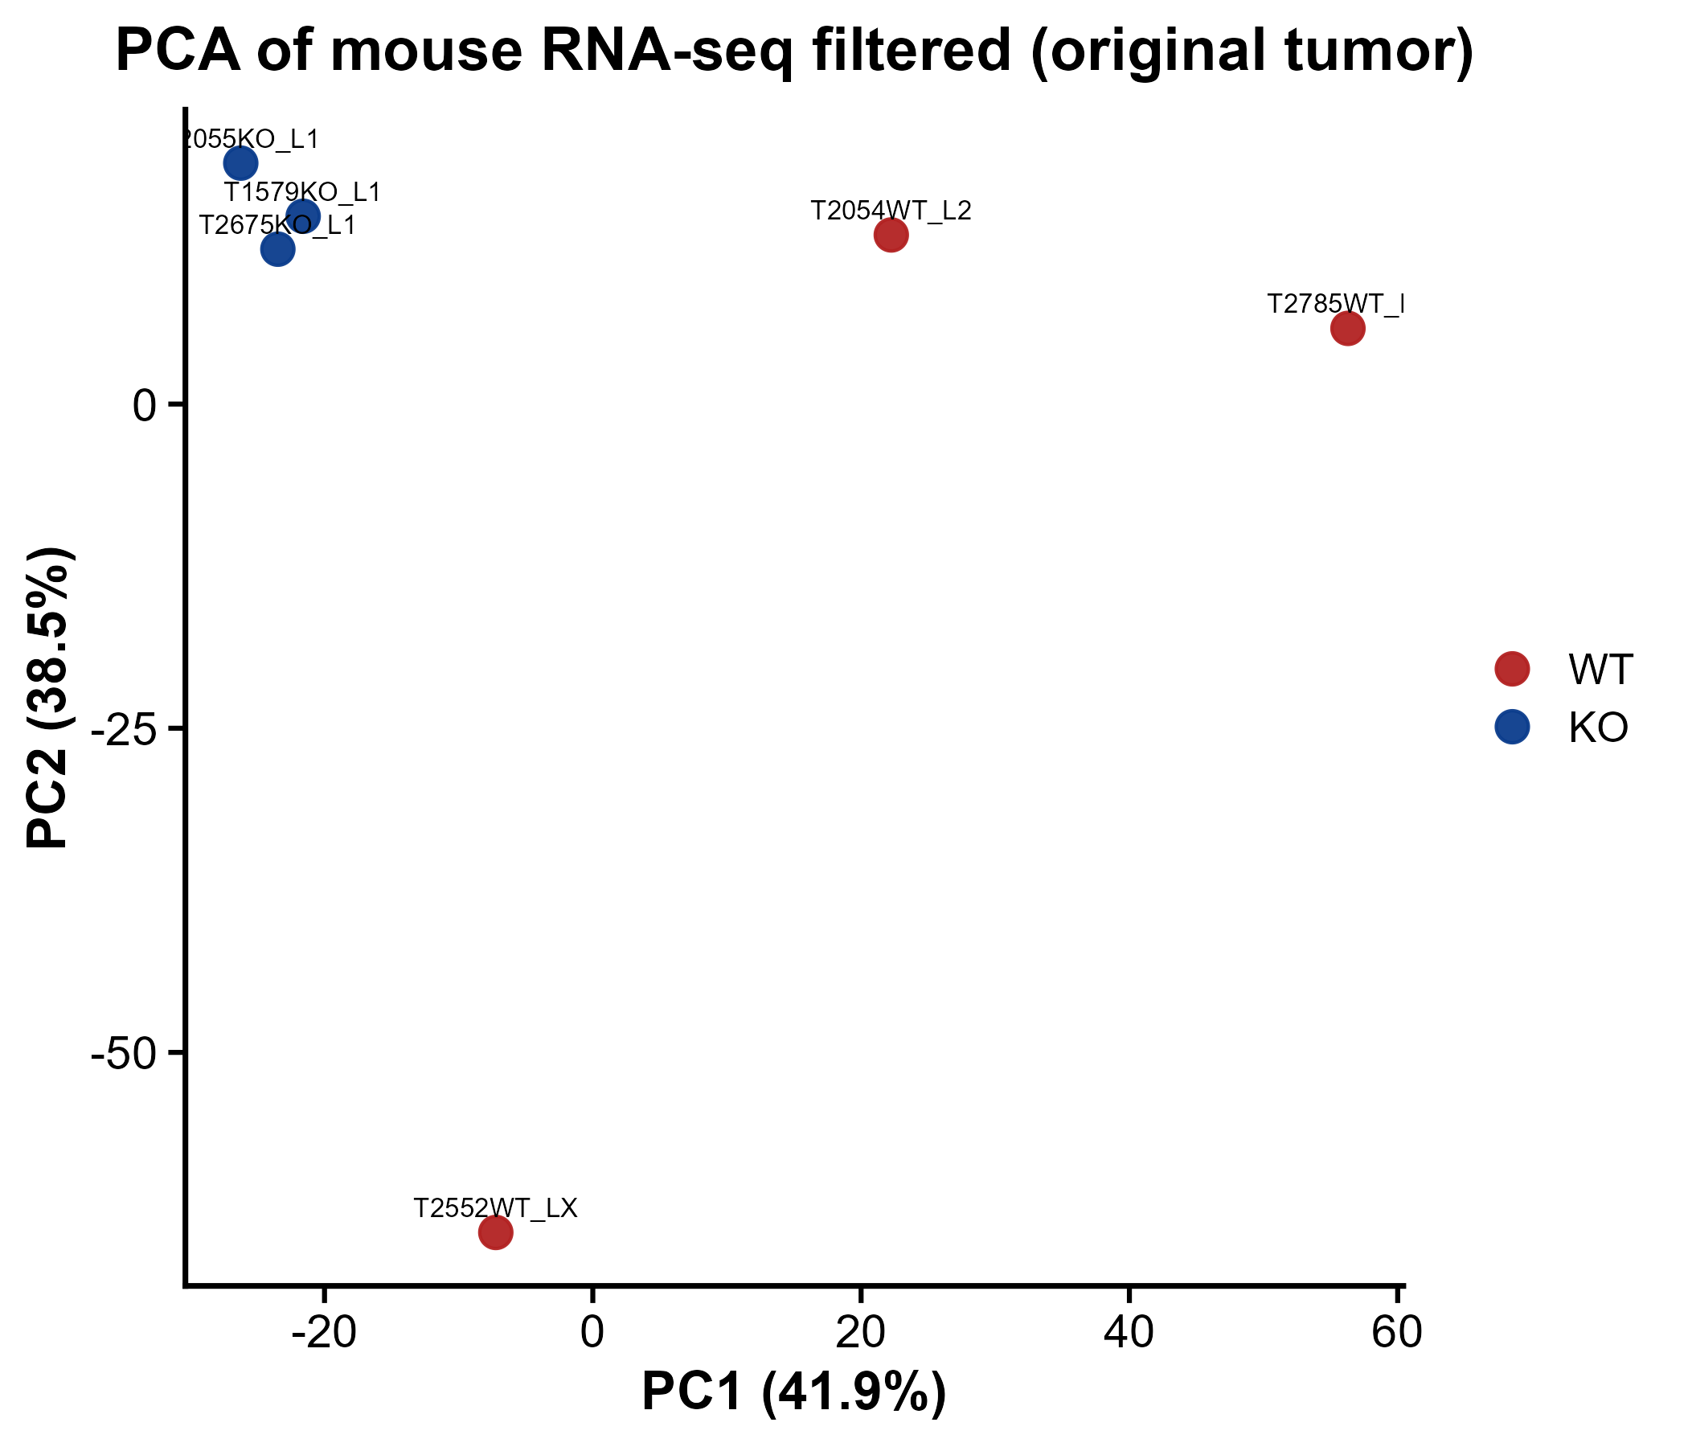
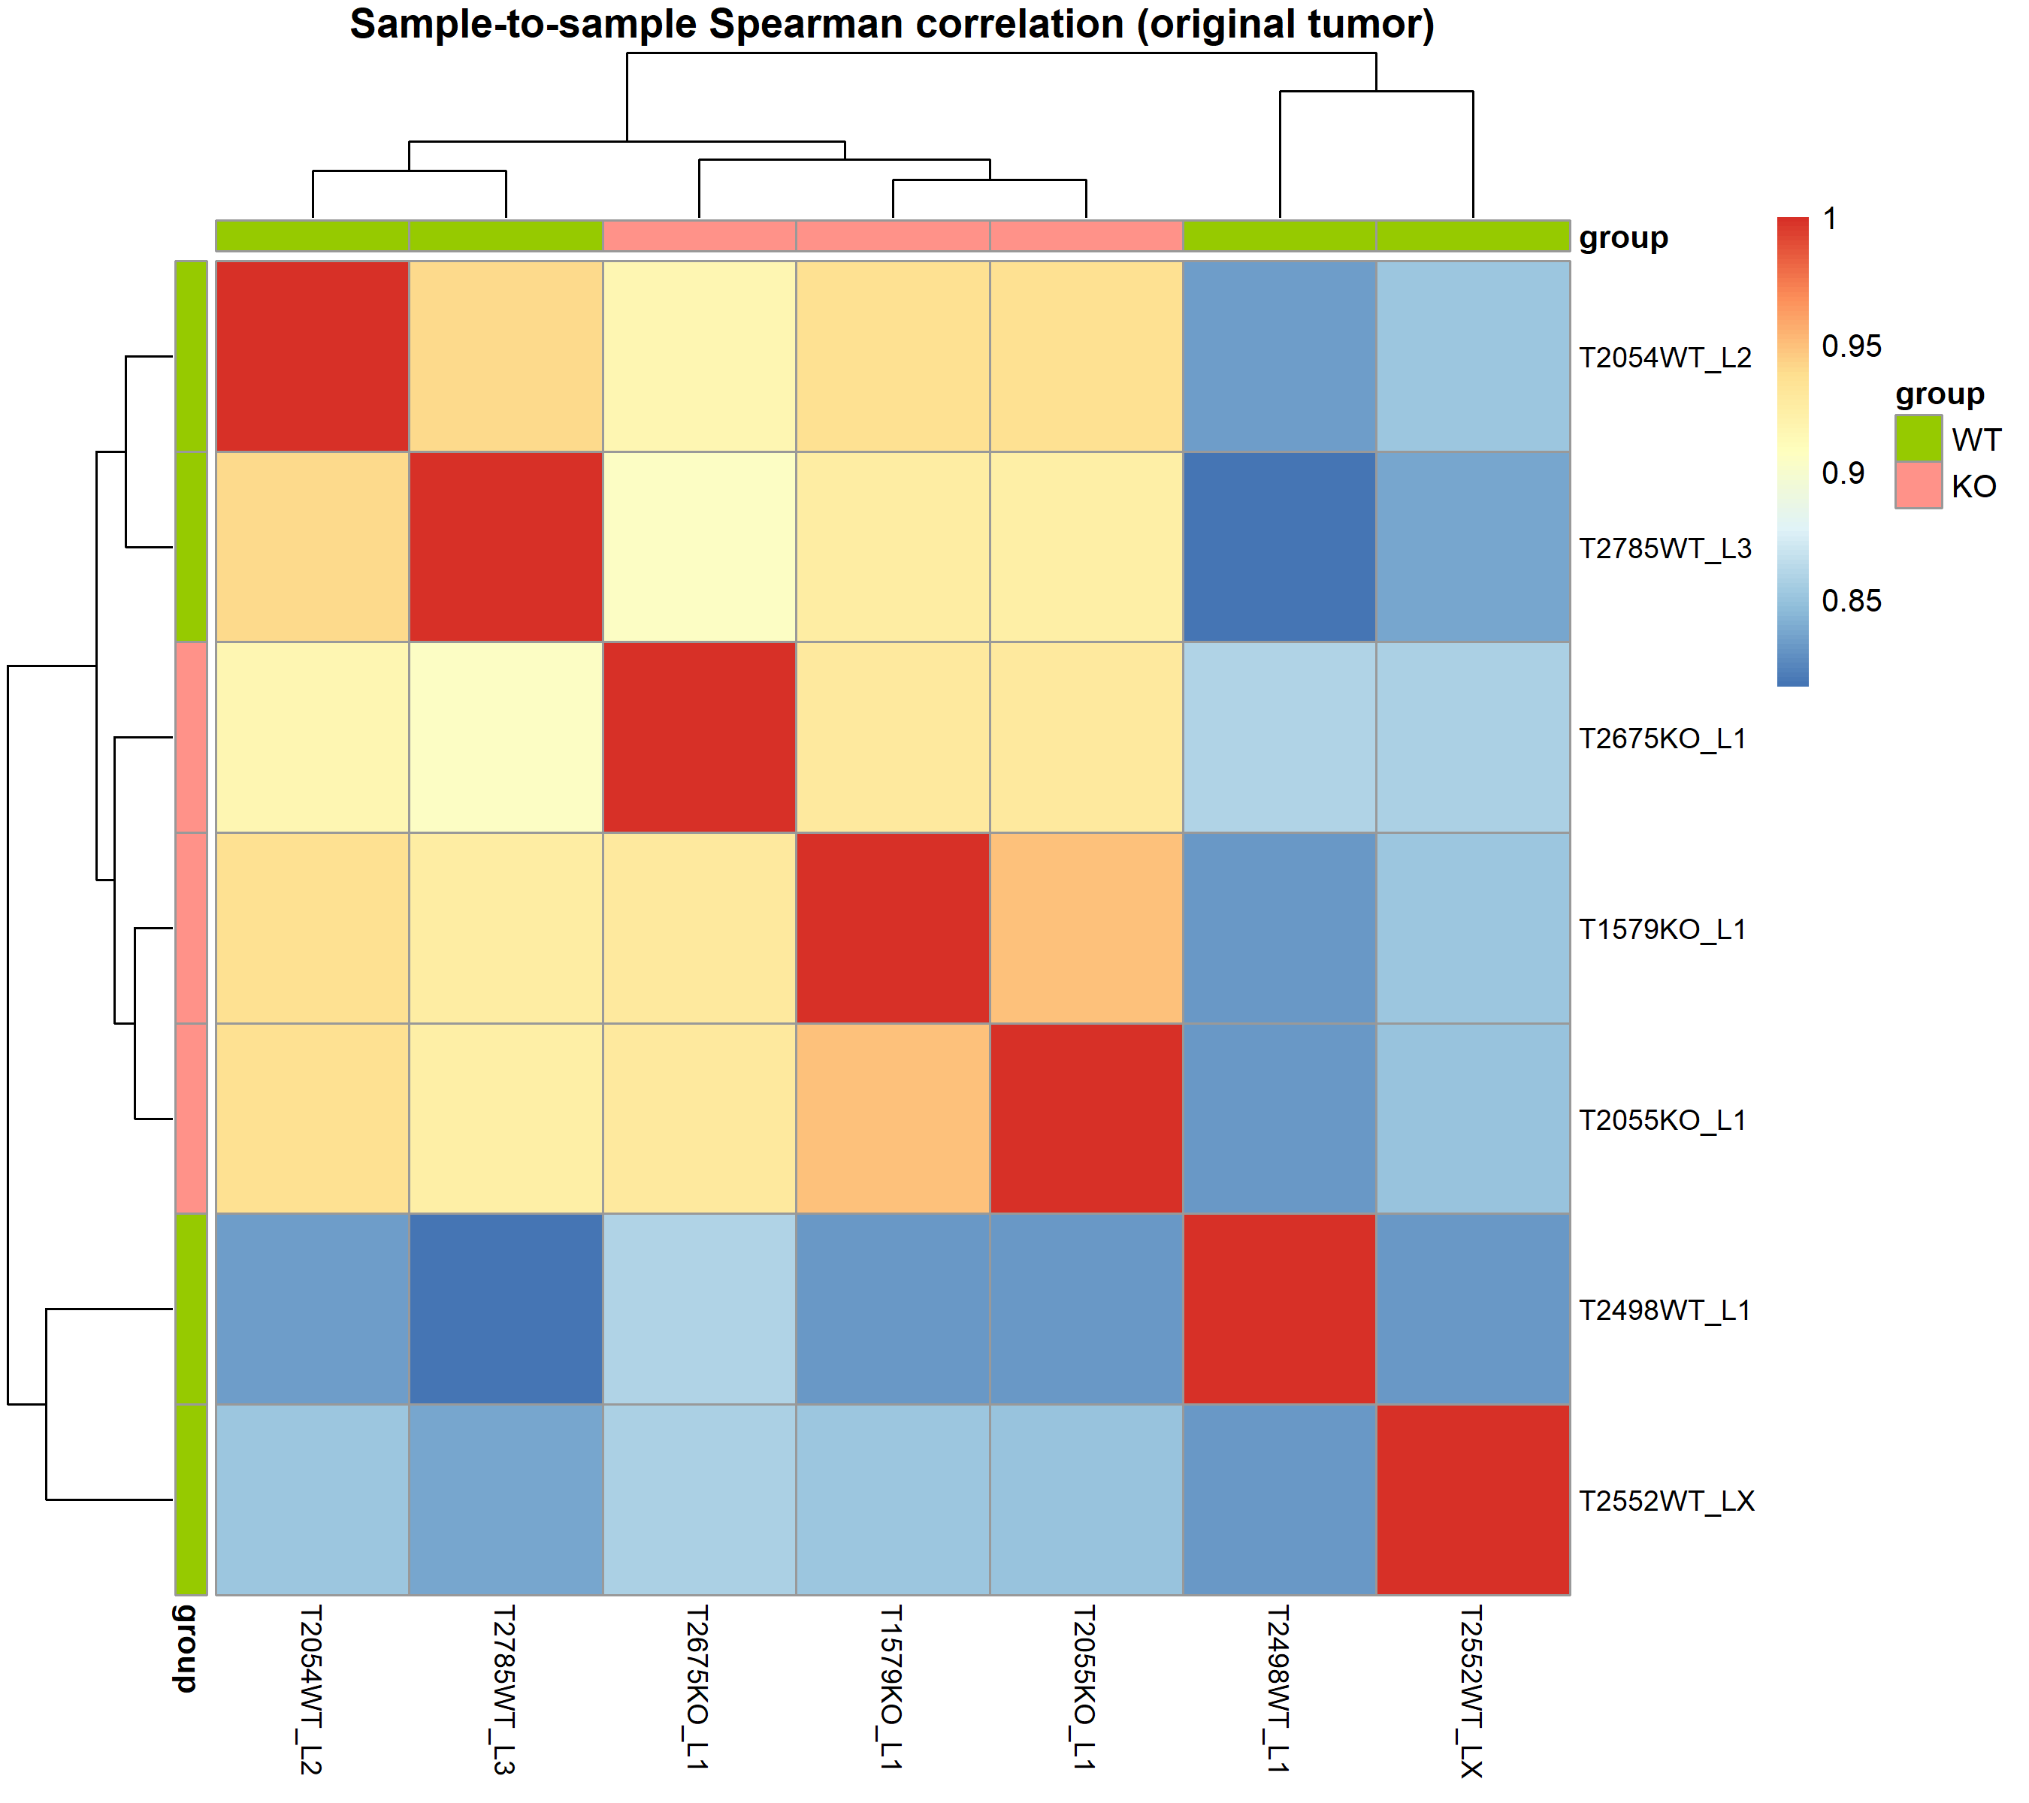
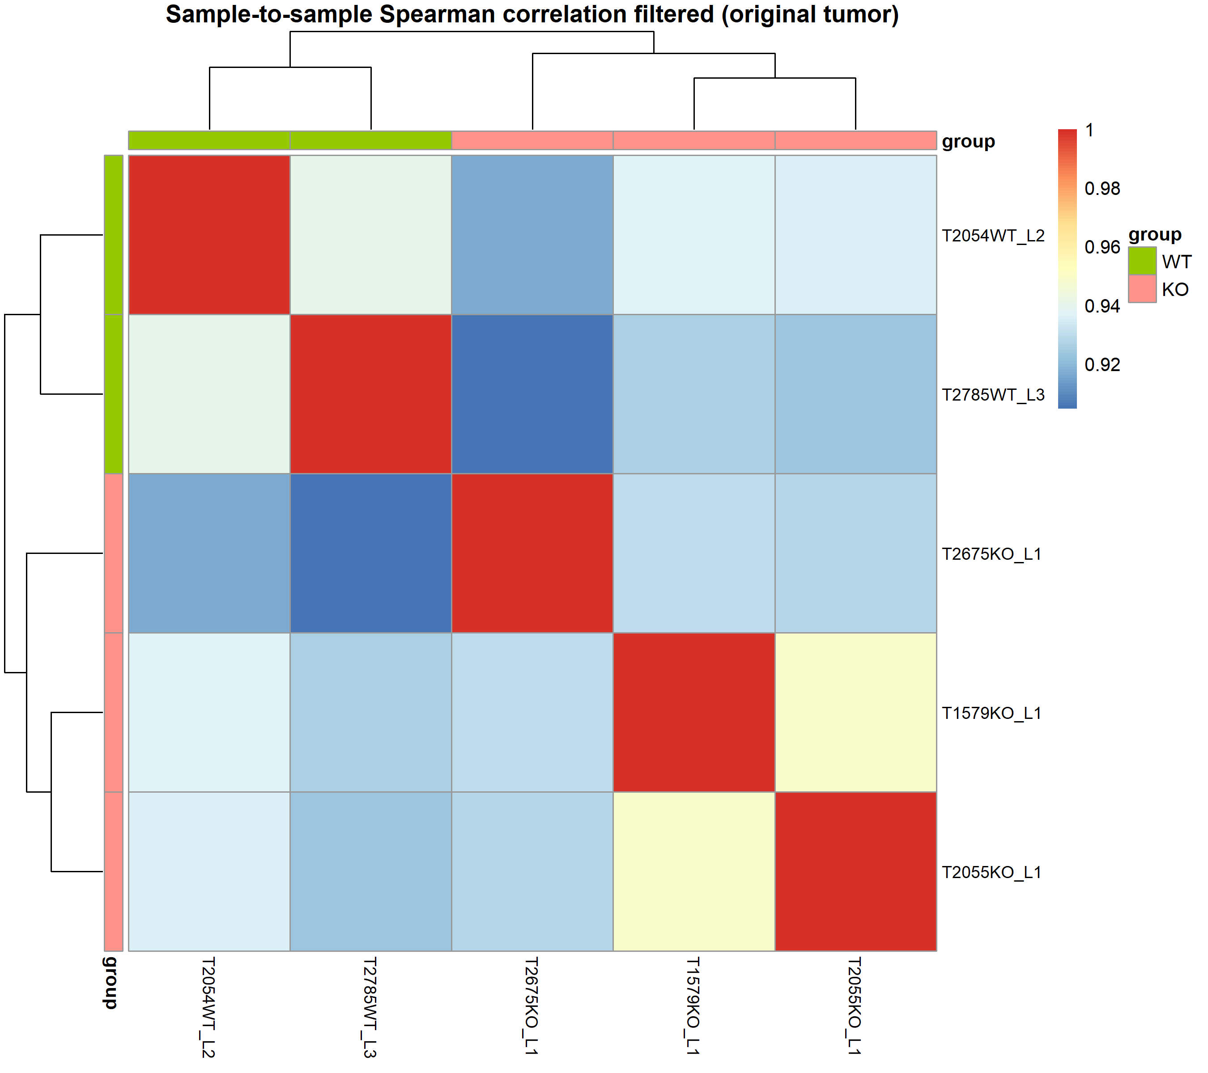
Spearman sample to sample correlation
filtered

Slide 5
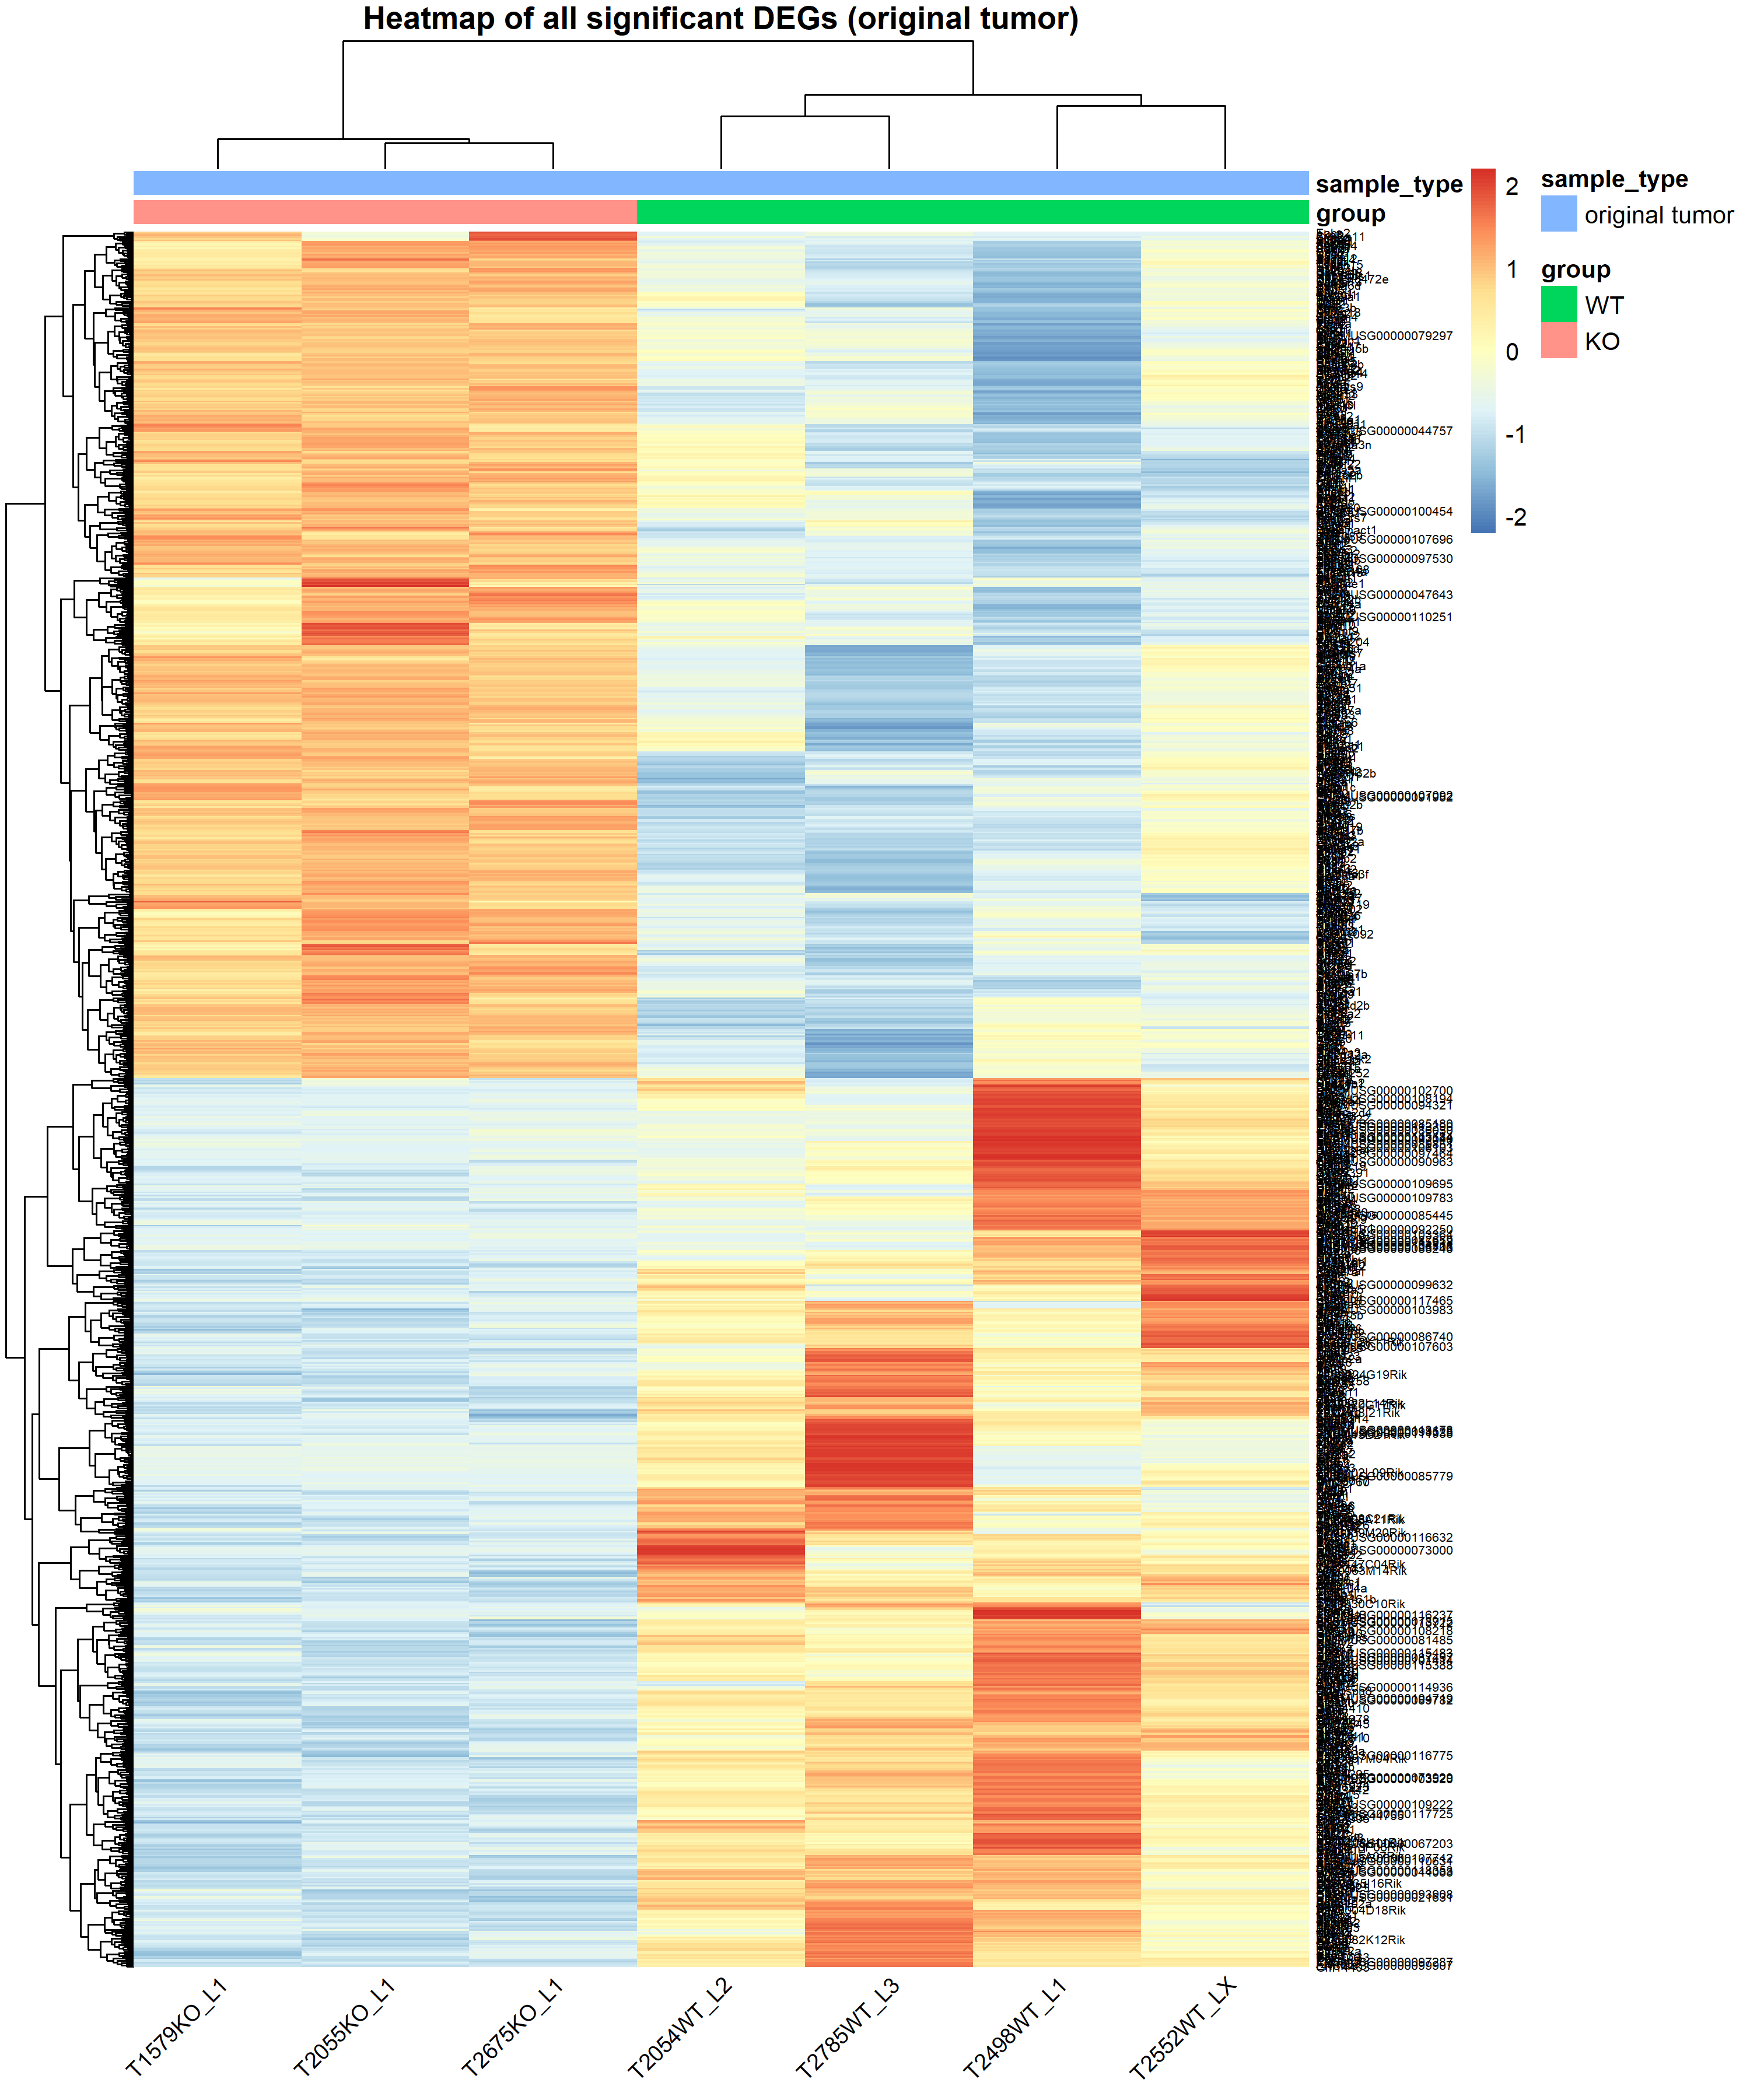
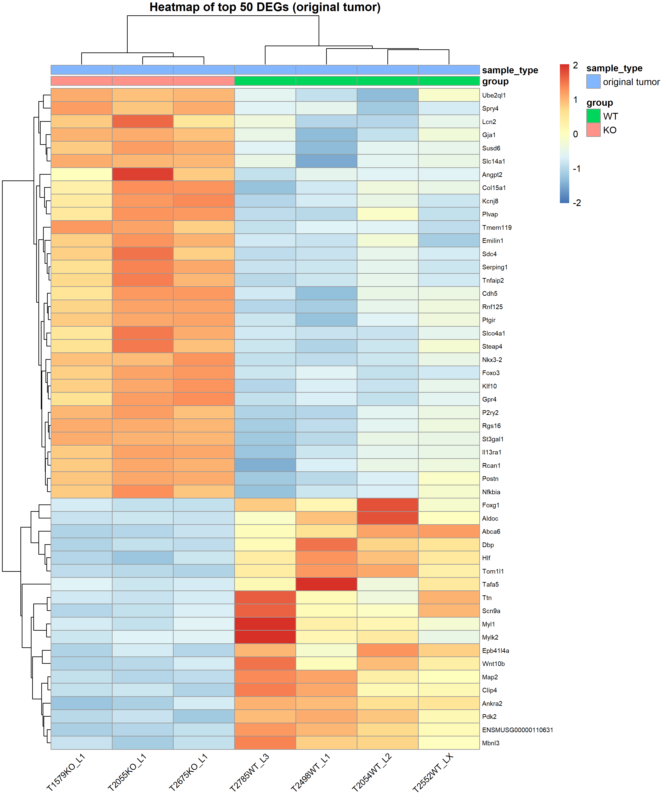

Slide 6
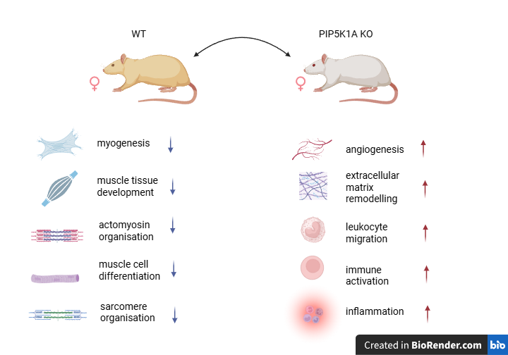
Original tumor (WT vs KO) Pathway & Immune enrichment Summary (Females)

Slide 7
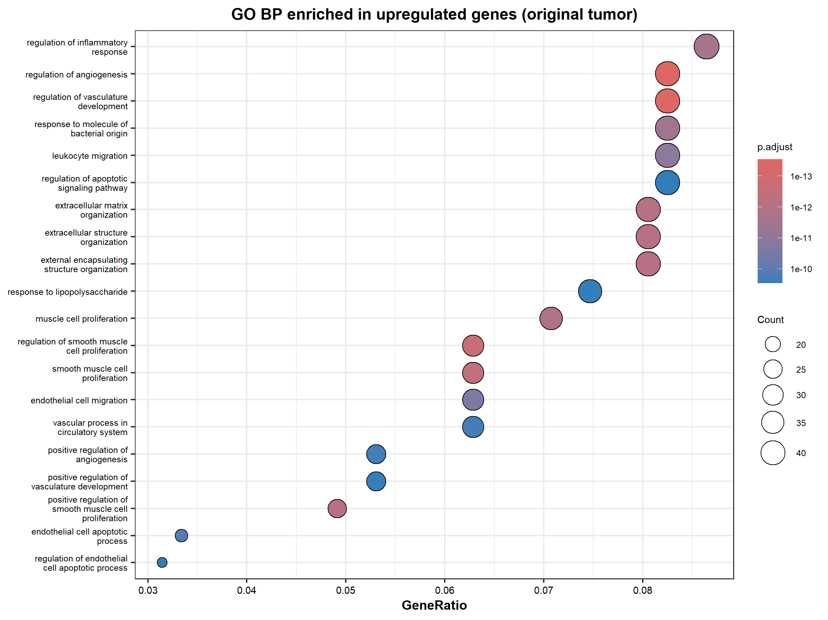

Slide 8
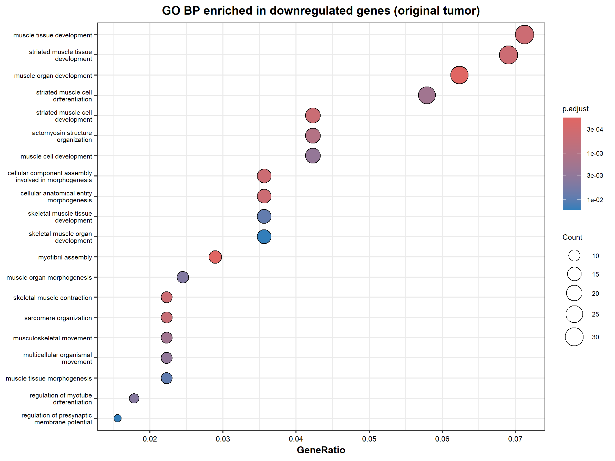

Slide 9
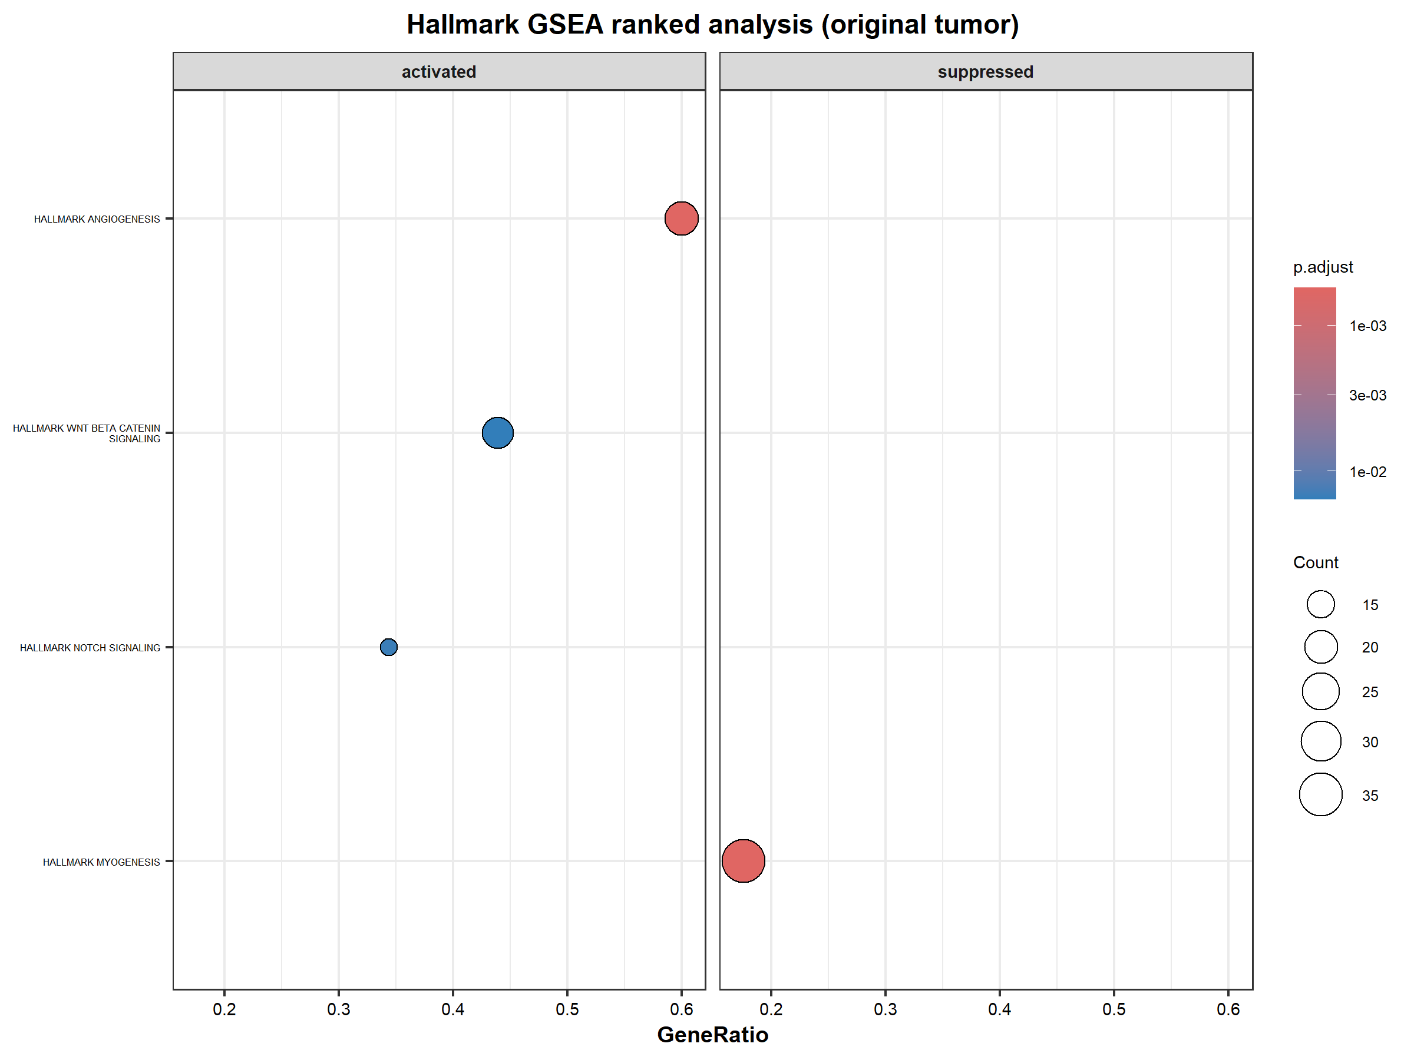

Slide 10
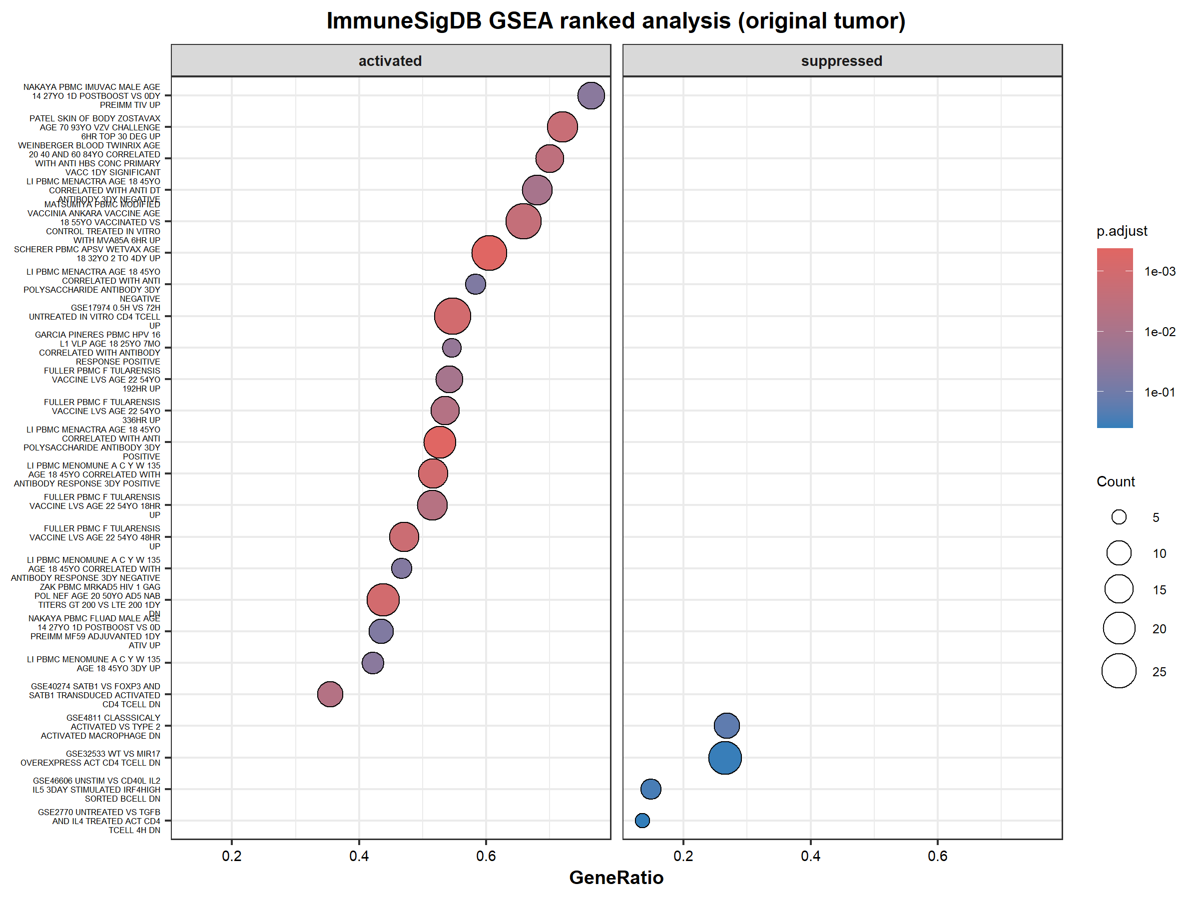

Slide 11
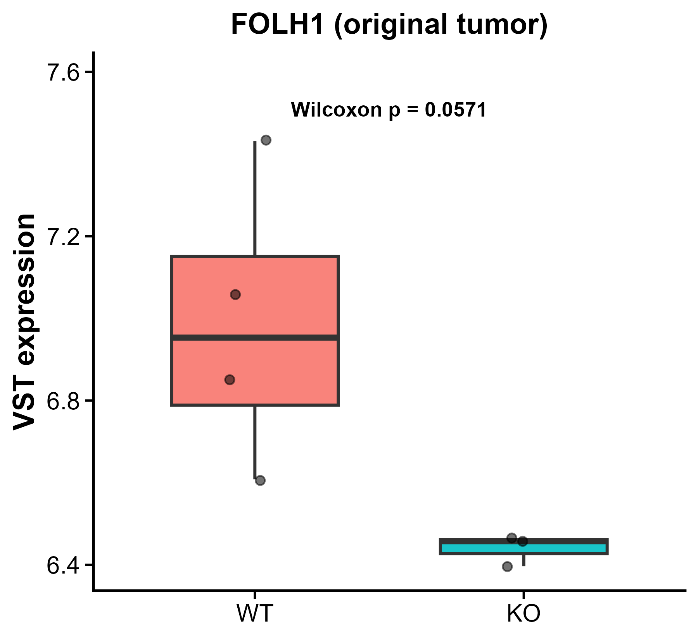
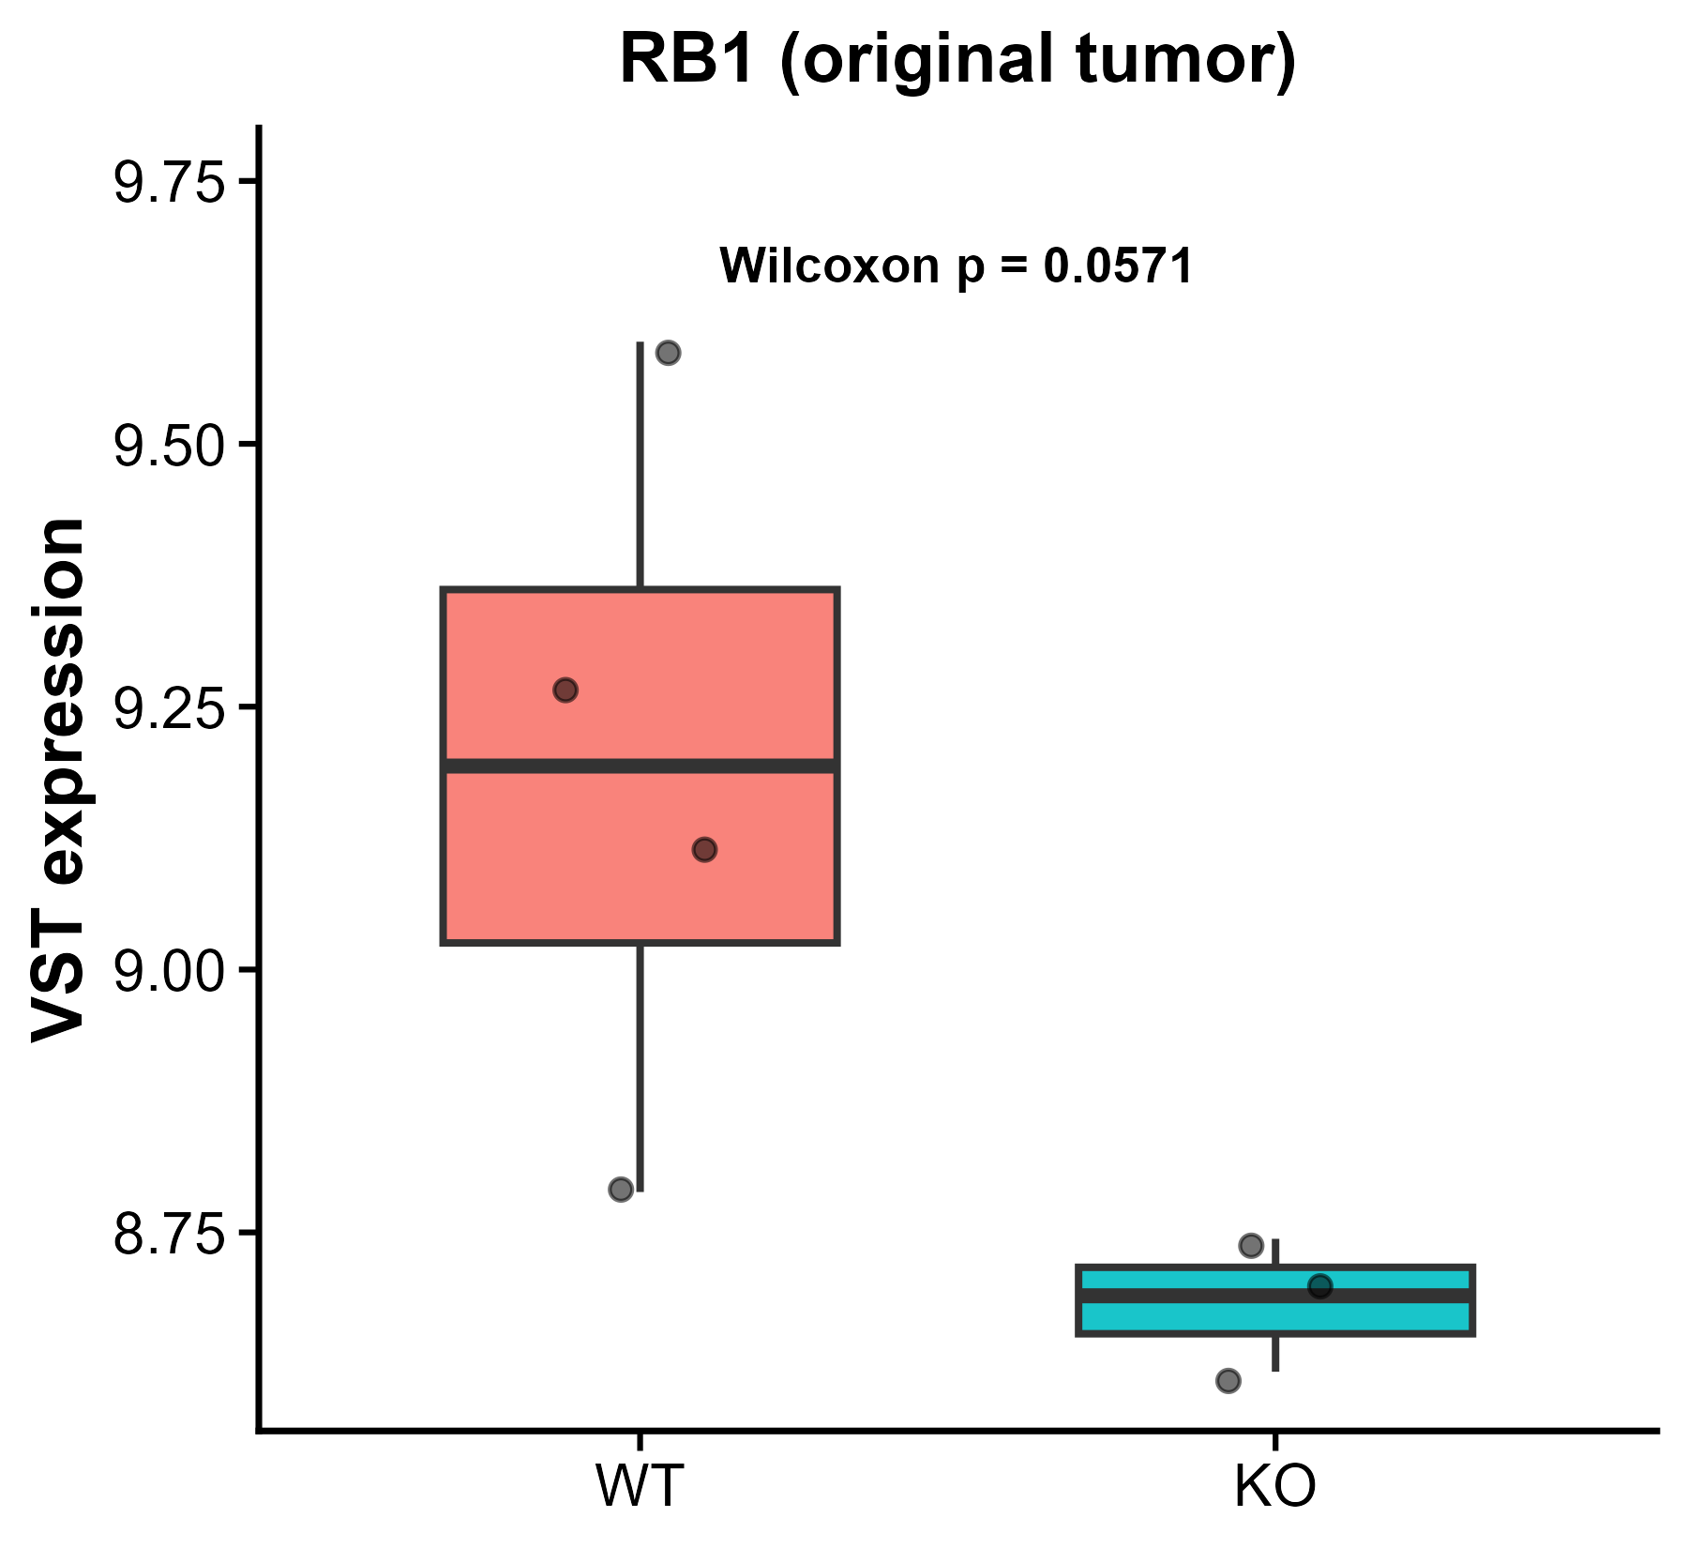
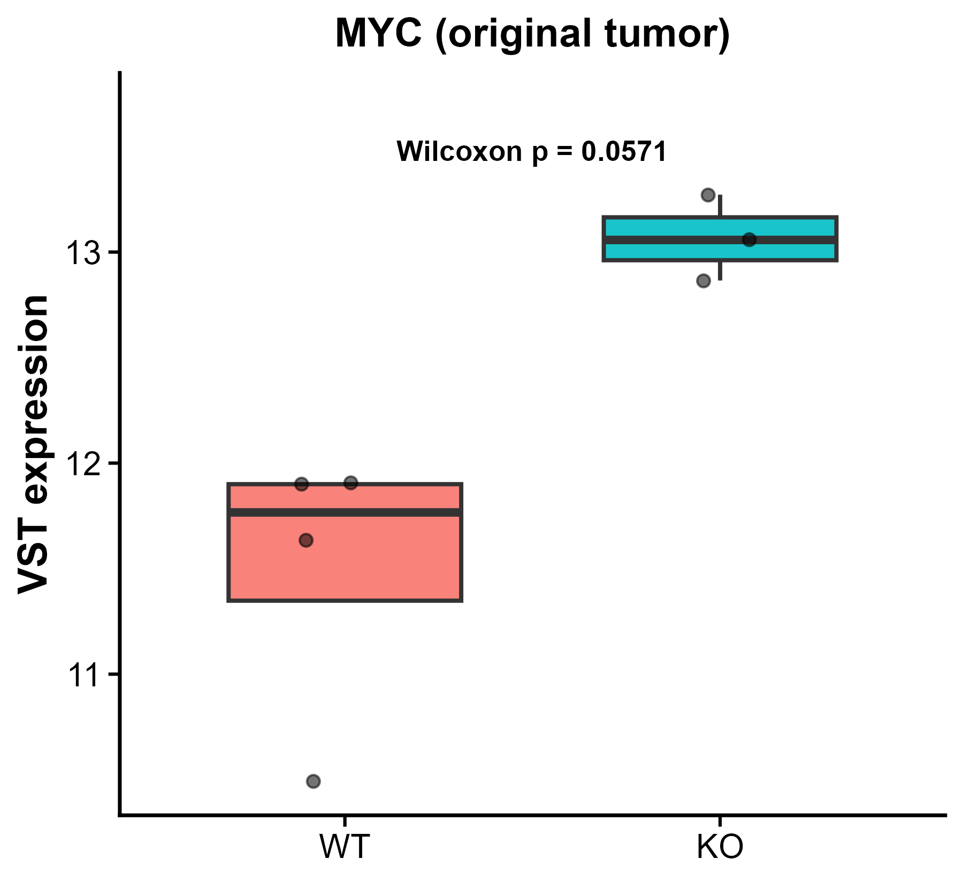
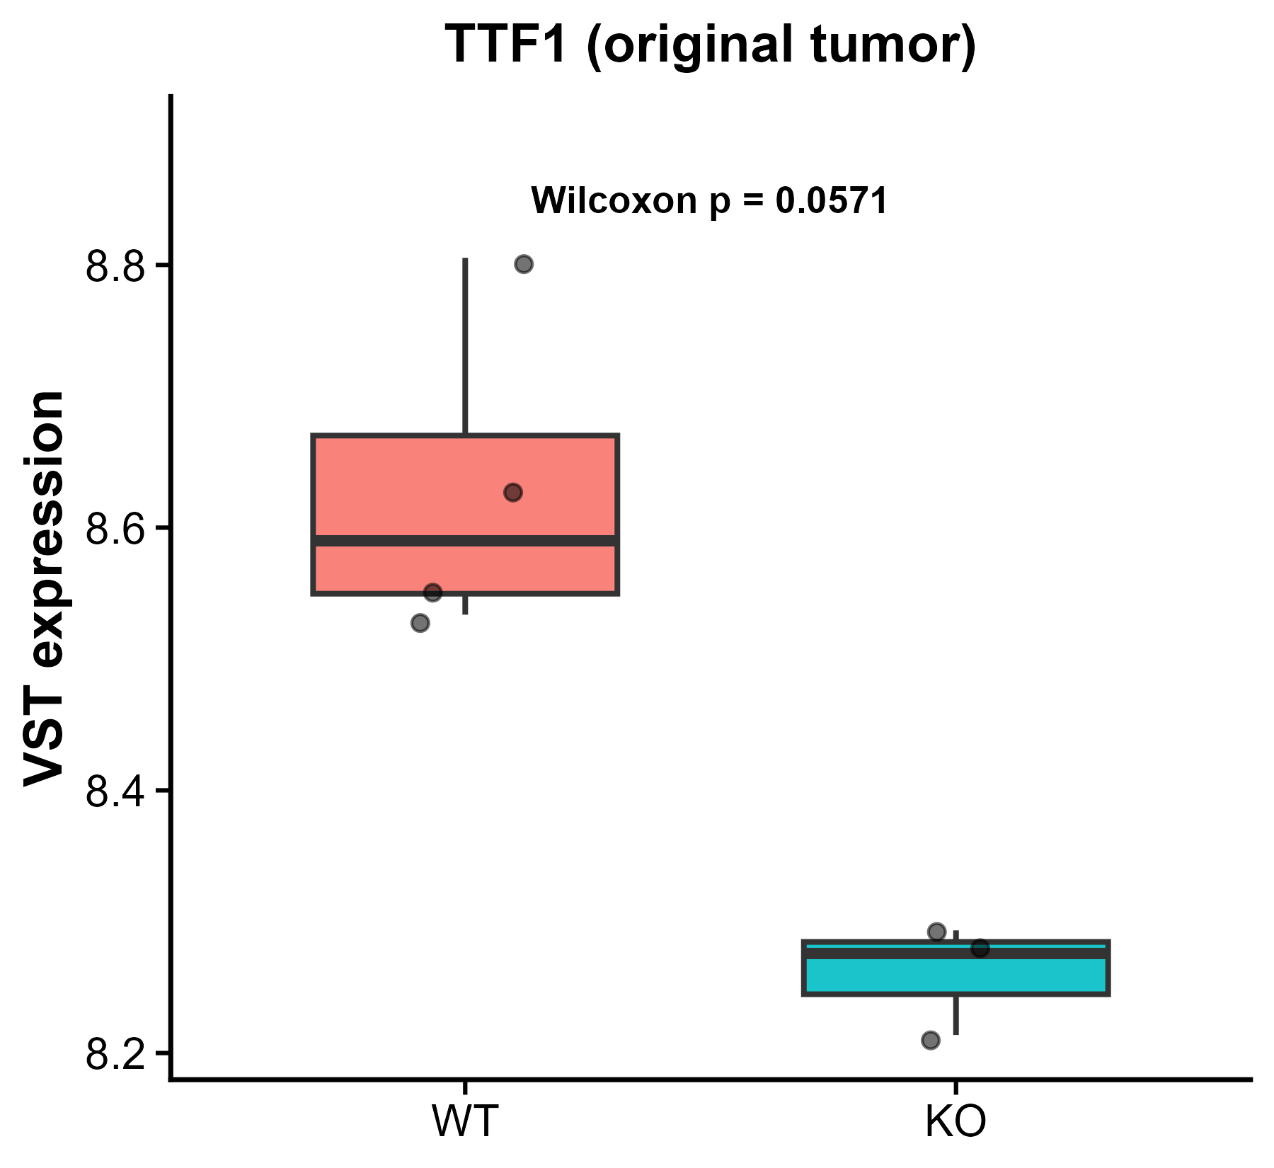
Expression patterns between WT and KO in
interested Biomarkers that showed significant
differences
FOLH1: encodes folate hydrolase 1, a type II transmembrane glycoprotein state. Through its folate hydrolase activity, FOLH1 mediates folate absorption in the gut.
RB1: a tumor suppressor that restrains the G1/S cell cycle transition by binding and inhibiting E2F transcription factors in its hypo-phosphorylated state.
TTF1: encodes transcription termination factor 1, a nucleolar factor that plays a critical role in ribosomal gene transcription. terminates RNA polymerase I transcription. Pathogenic association reported in hepatocellular carcinoma.
MYC: encodes a basic helix-loop-helix transcription factor that functions as a nuclear phosphoprotein in cell cycle progression, apoptosis, and cellular transformation. Amplification of MYC is frequently observed in numerous human cancers.

Slide 12
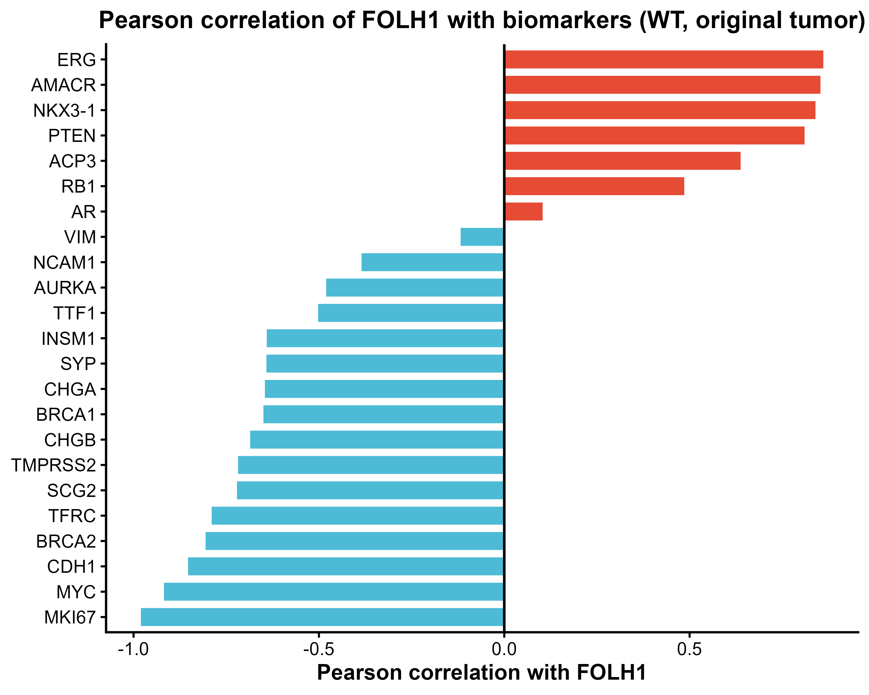
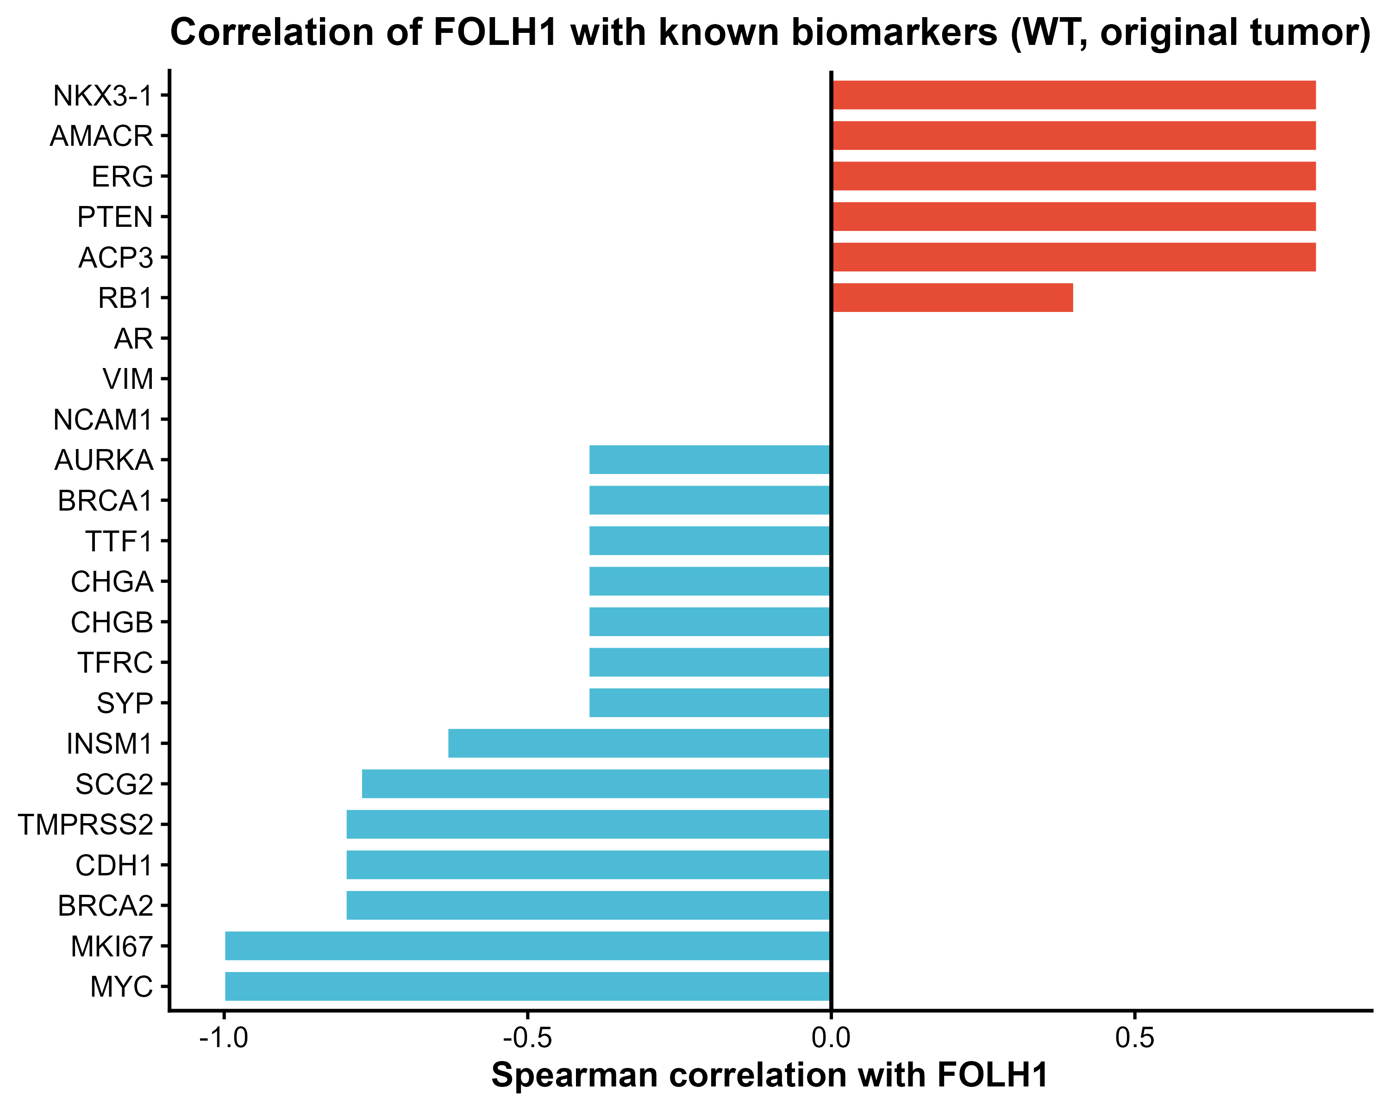
Correlation of Interested biomarkers with FOLH1 (WT)

Slide 13
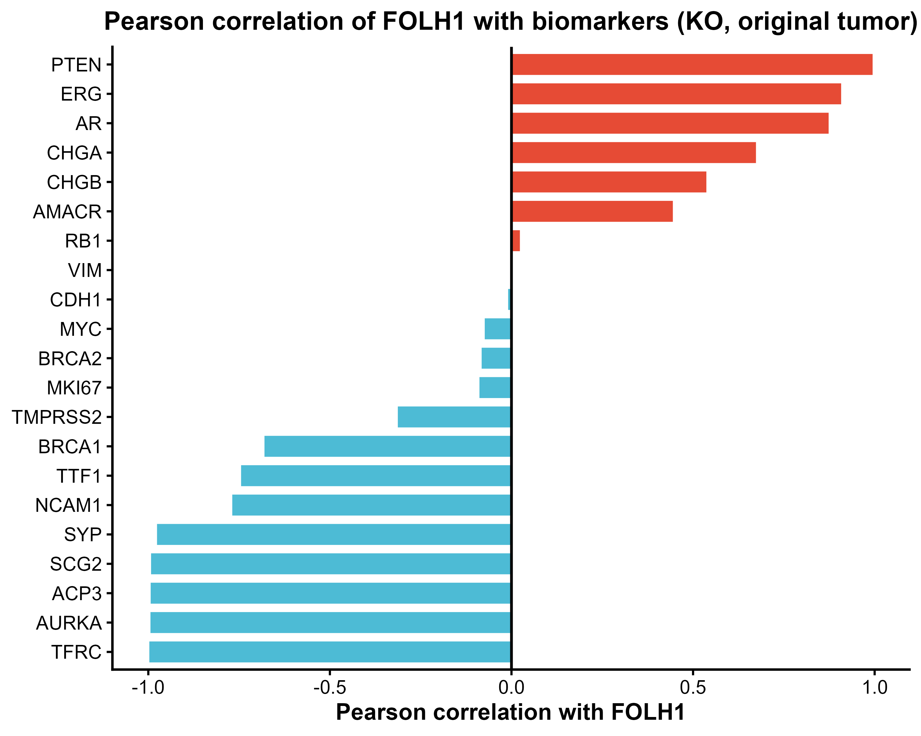
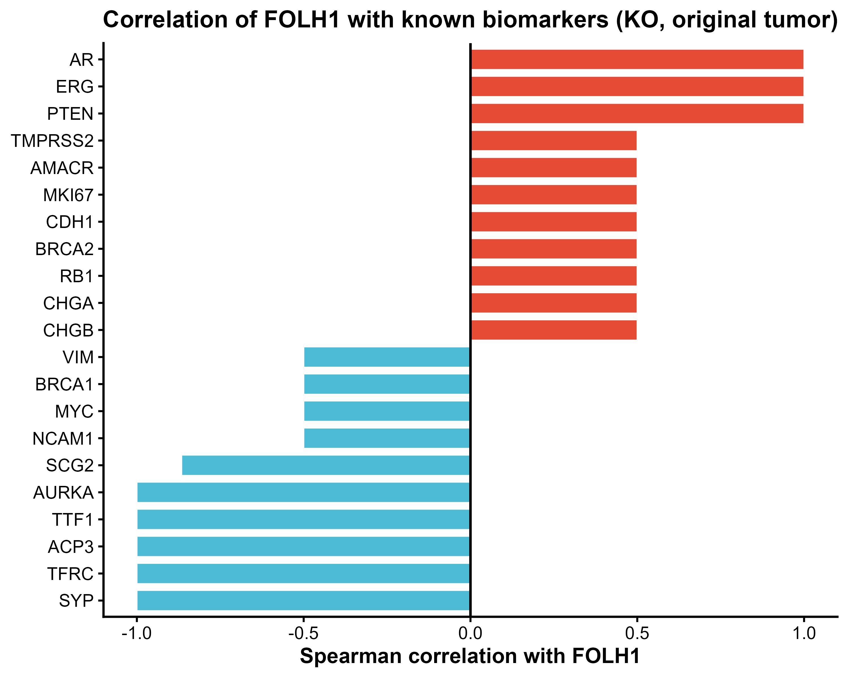
Correlation of Interested biomarkers with FOLH1 (PIP5K1A KO)

Slide 14
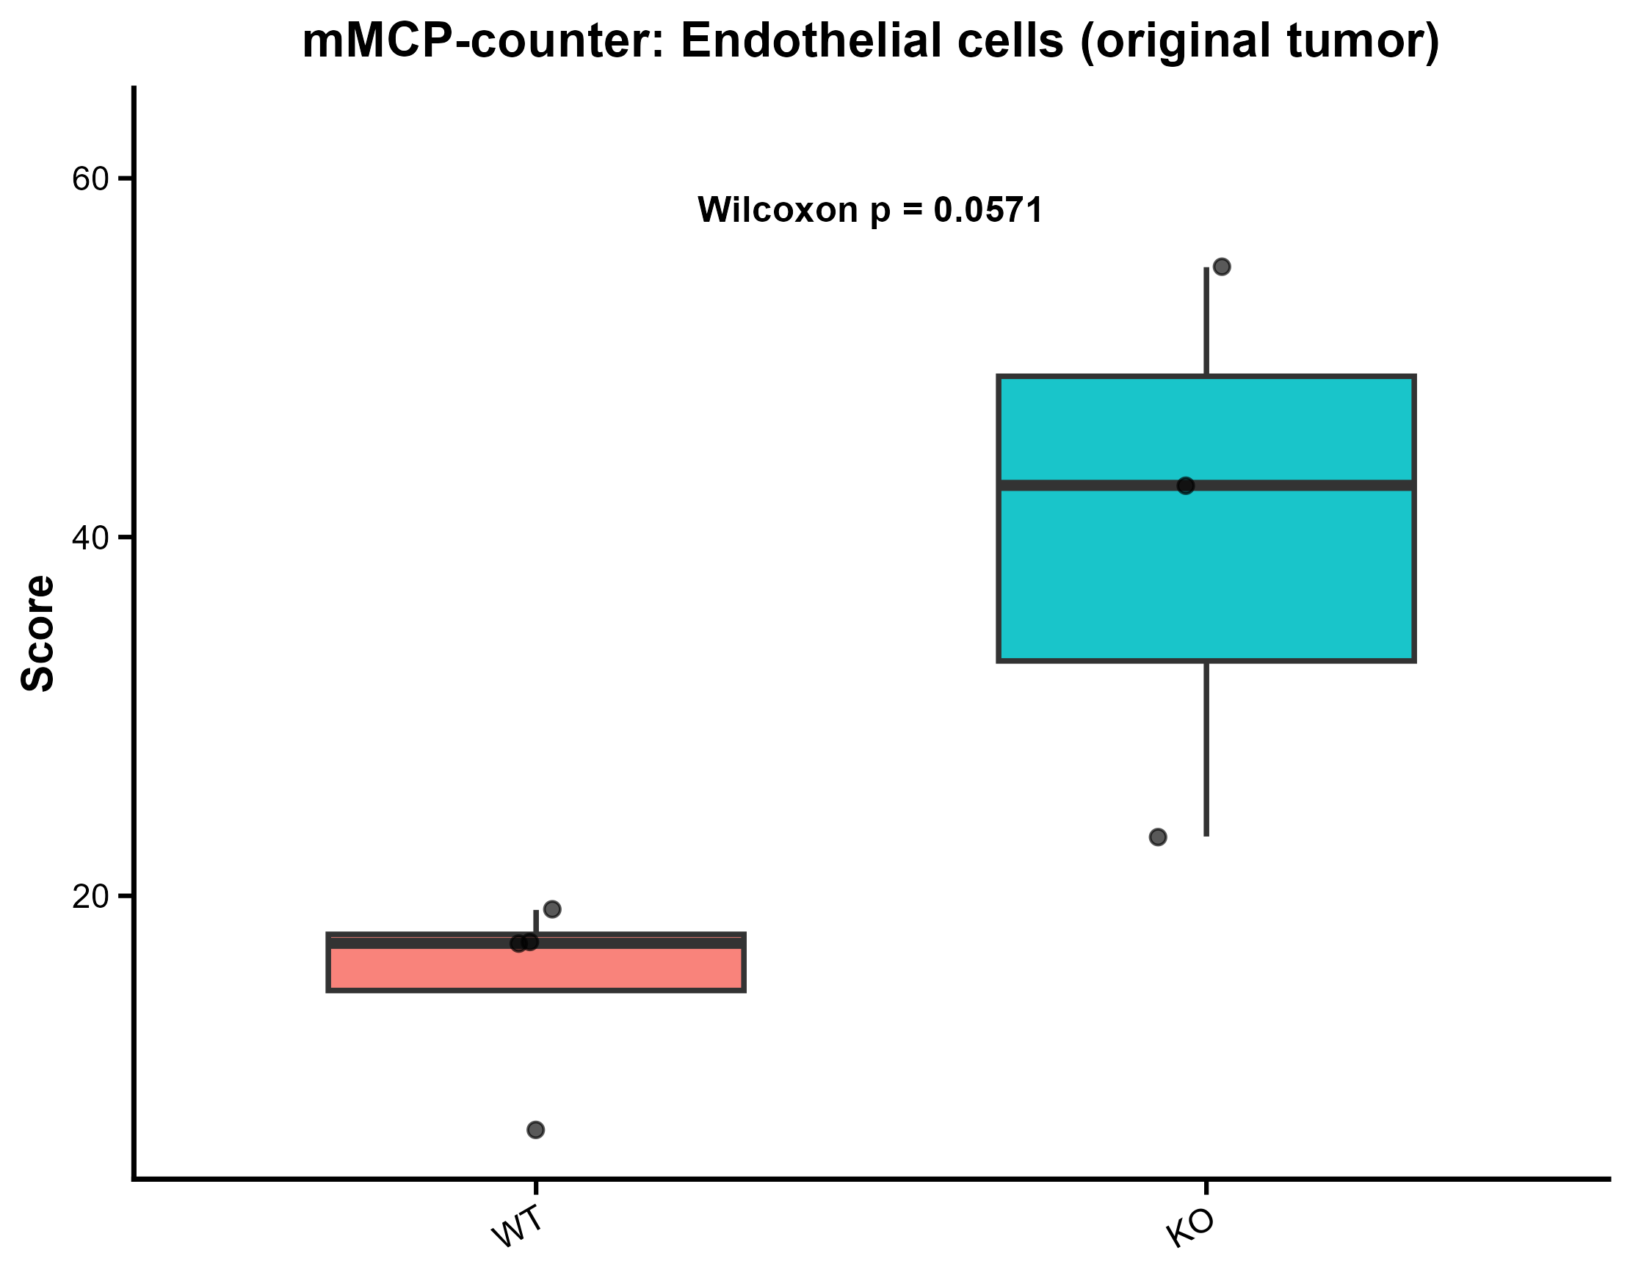
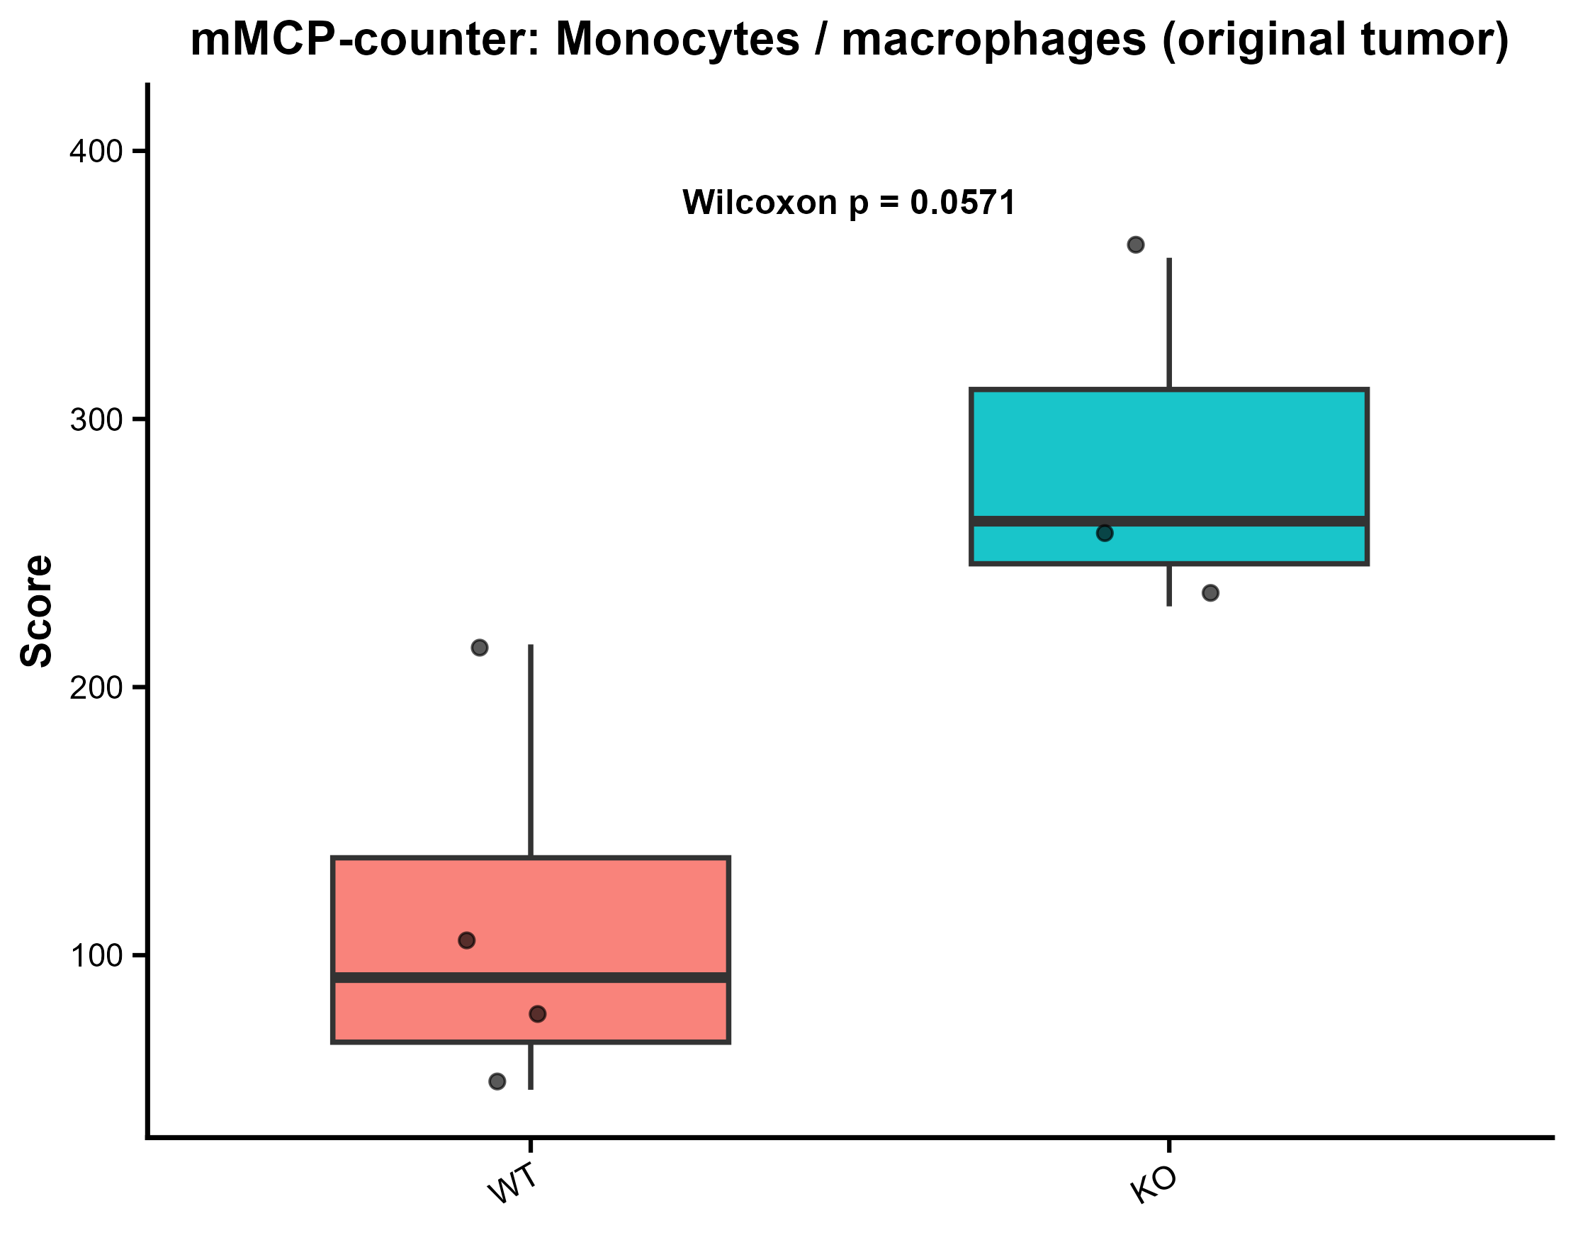
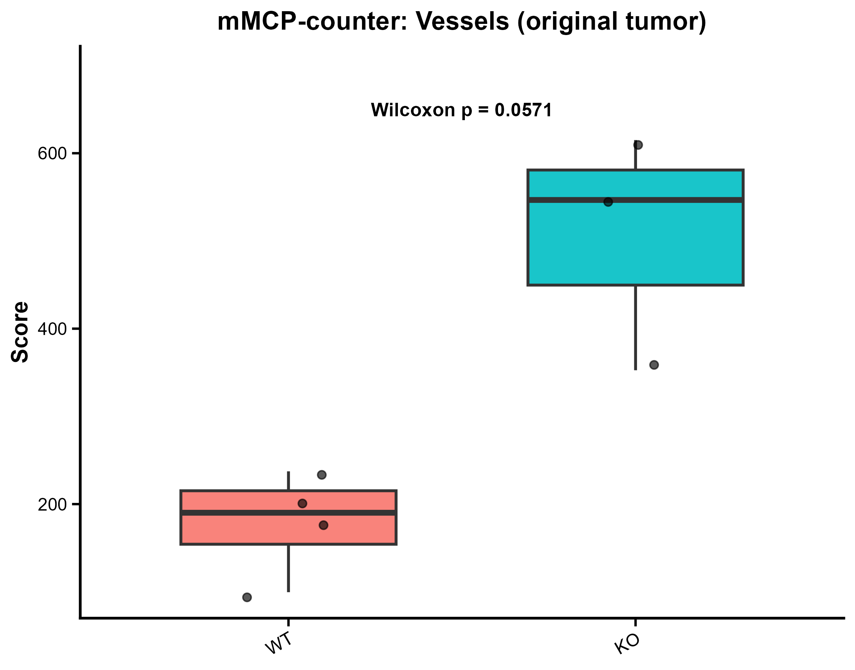
MCP counter groups with significant differences between WT and KO

Slide 15
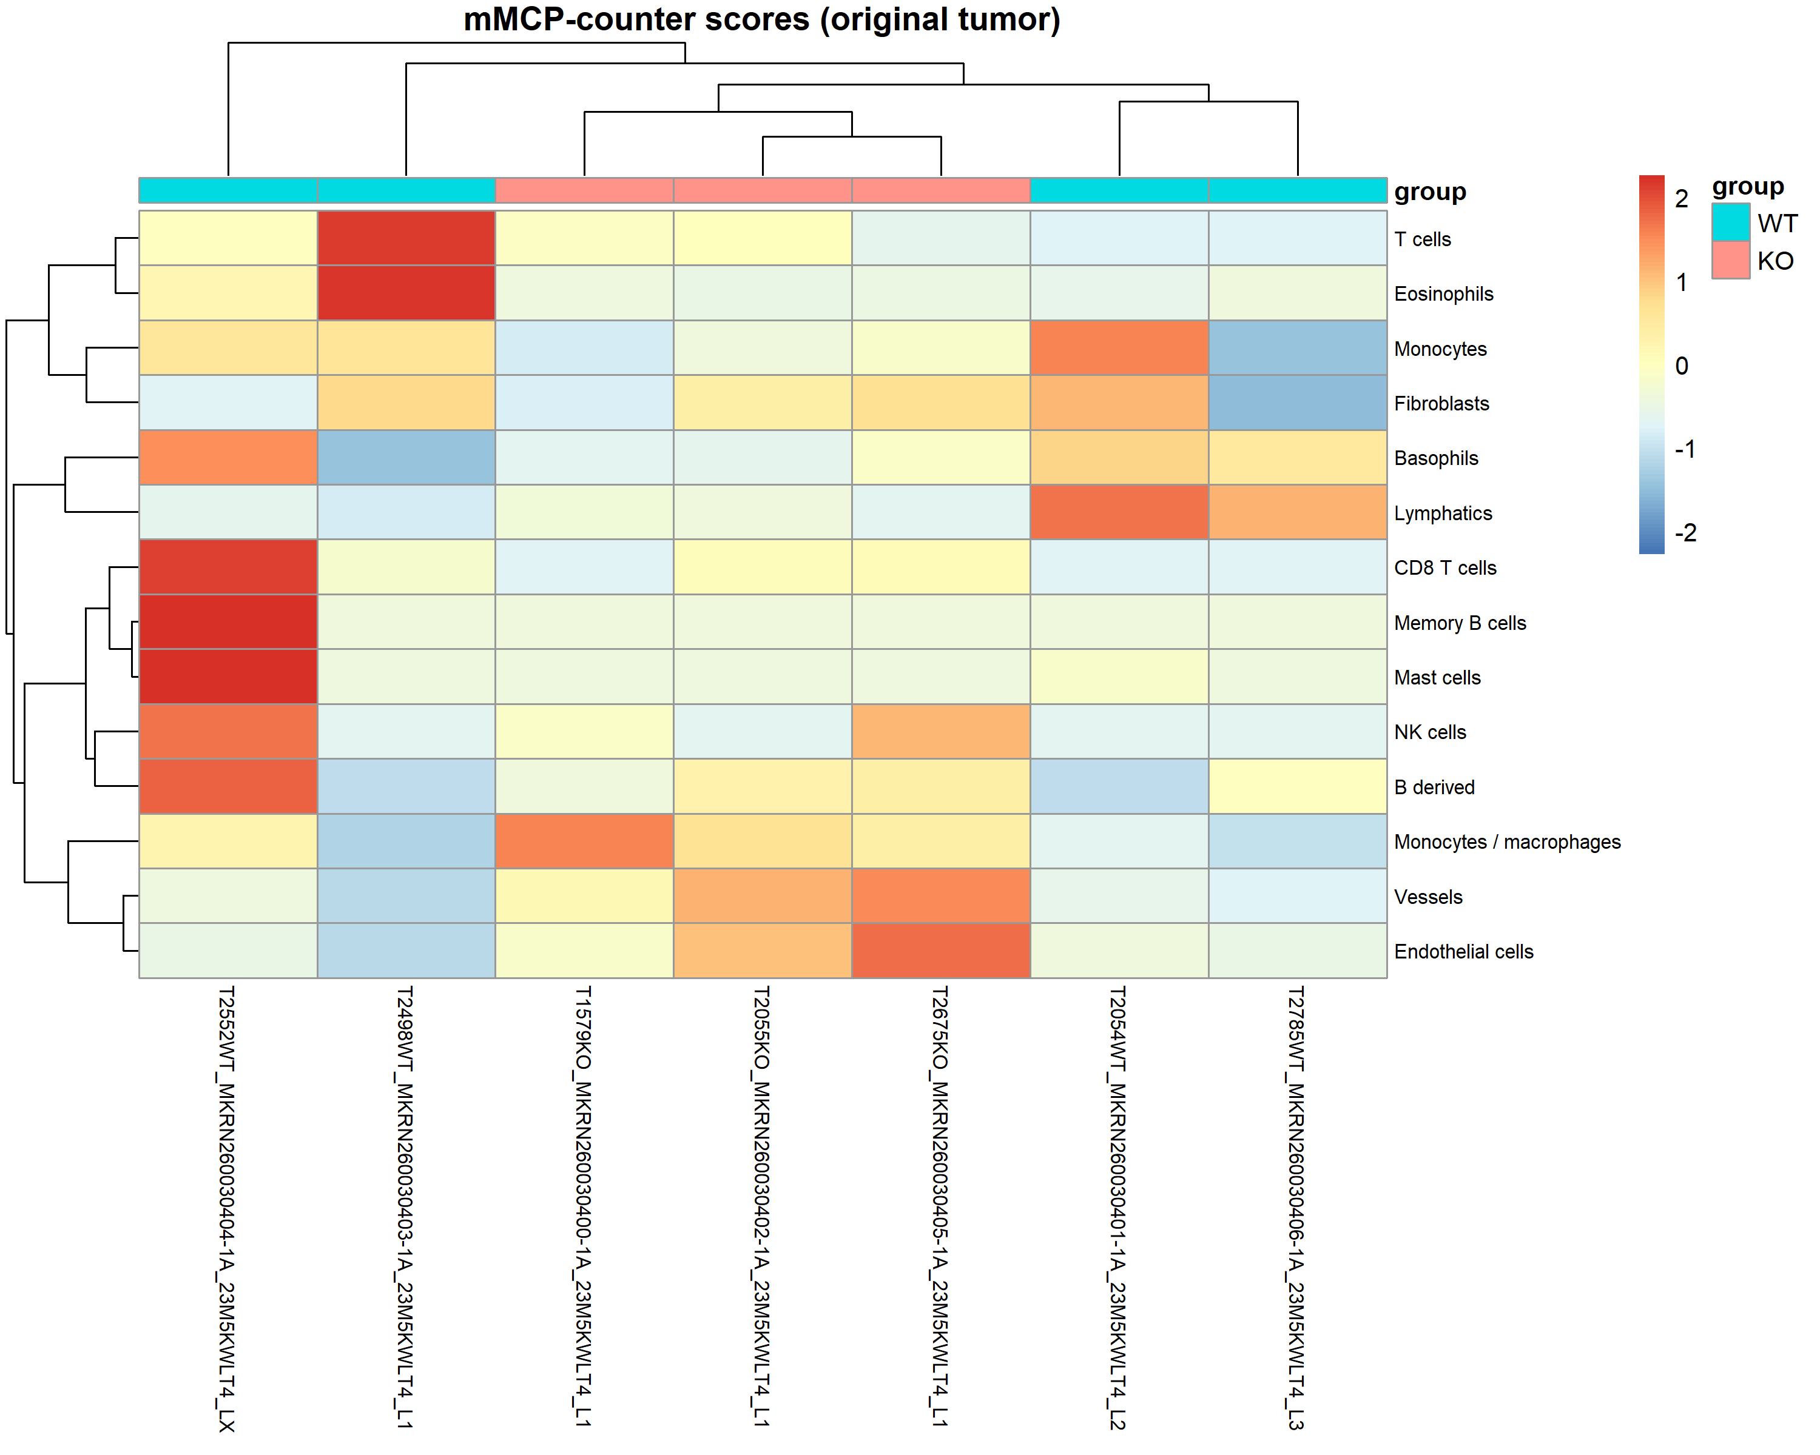
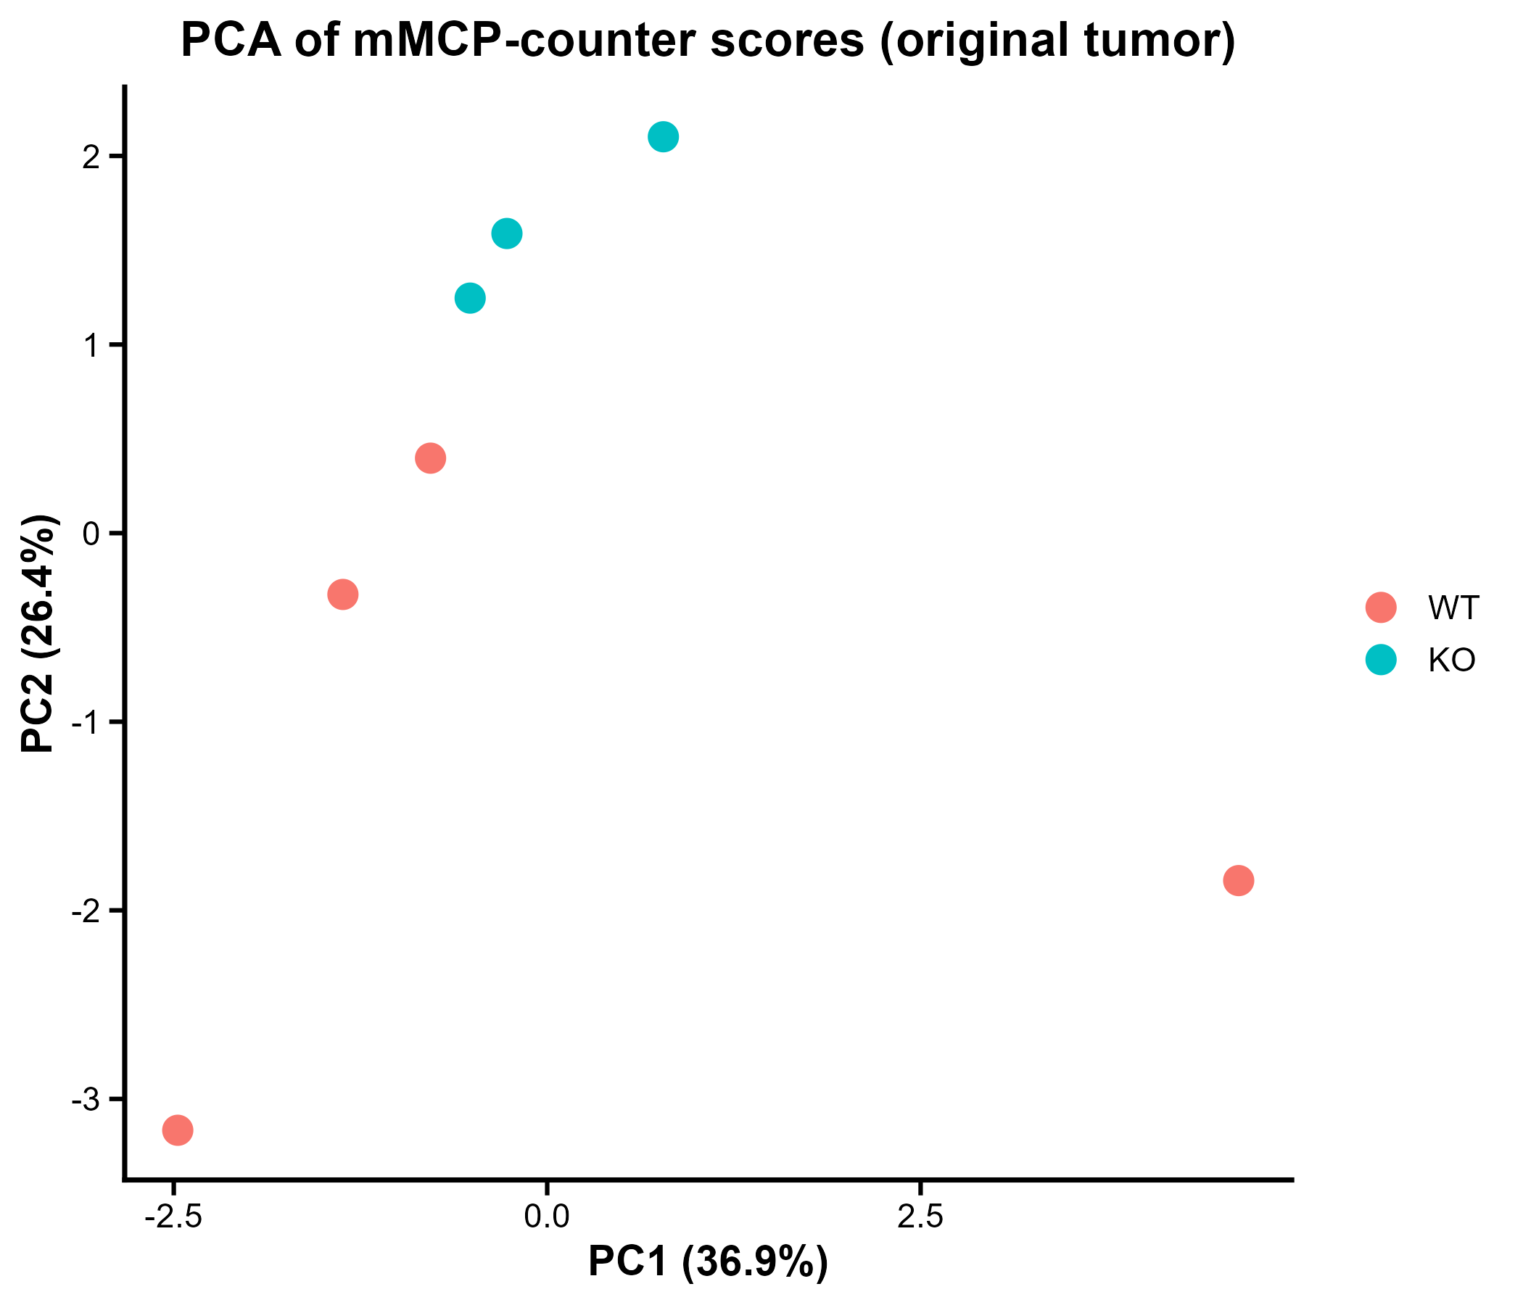
Clustering based on MCP-counter scores

Slide 16
2. Male v Female for both PIP5K1A WT & KO (Syngeneic tumor controls combined)

Slide 17
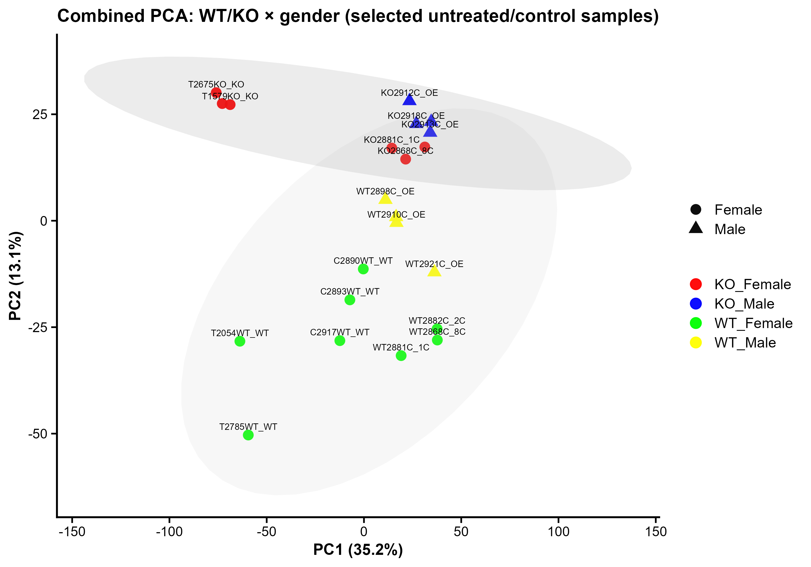
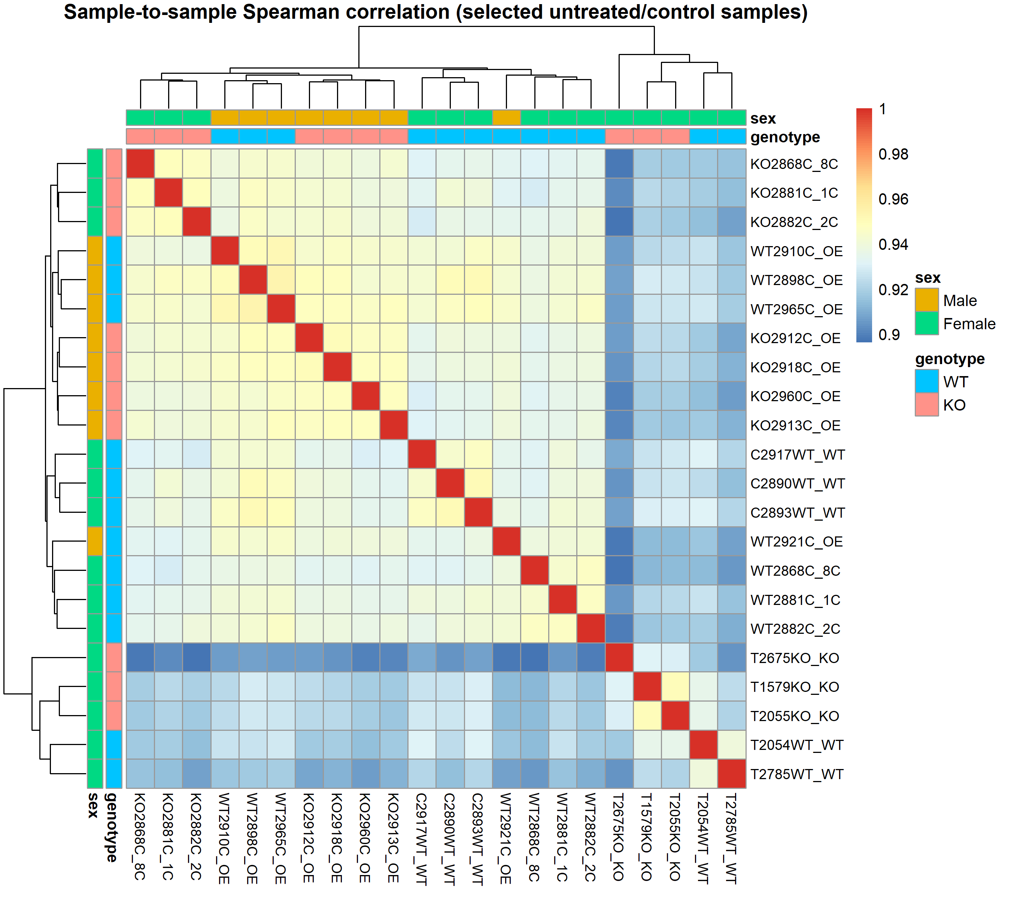
Both Original and Syngeneic tumors

Slide 18
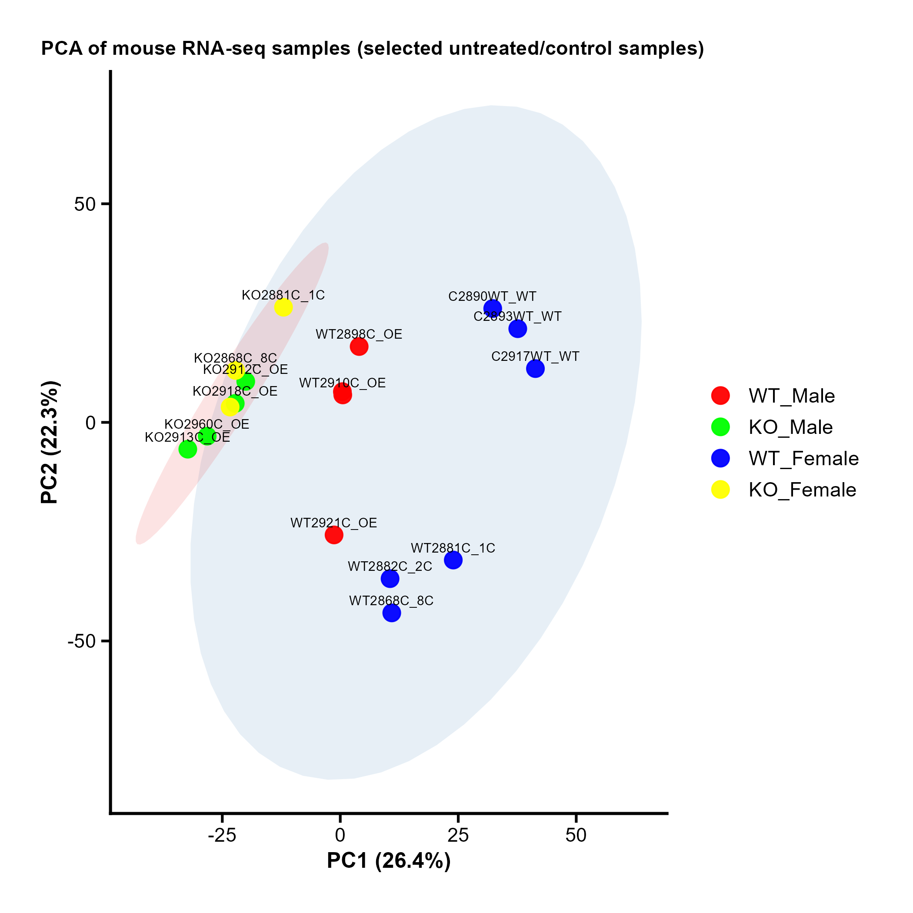
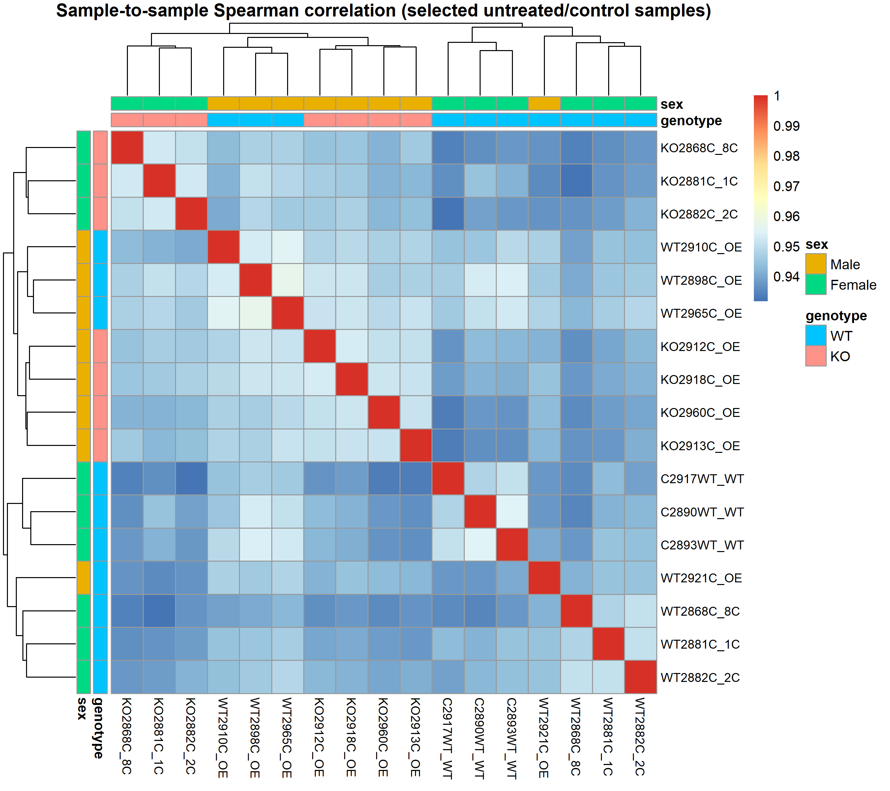
Only syngeneic tumors

Slide 19
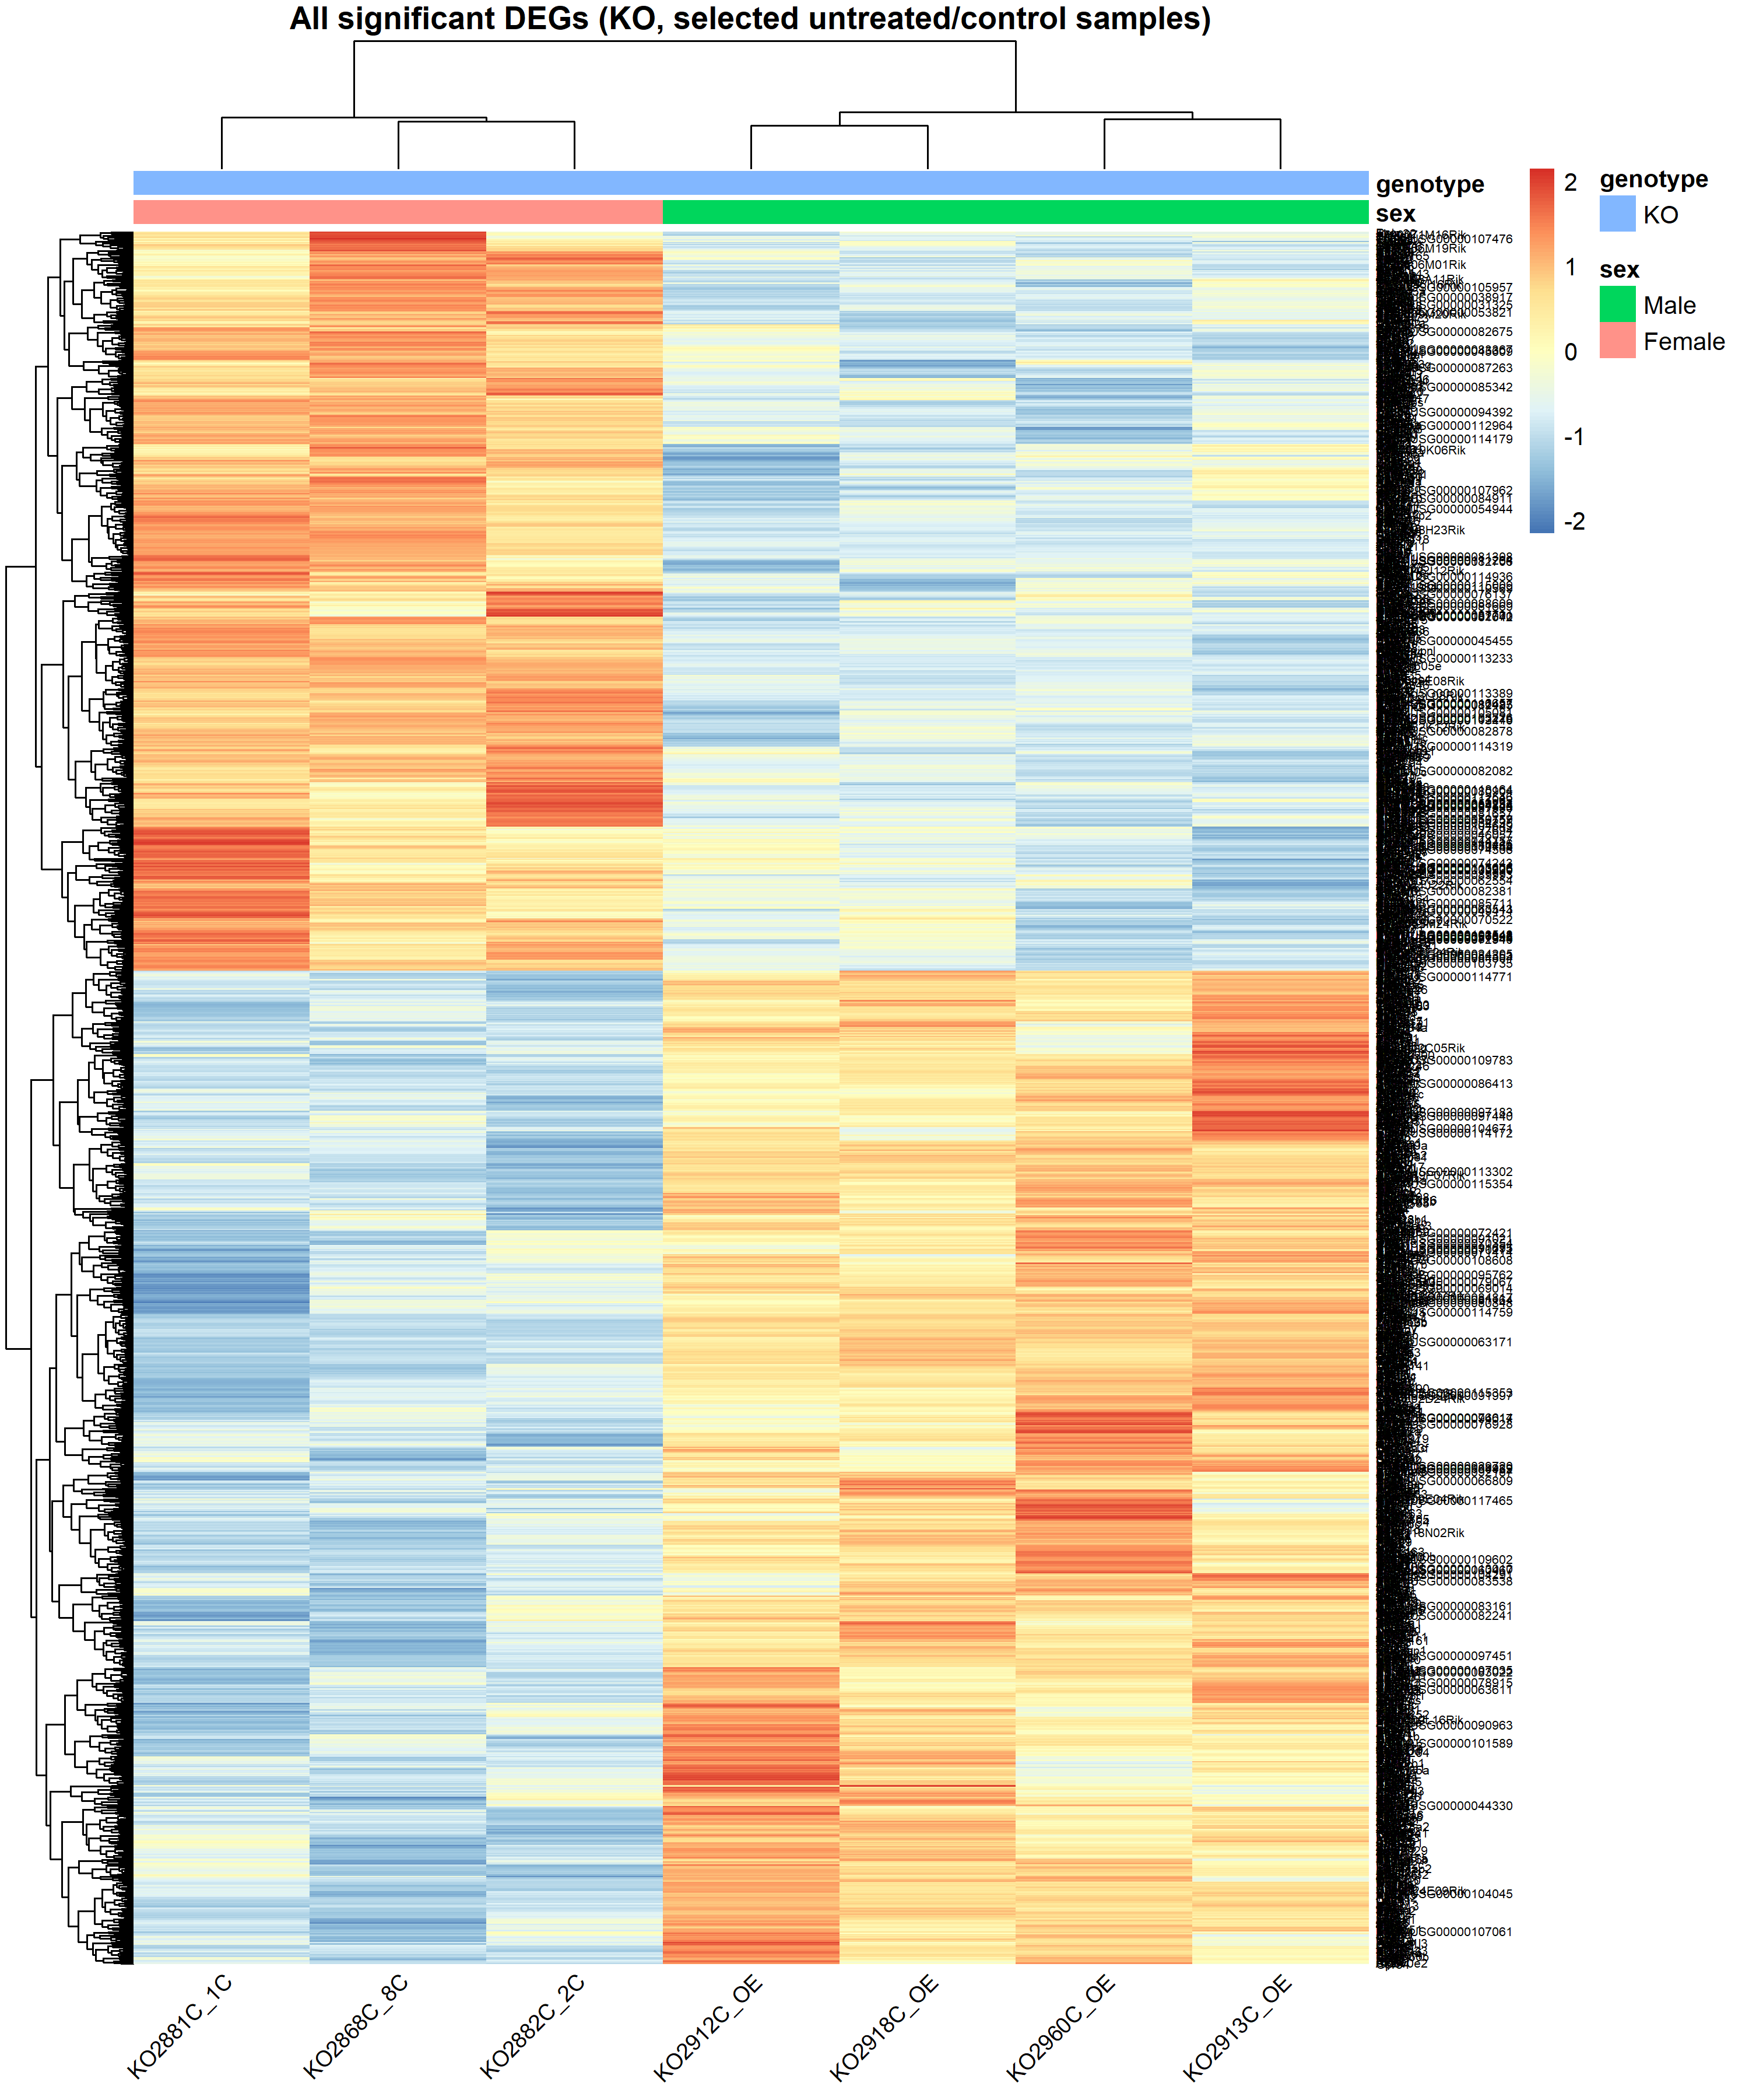
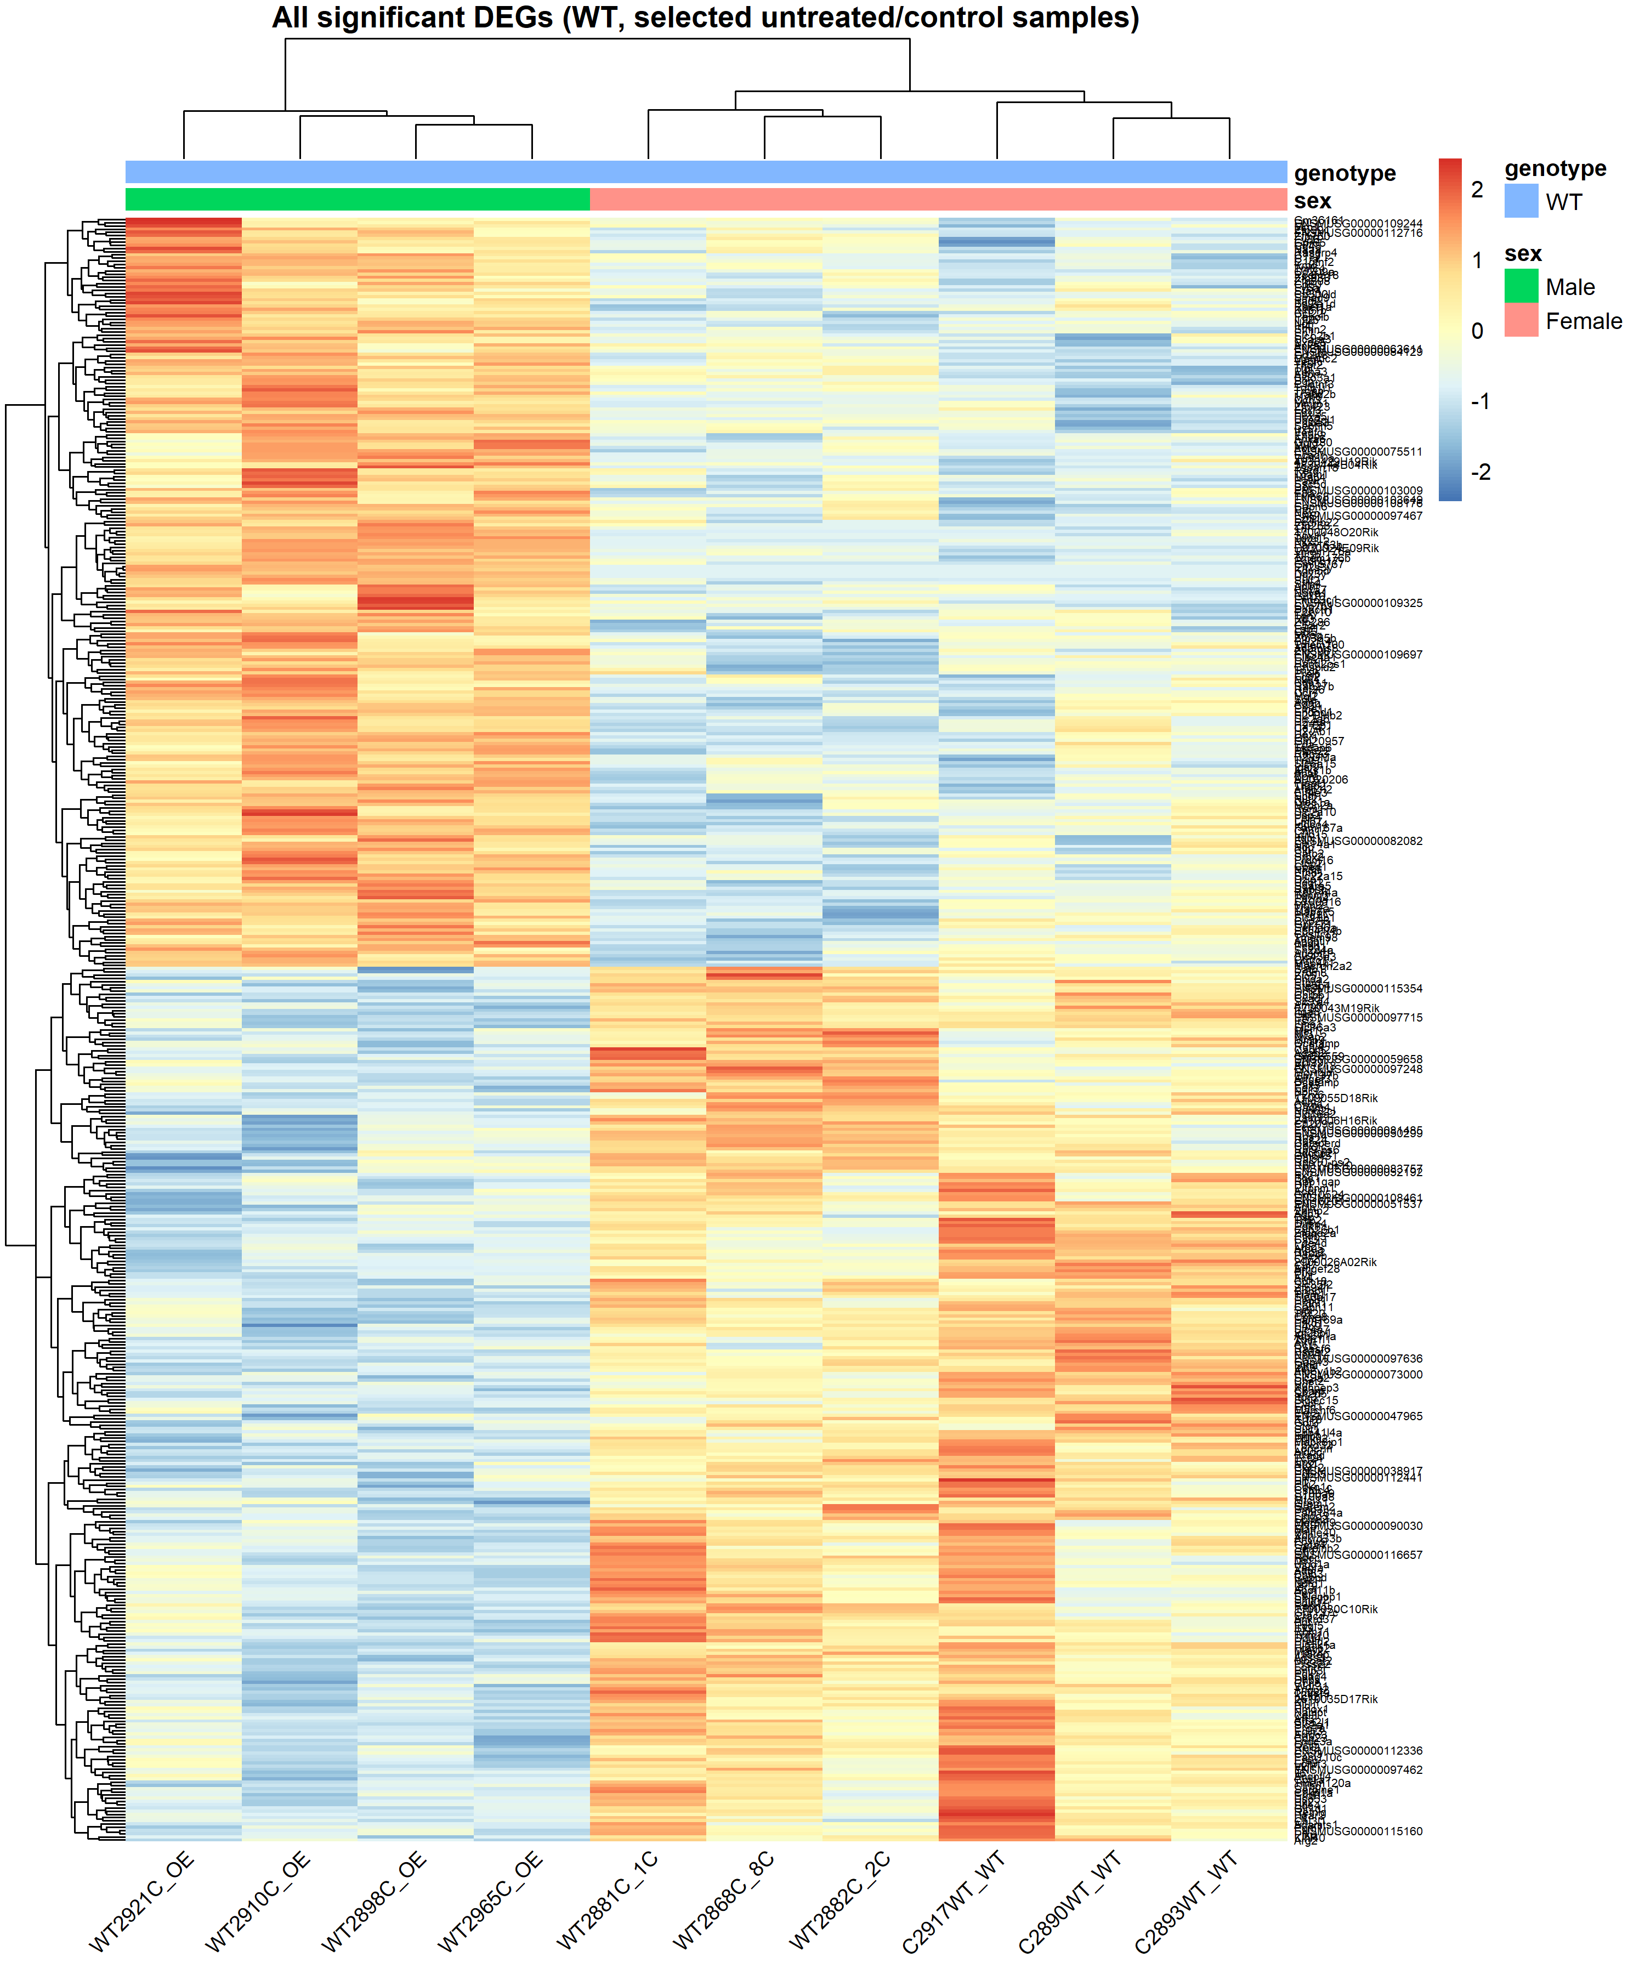
KO samples
WT samples

Slide 20
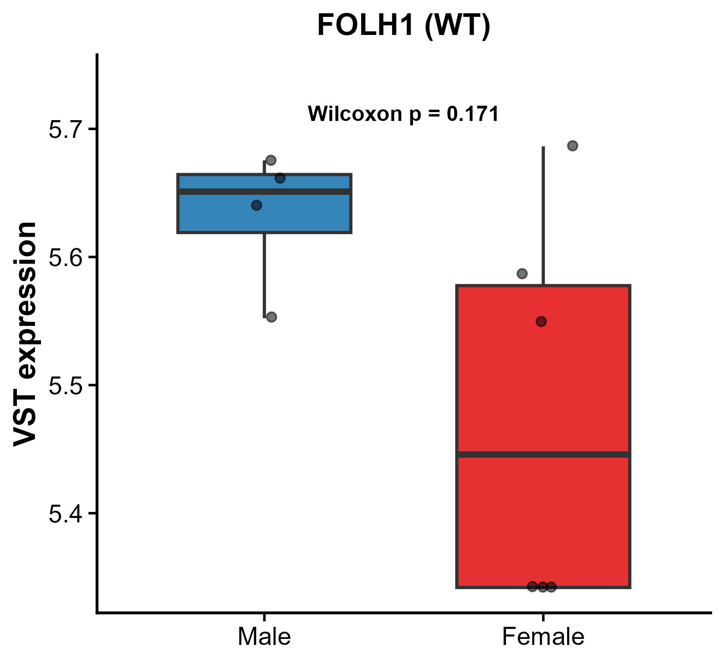
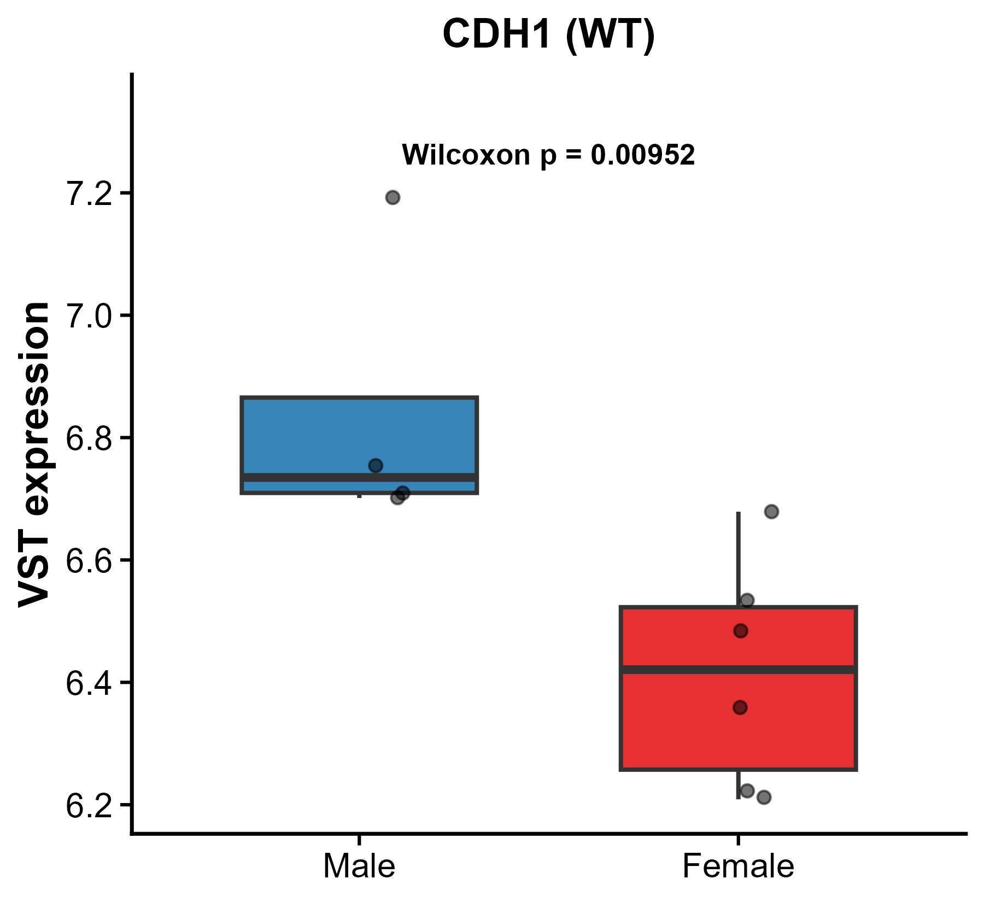
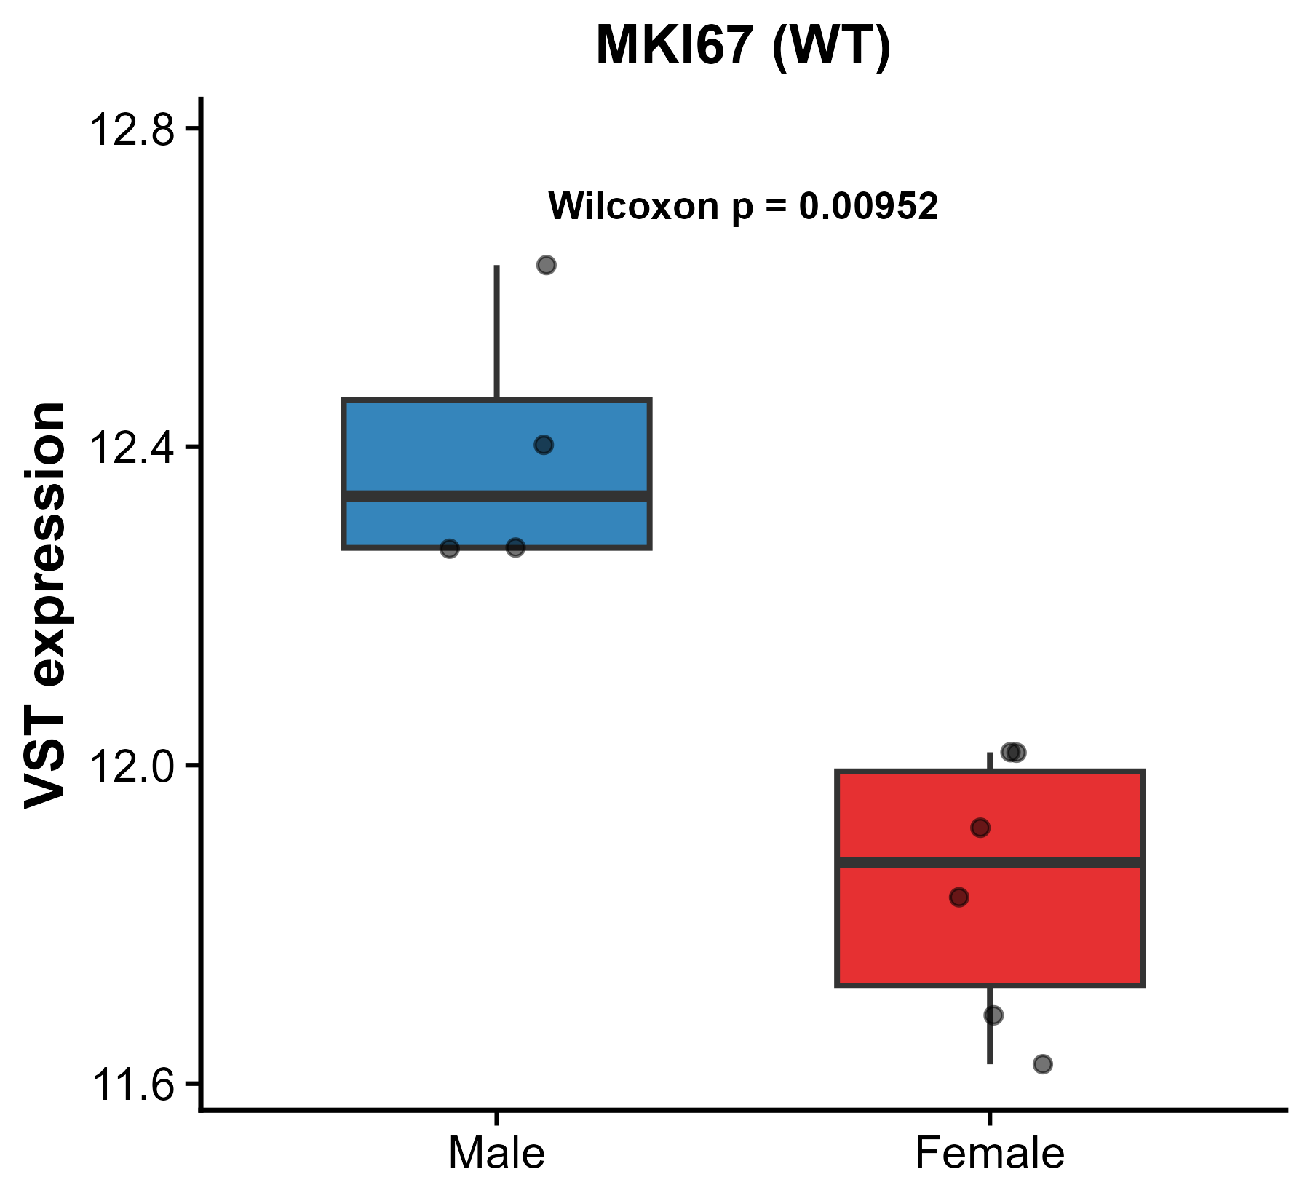
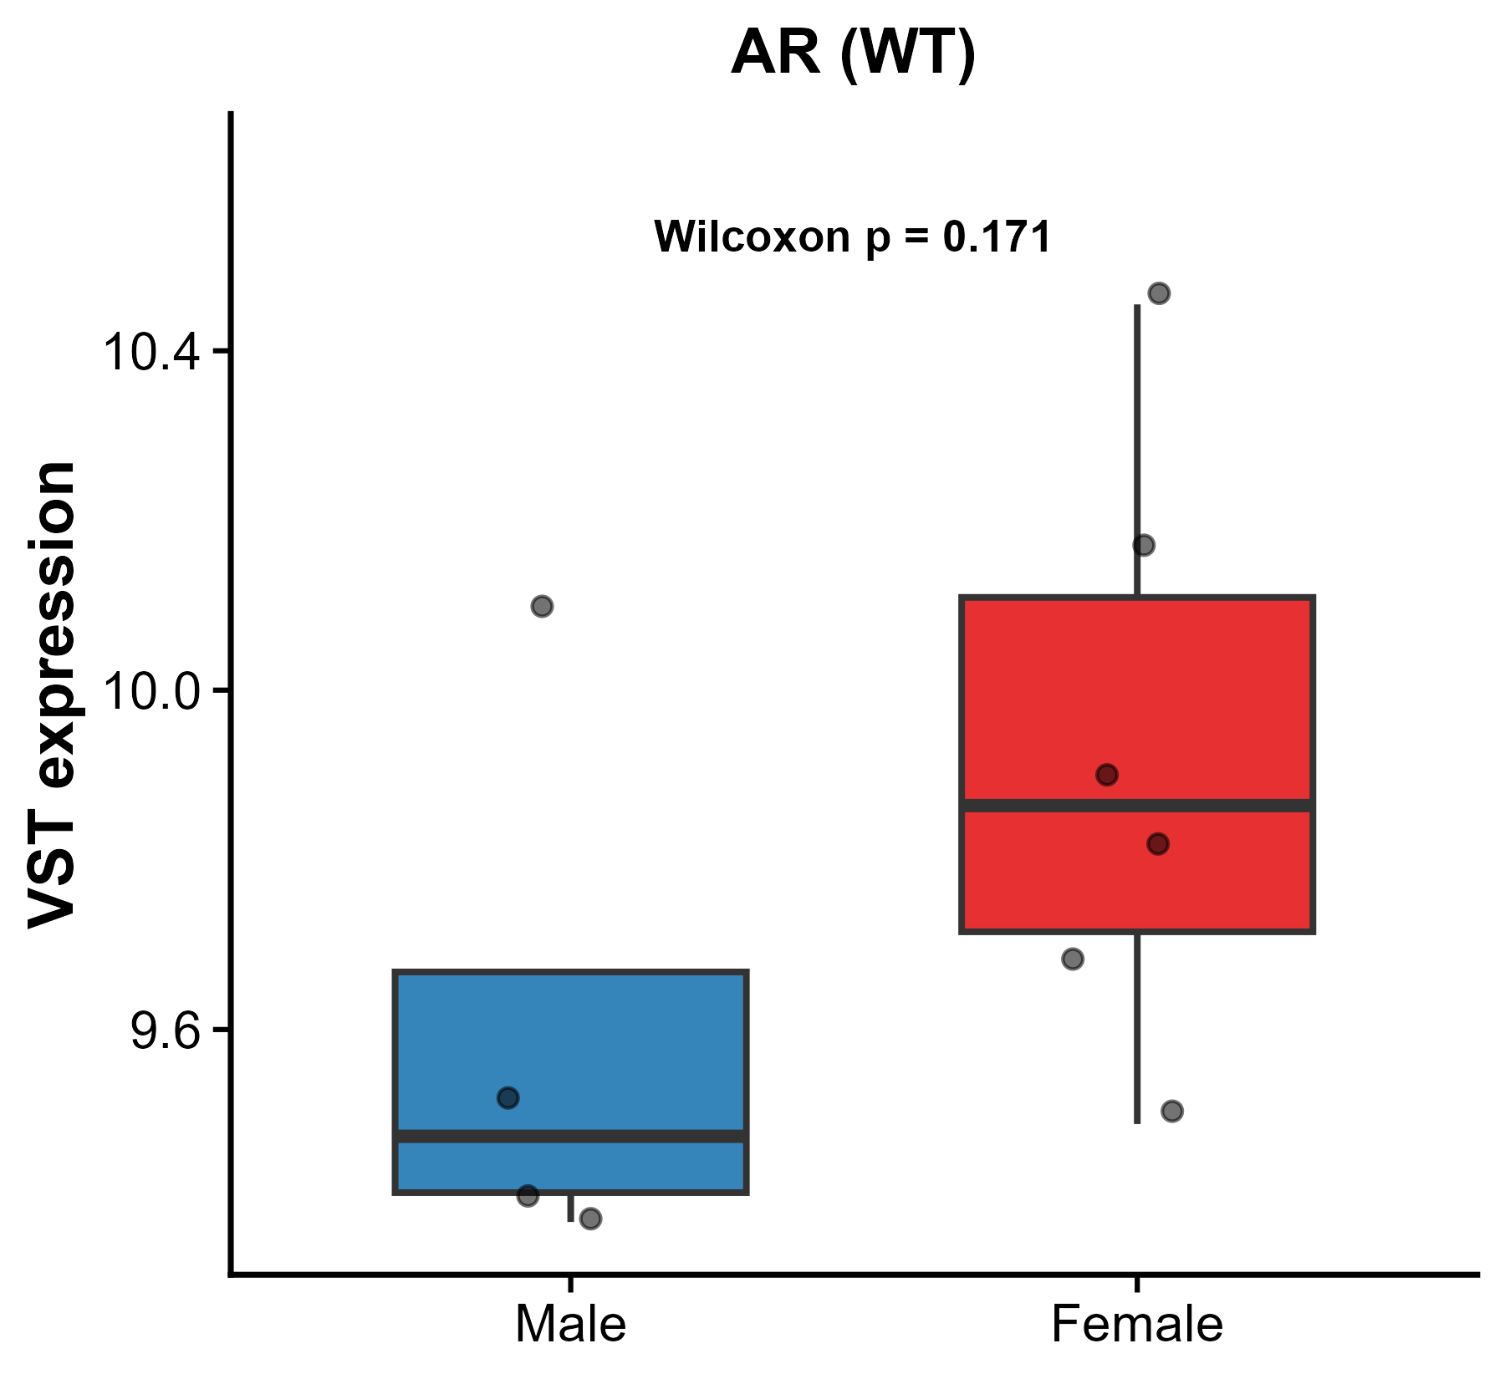
Expression patterns with Significant differences
between Males and Females in WT
RB1: a tumor suppressor that restrains the G1/S cell cycle transition by binding and inhibiting E2F transcription factors in its hypo-phosphorylated state.
FOLH1: encodes folate hydrolase 1, a type II transmembrane glycoprotein state. Through its folate hydrolase activity, FOLH1 mediates folate absorption in the gut.

Slide 21
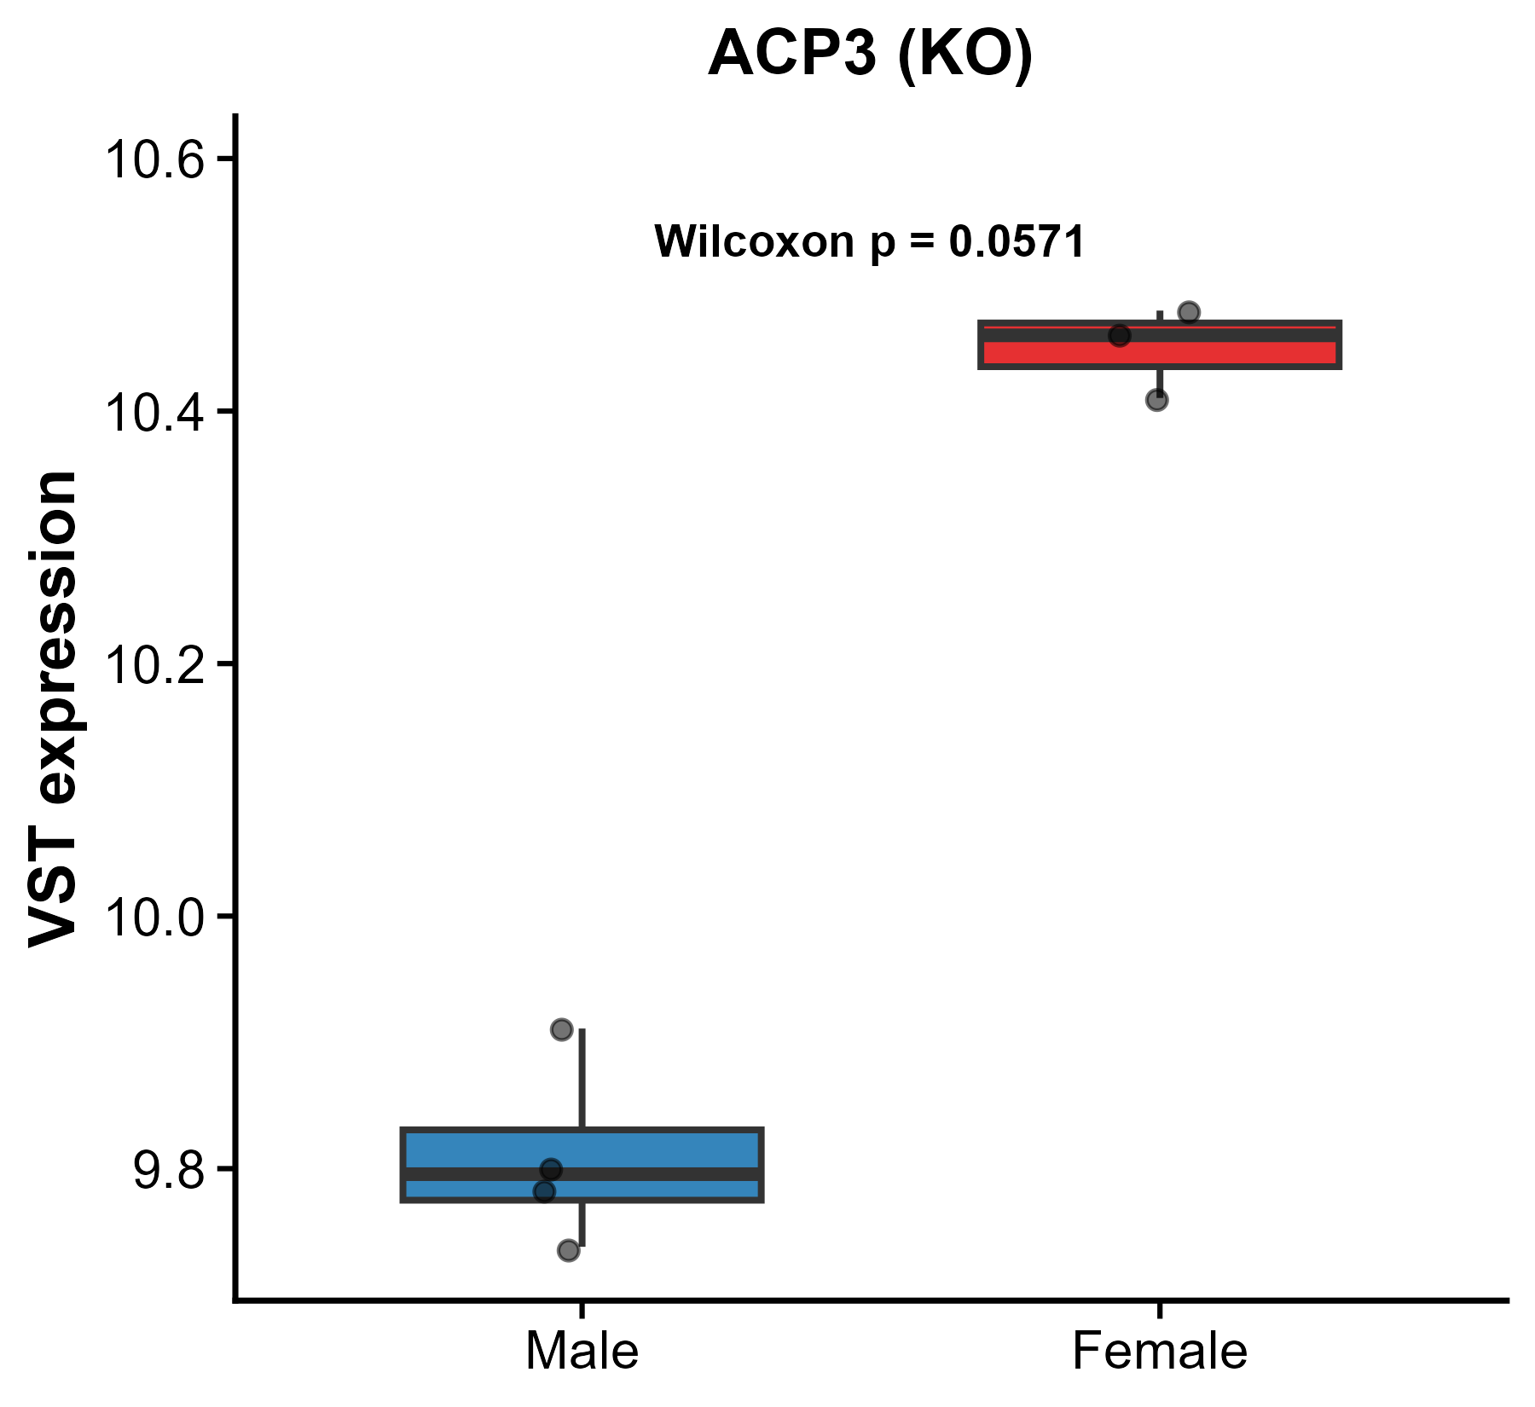
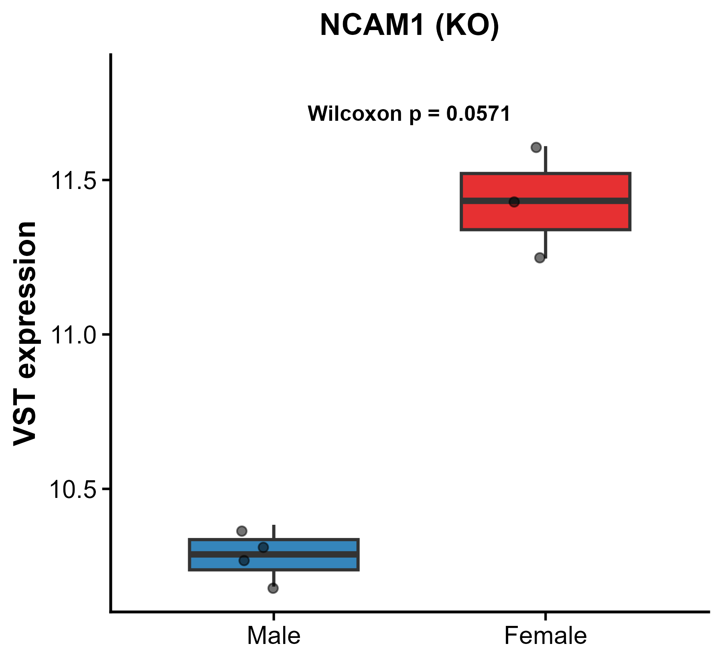
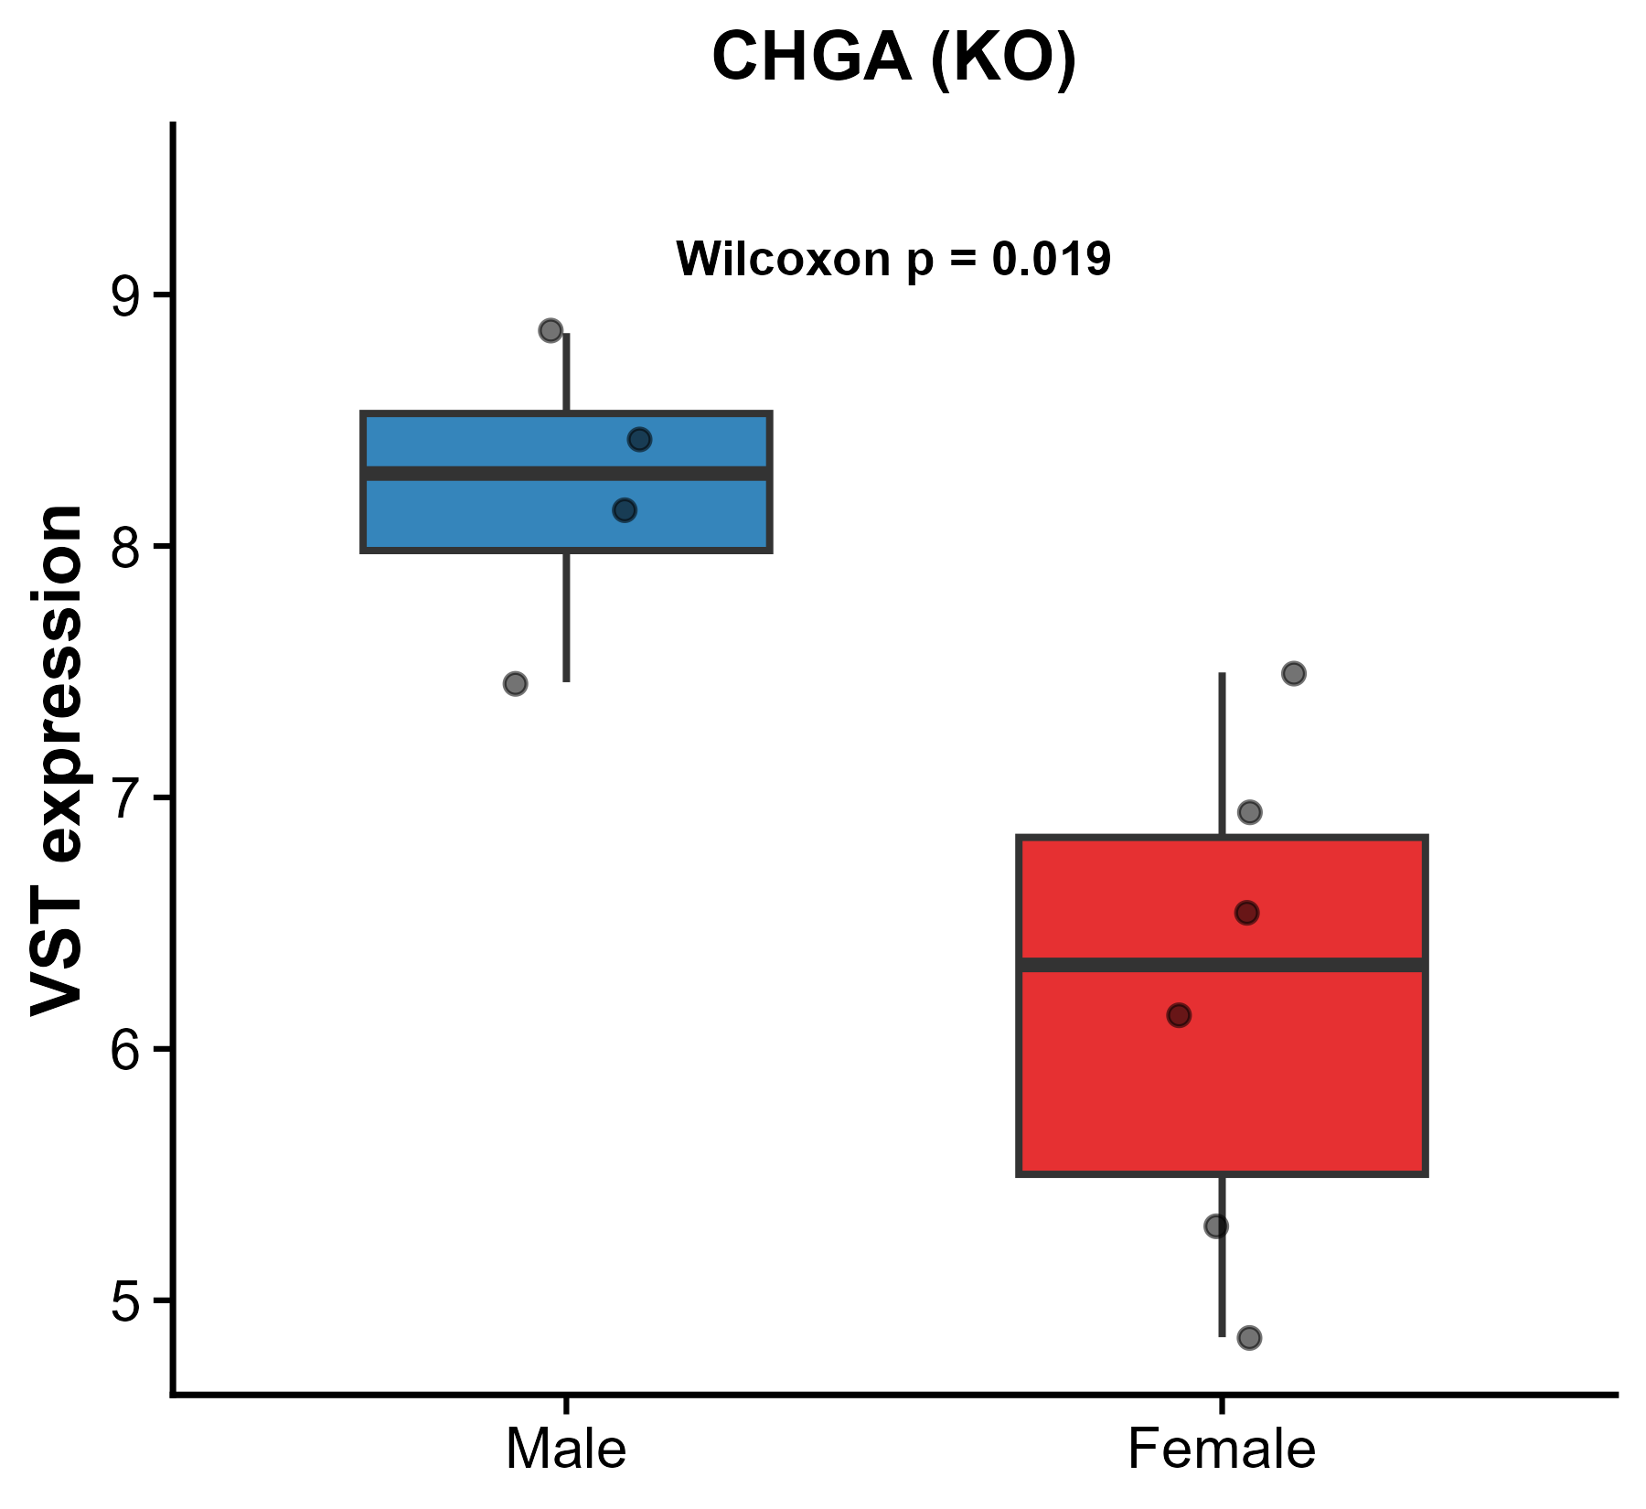
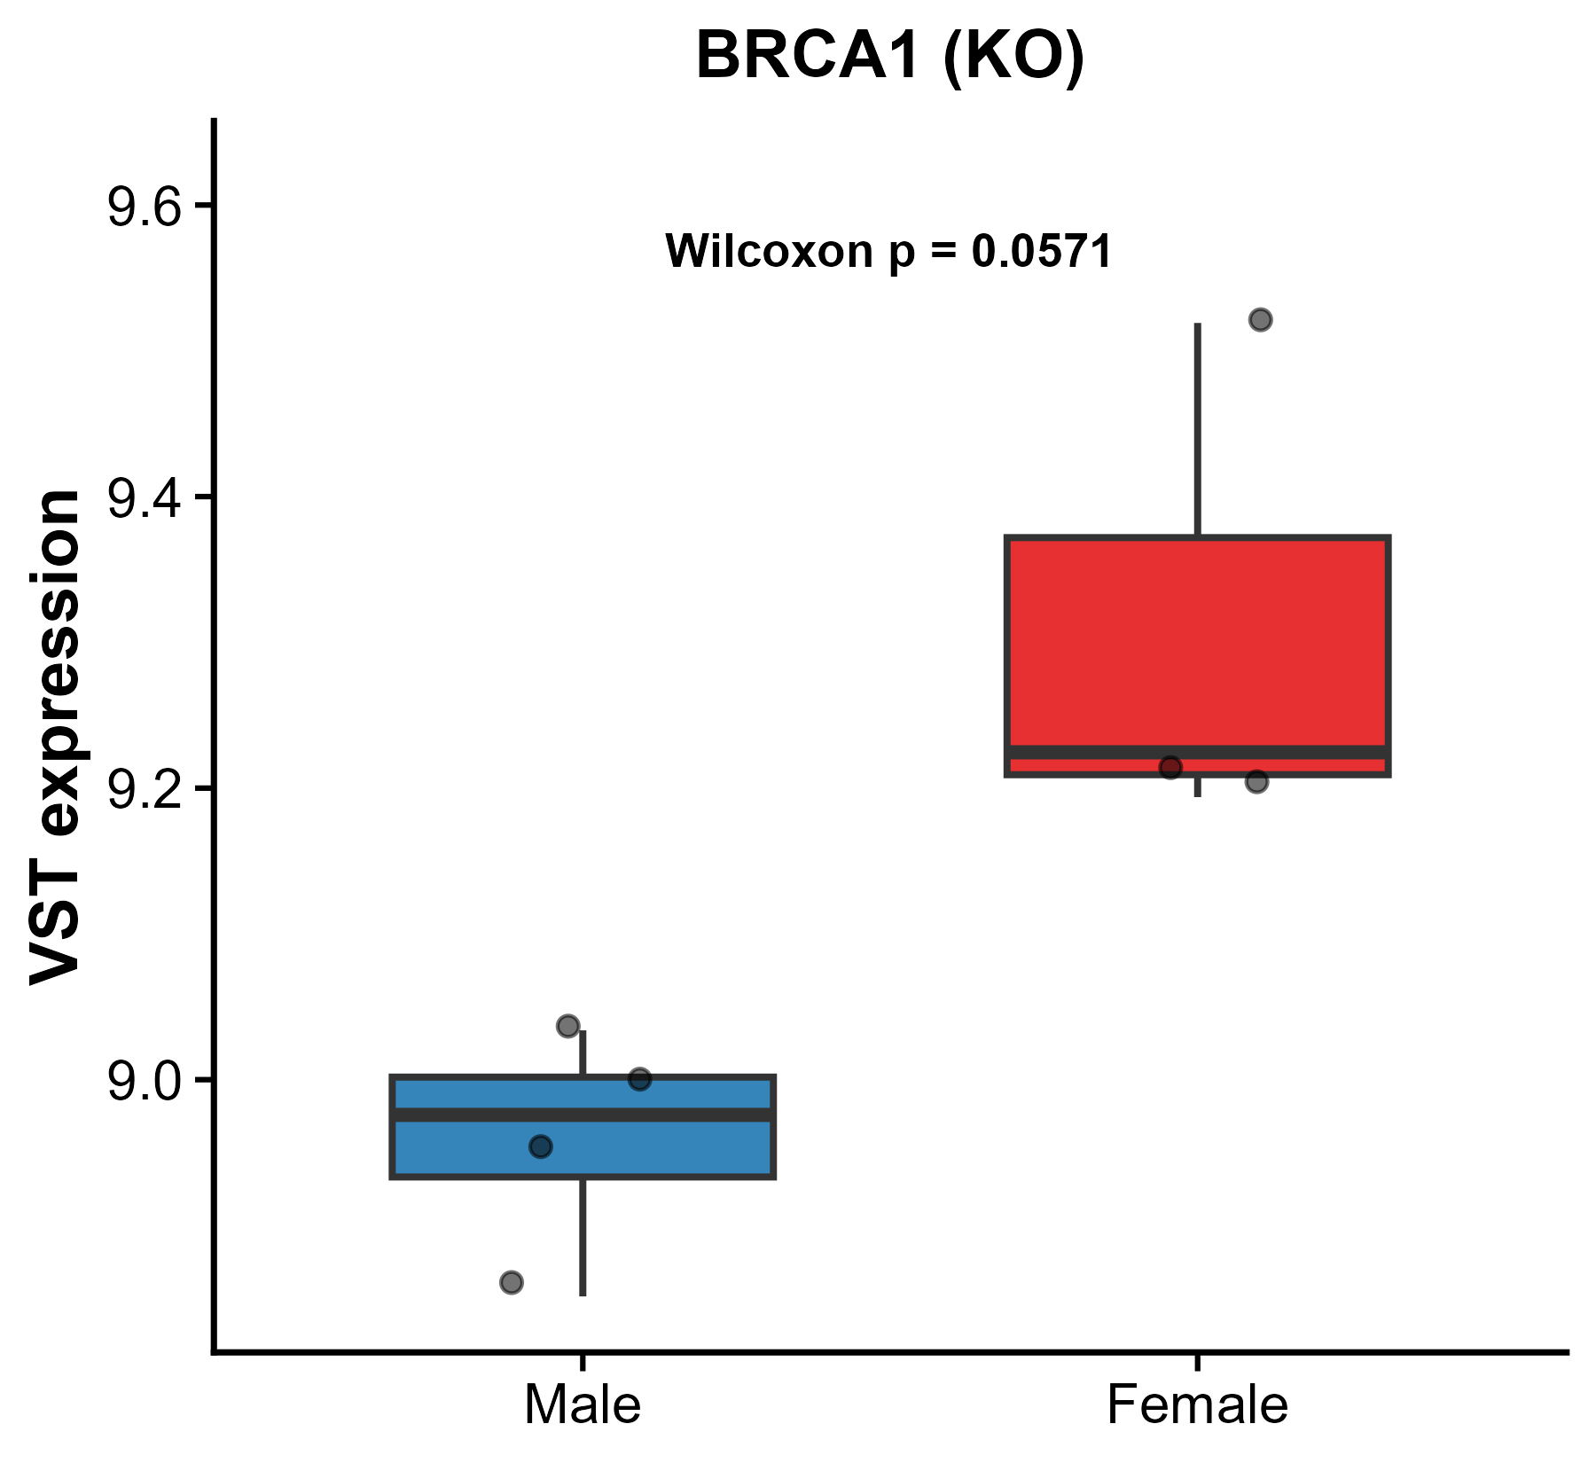
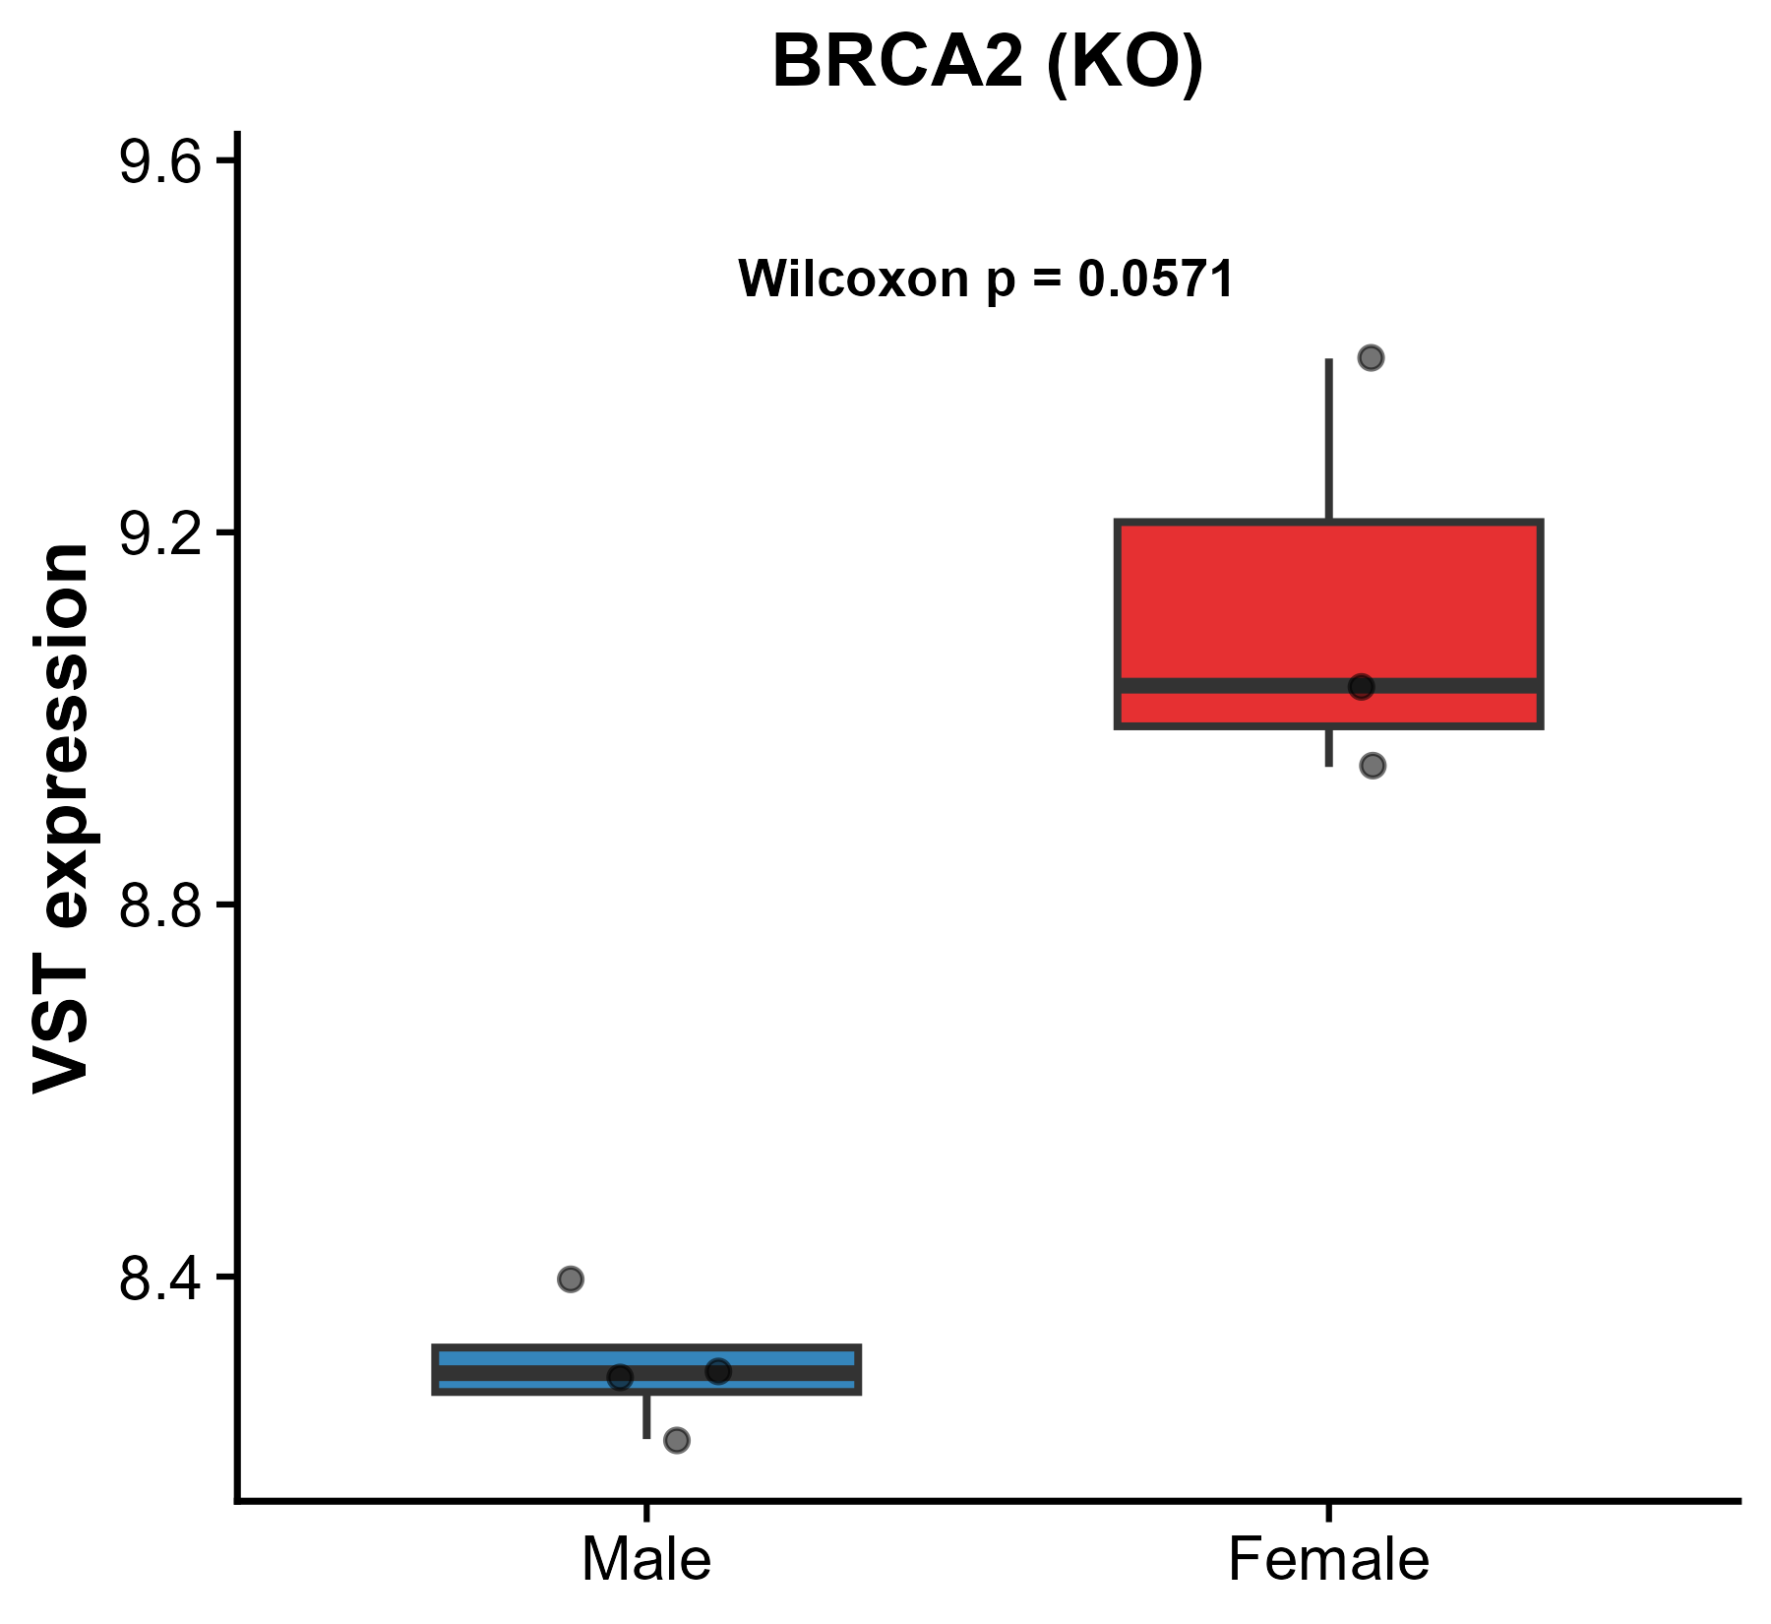
Expression patterns with significant differences
between Males and females in KO

Slide 22
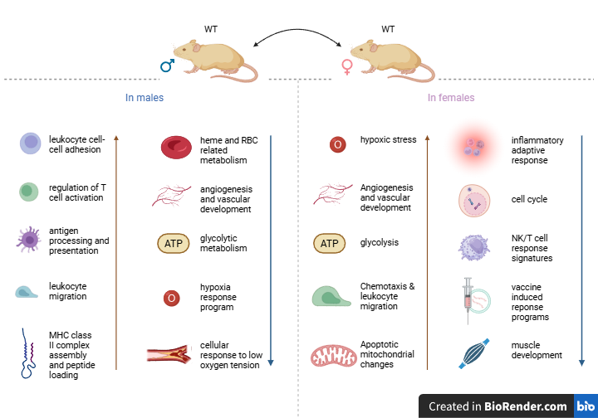
Untreated WT Pathway & Immune enrichment Summary (Female vs Male)

Slide 23
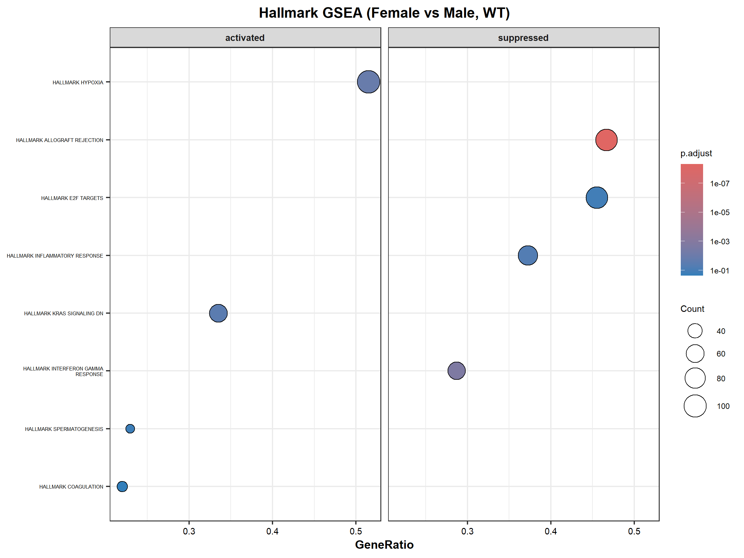
In WT Samples for PIP5K1A

Slide 24
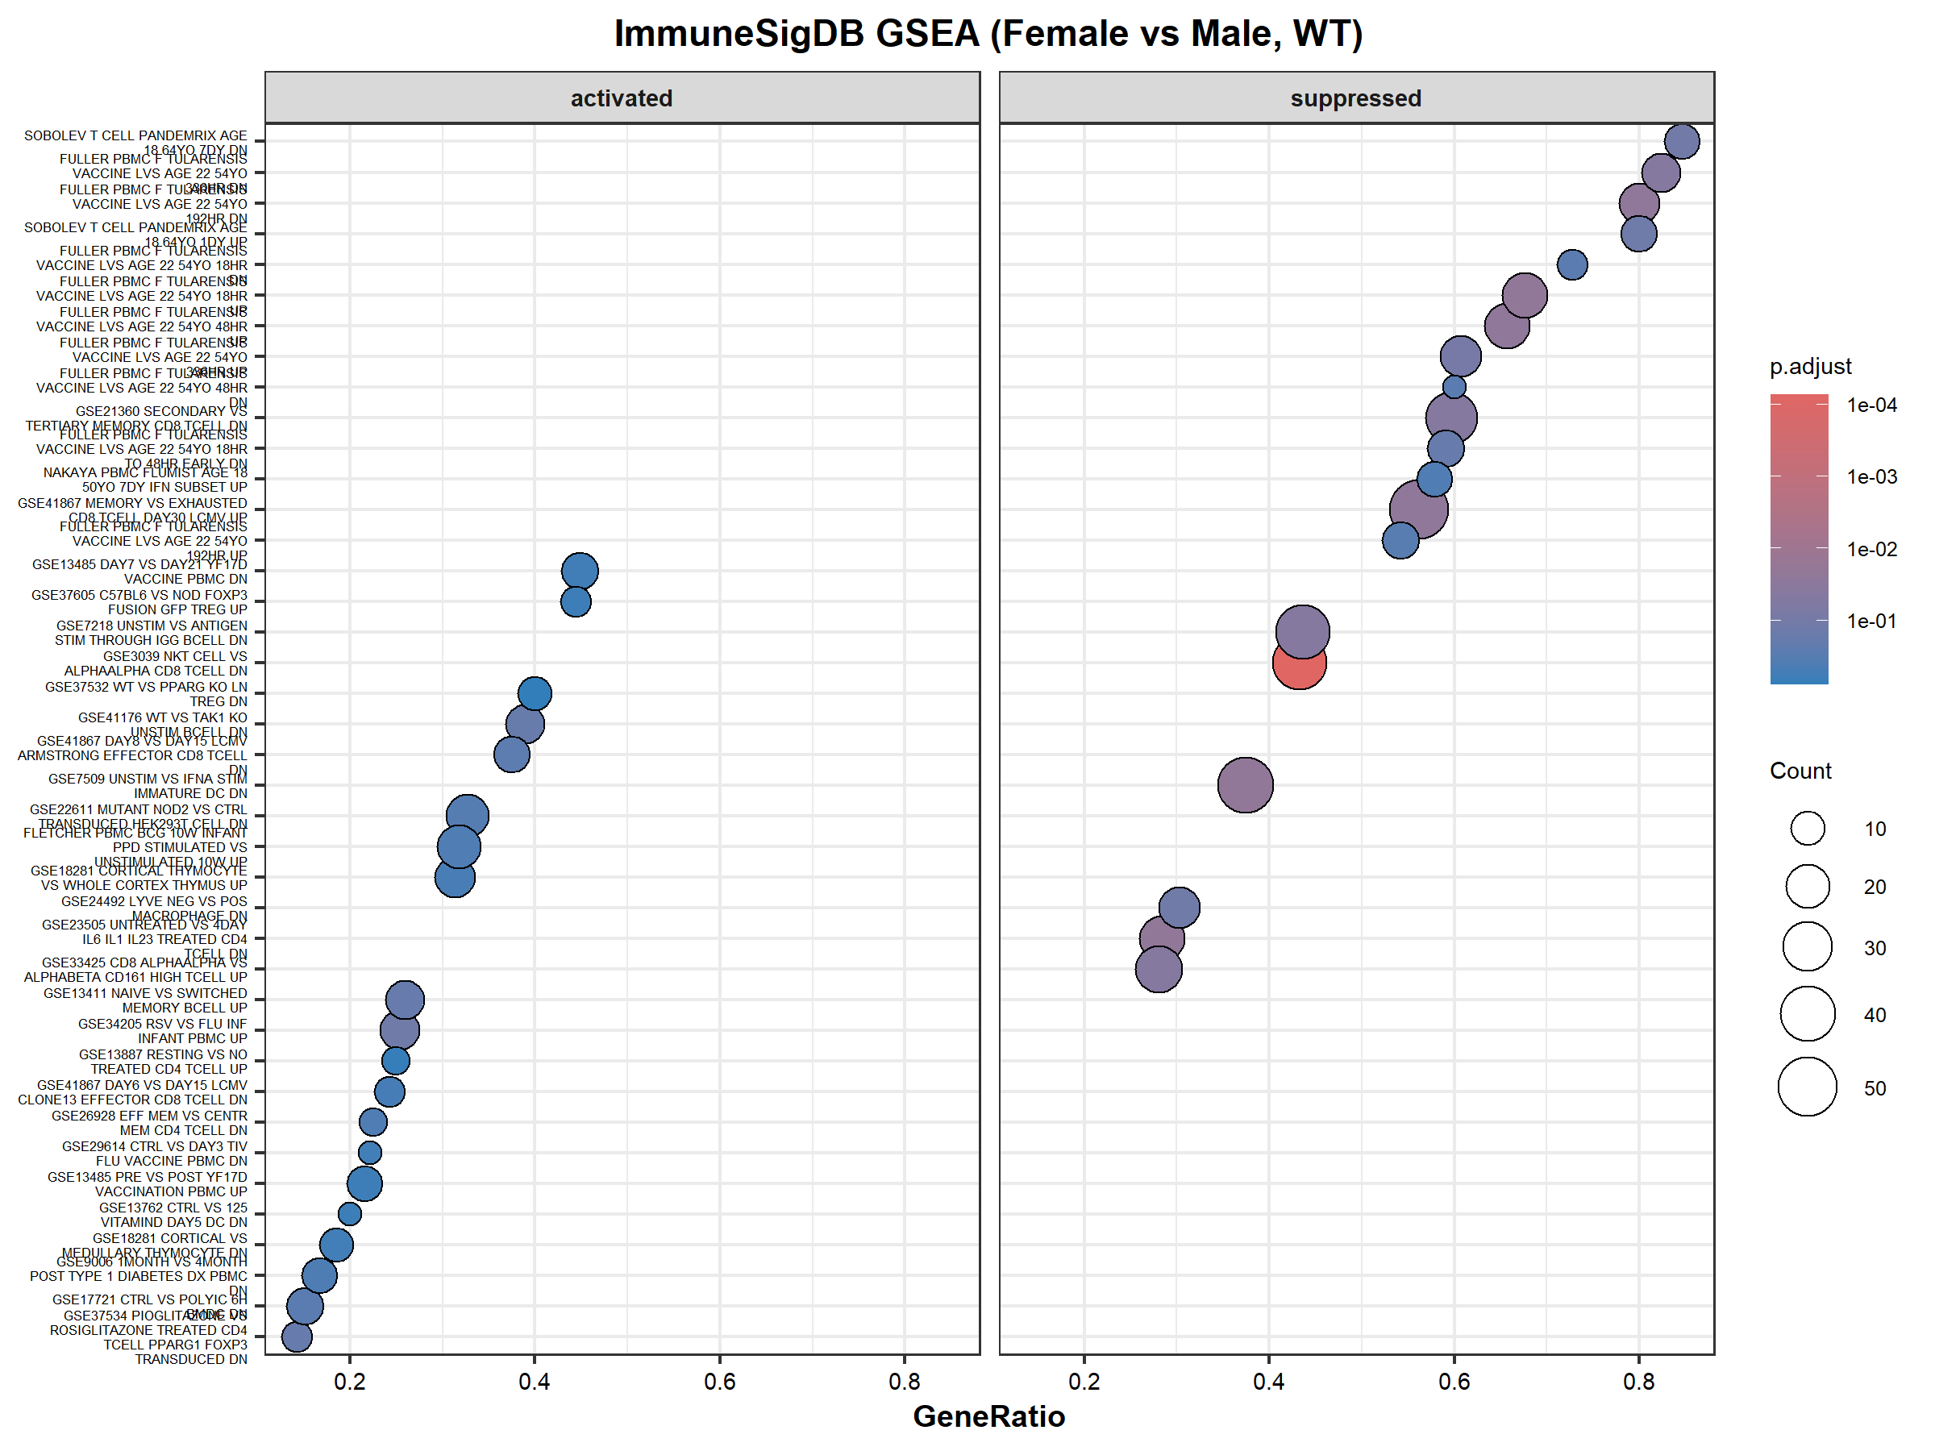

Slide 25
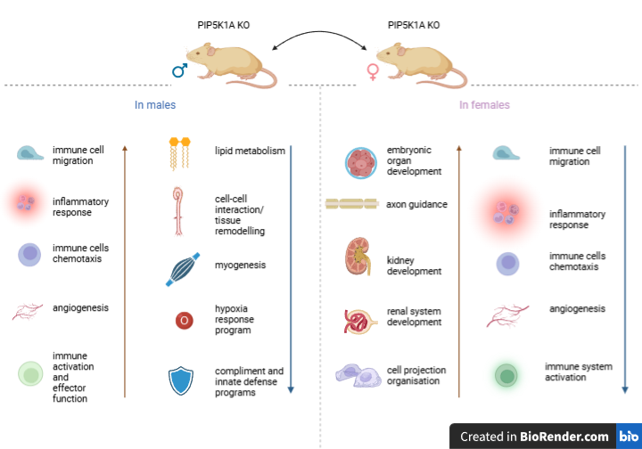
Untreated KO Pathway & Immune enrichment Summary (Female vs Male)

Slide 26
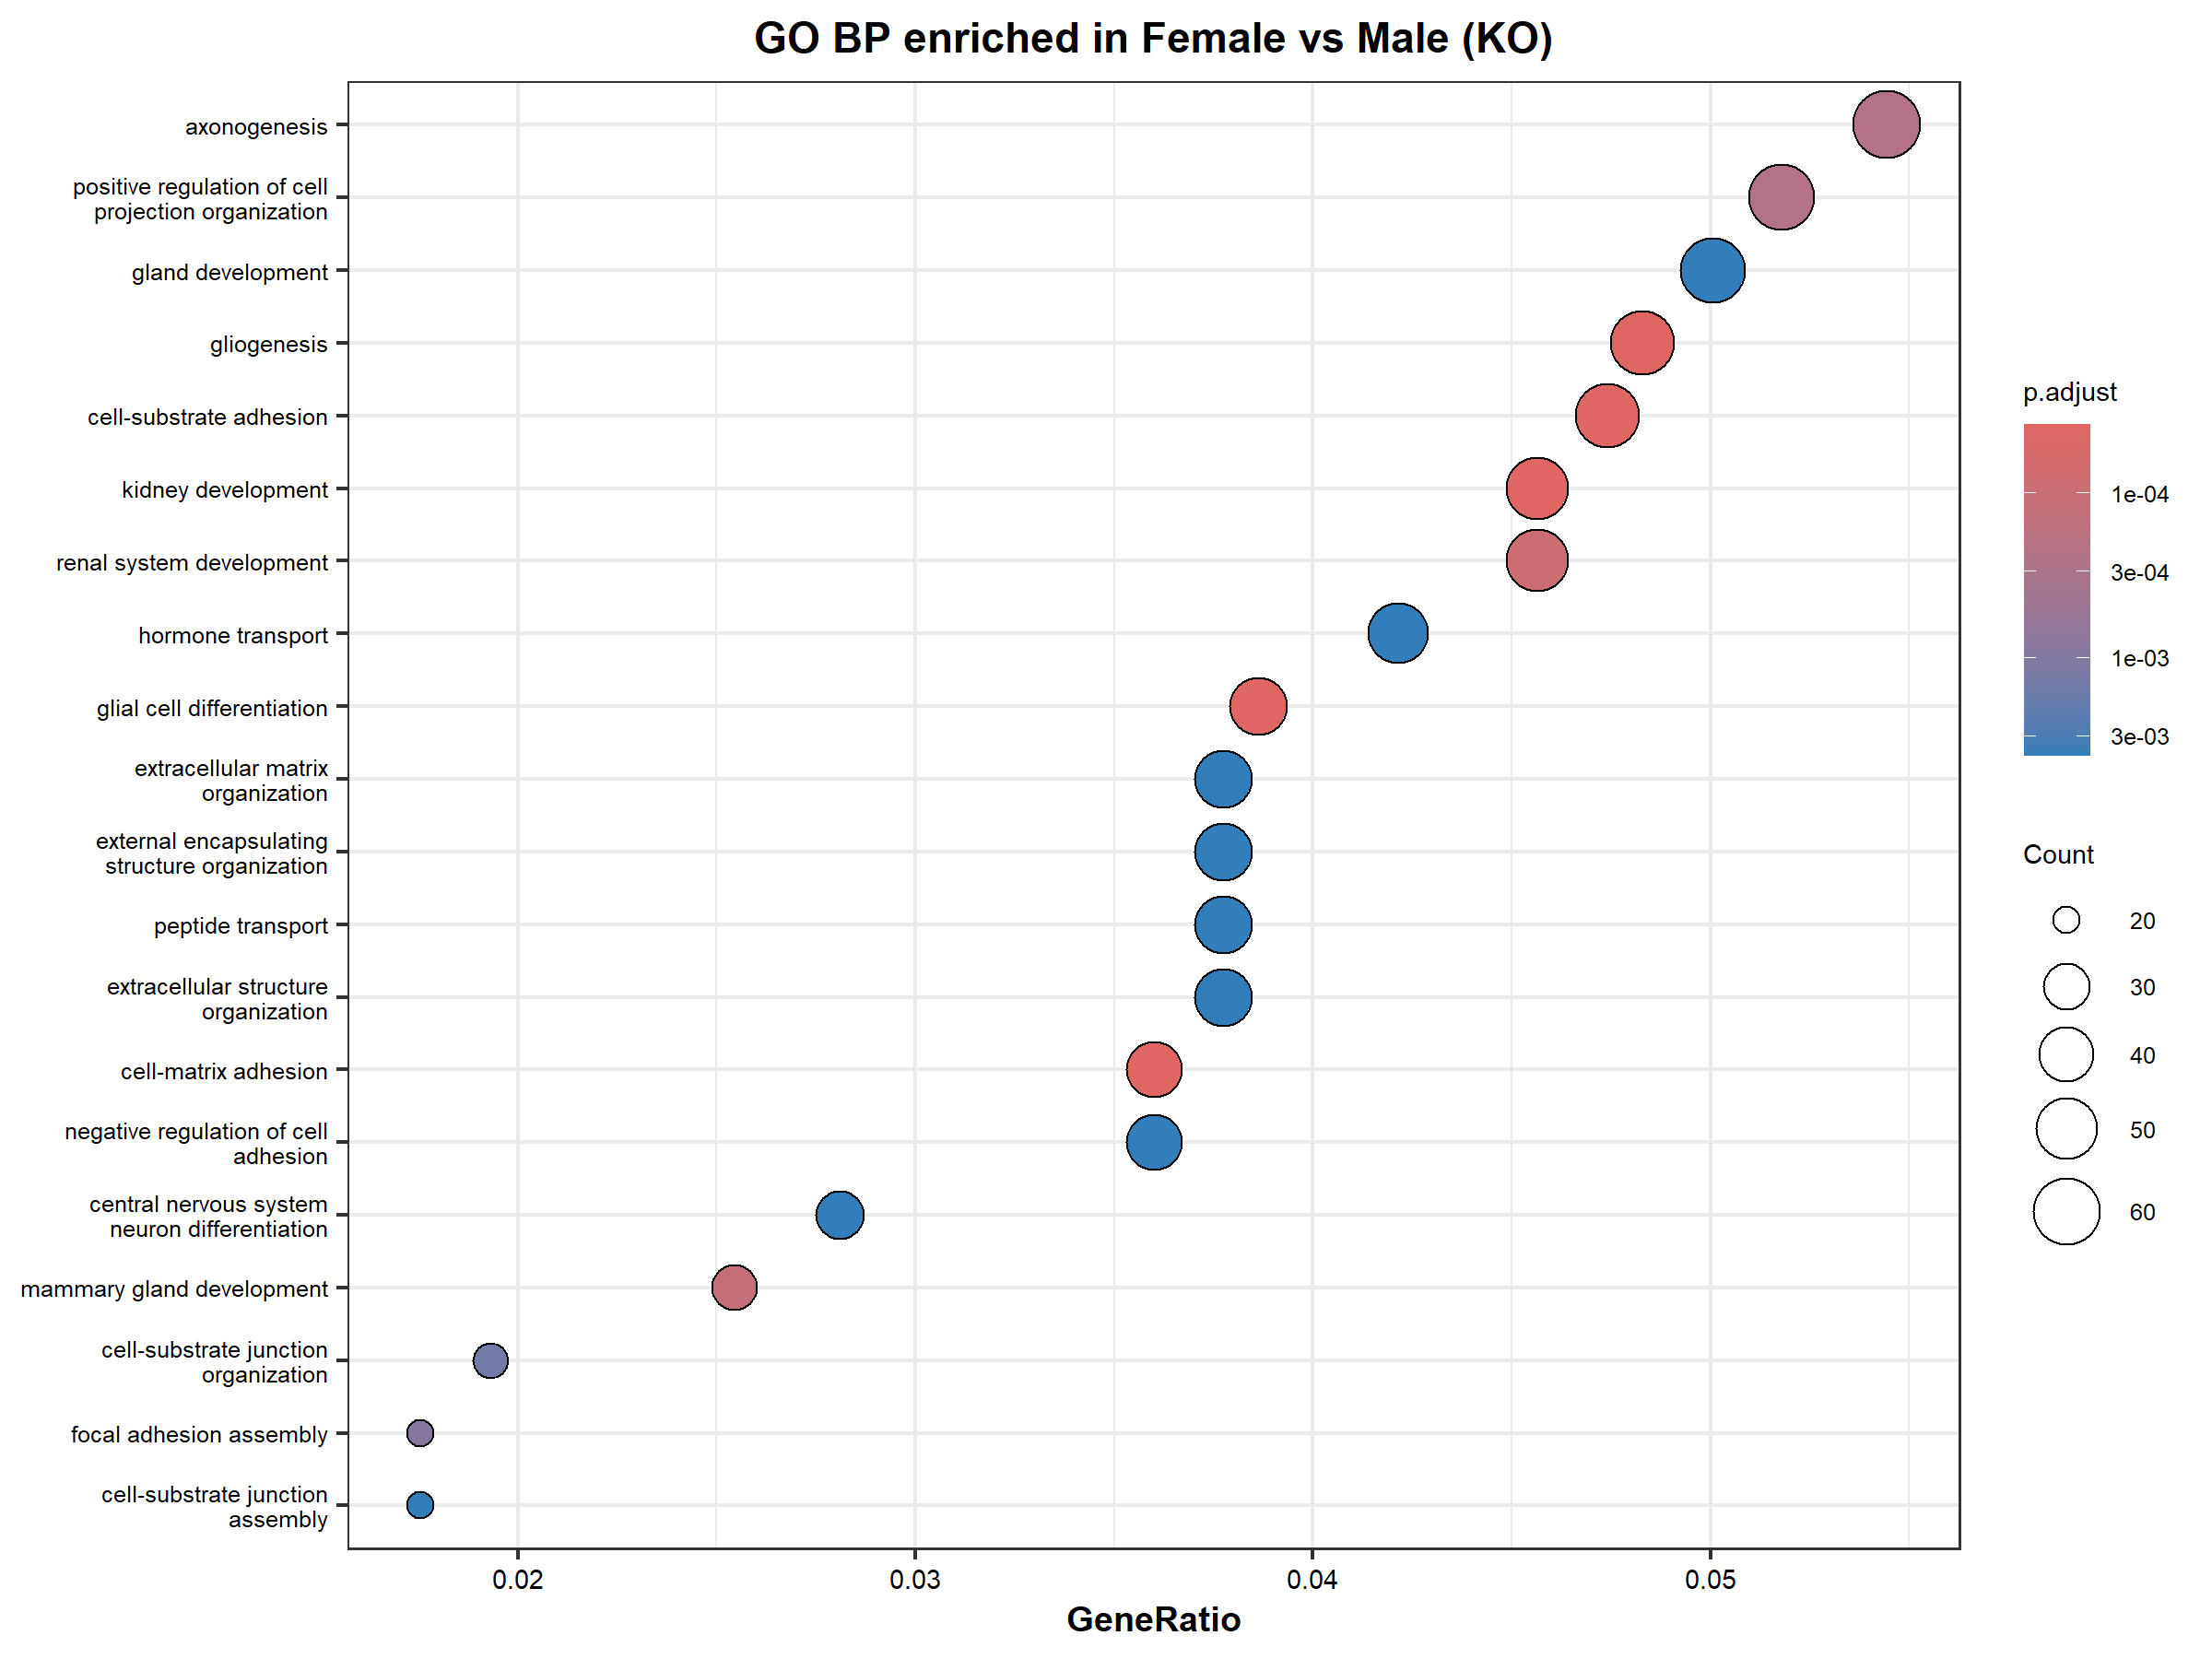
In PIP5K1A KO Samples

Slide 27
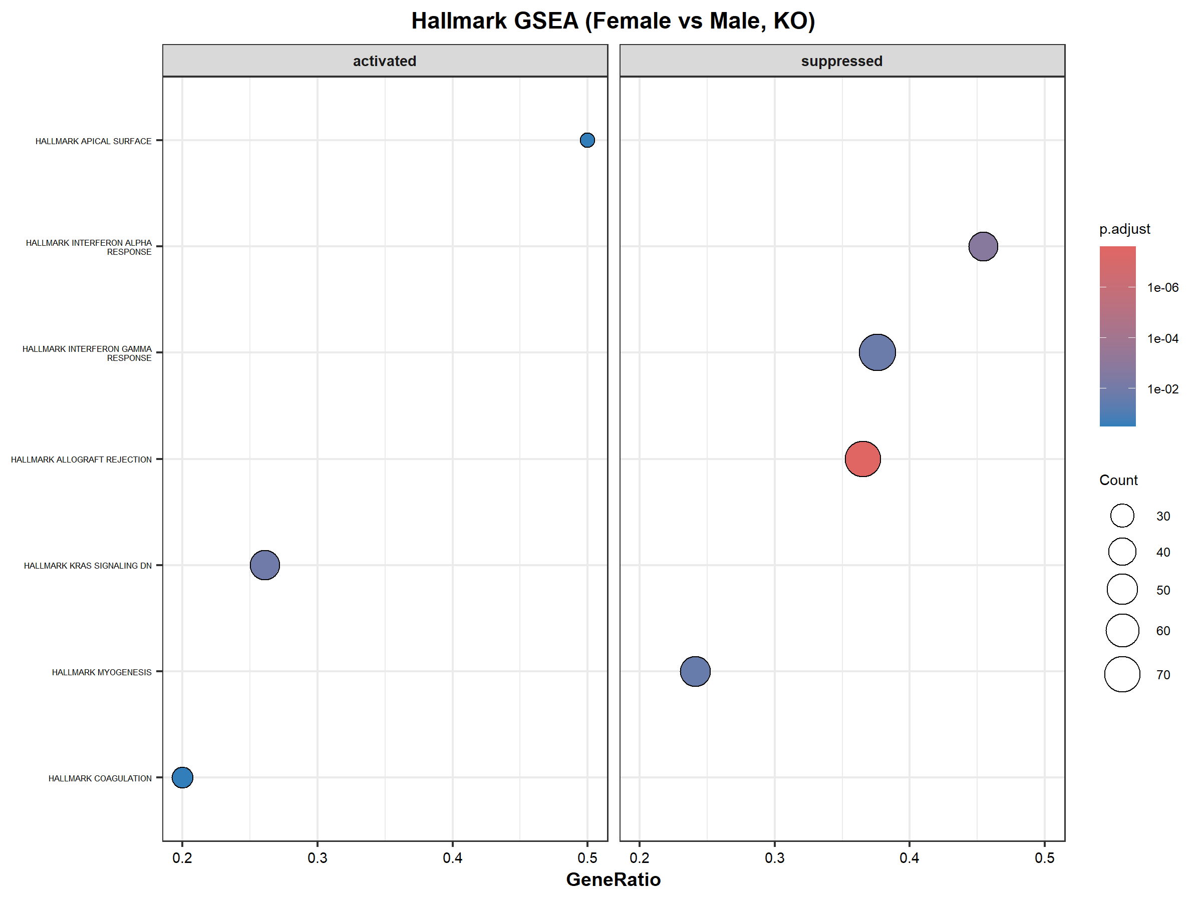

Slide 28
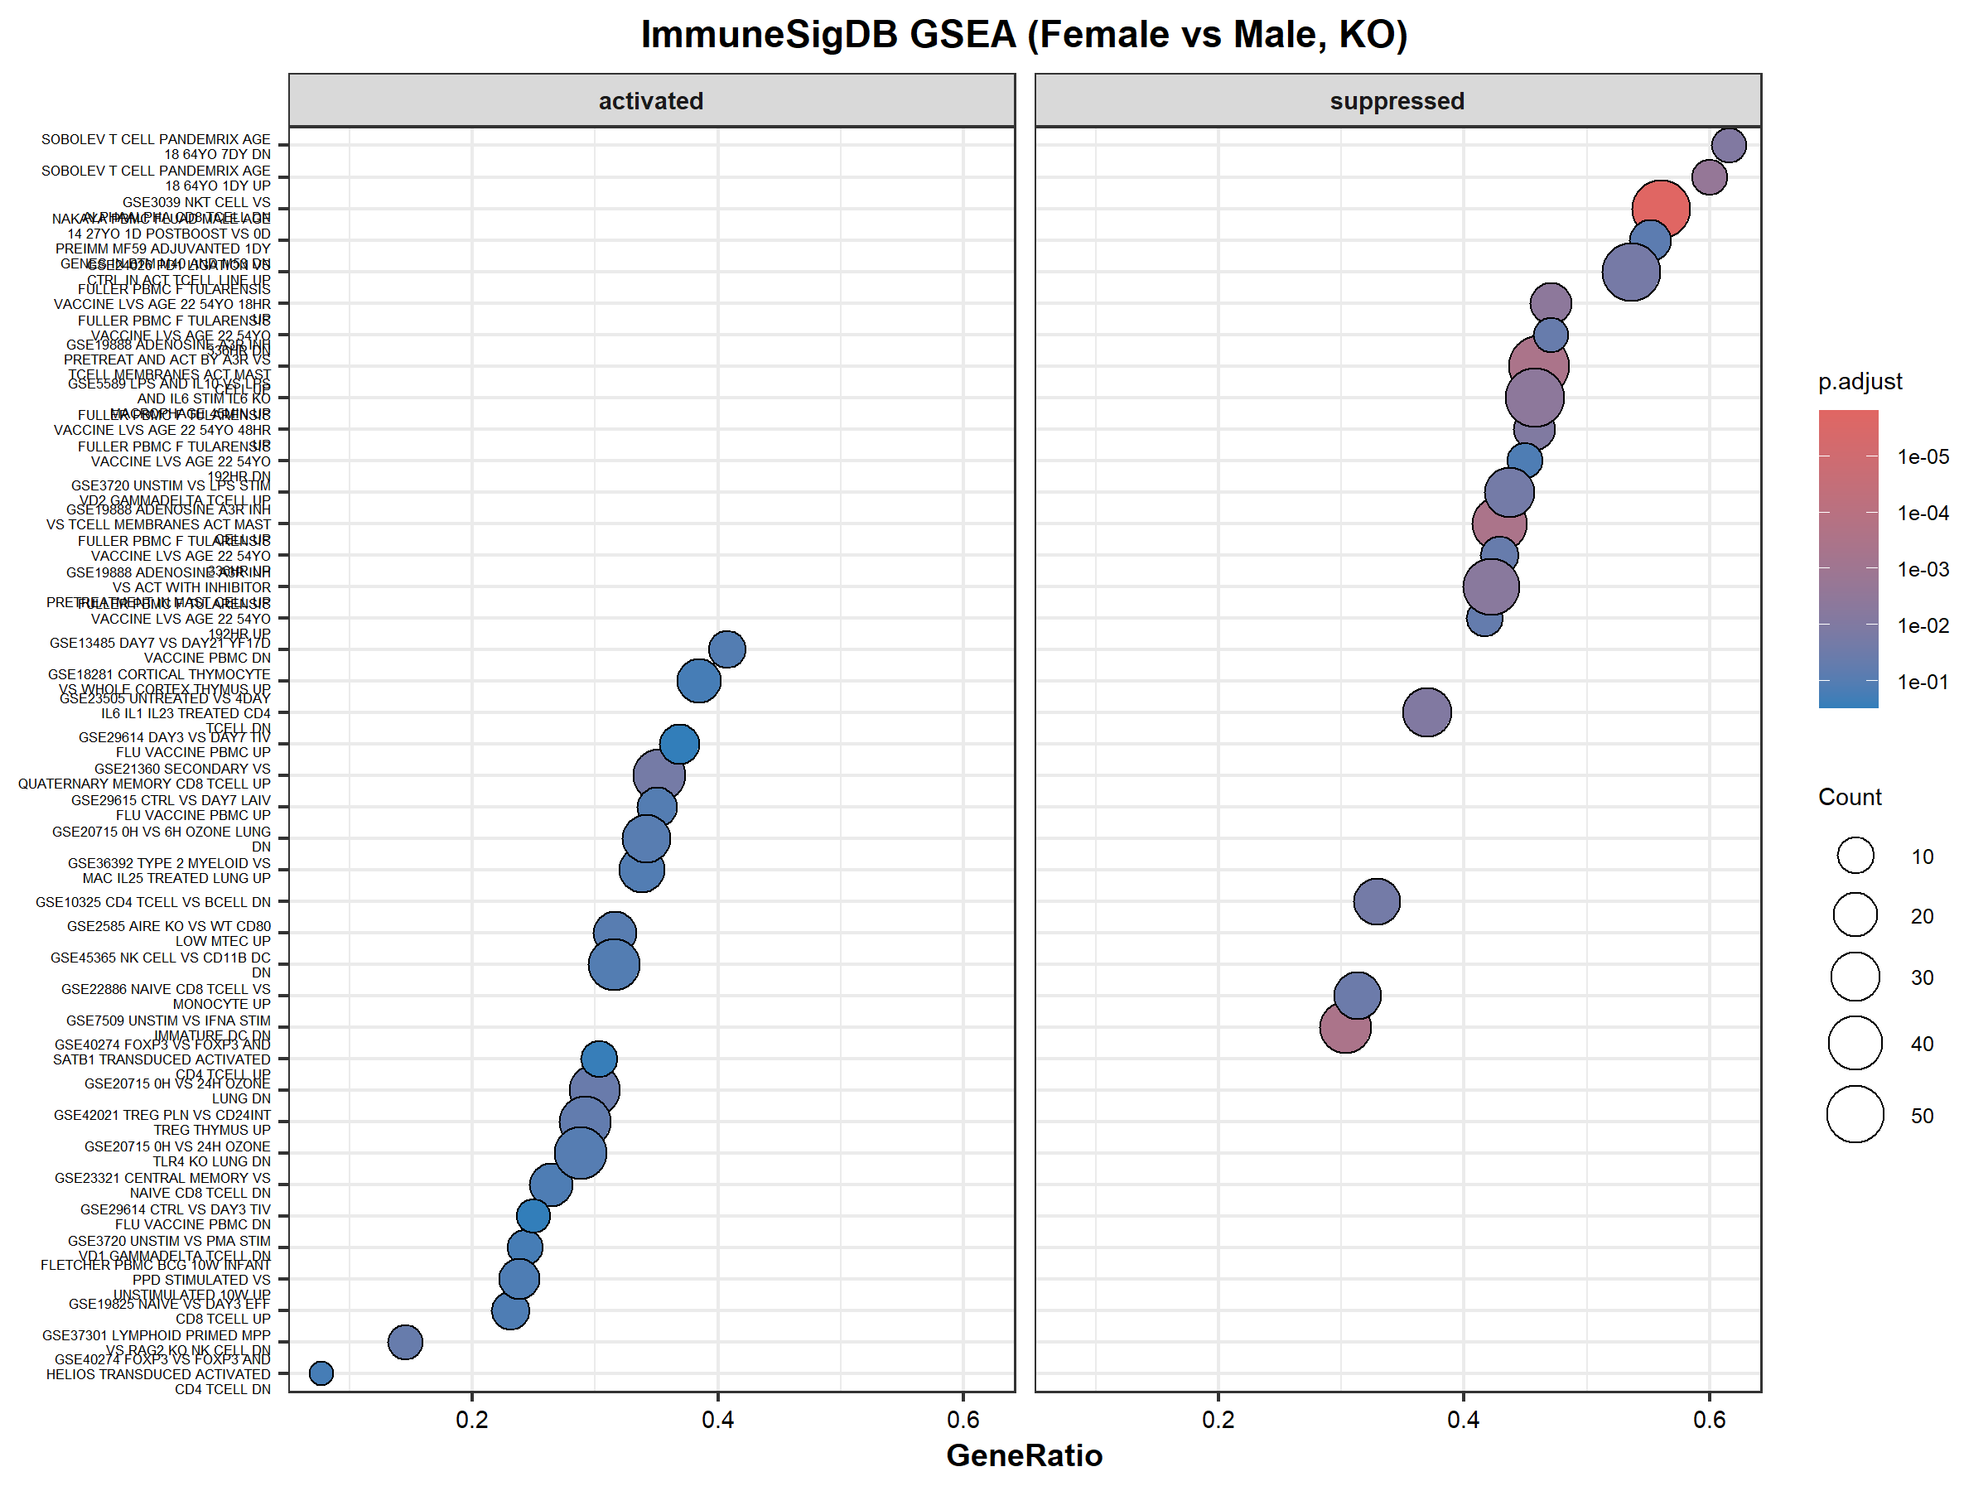

Slide 29
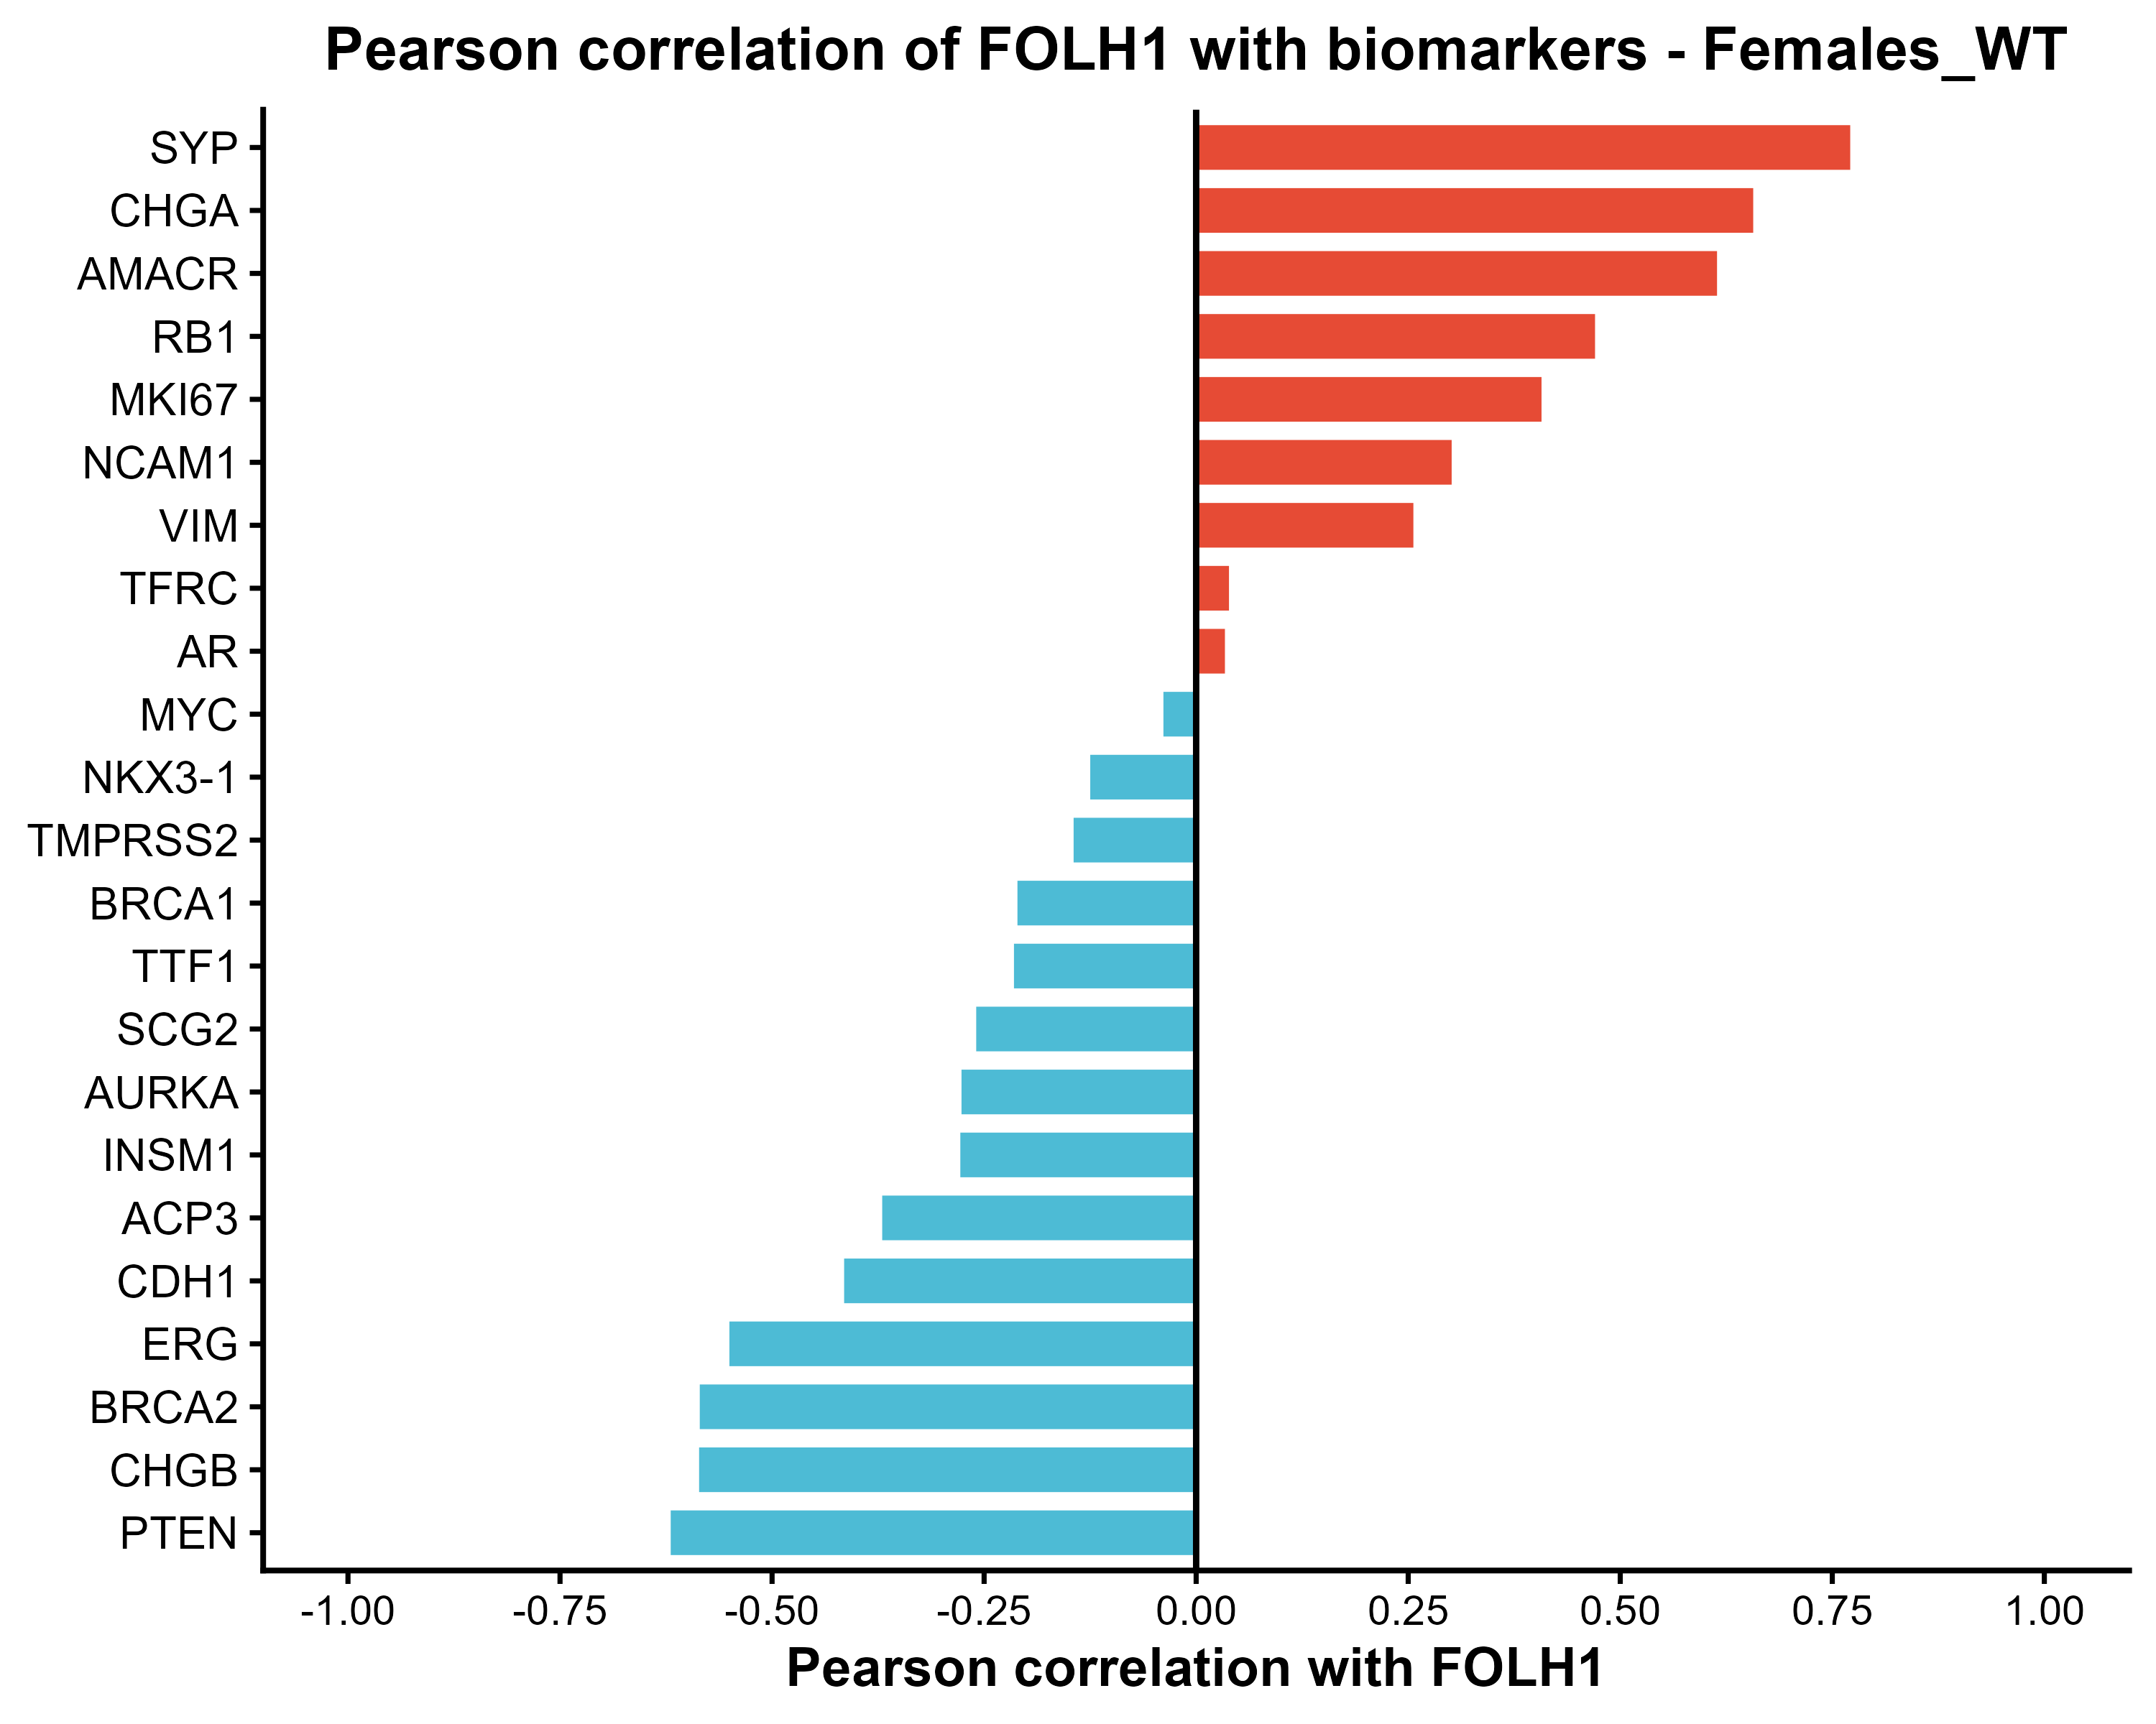
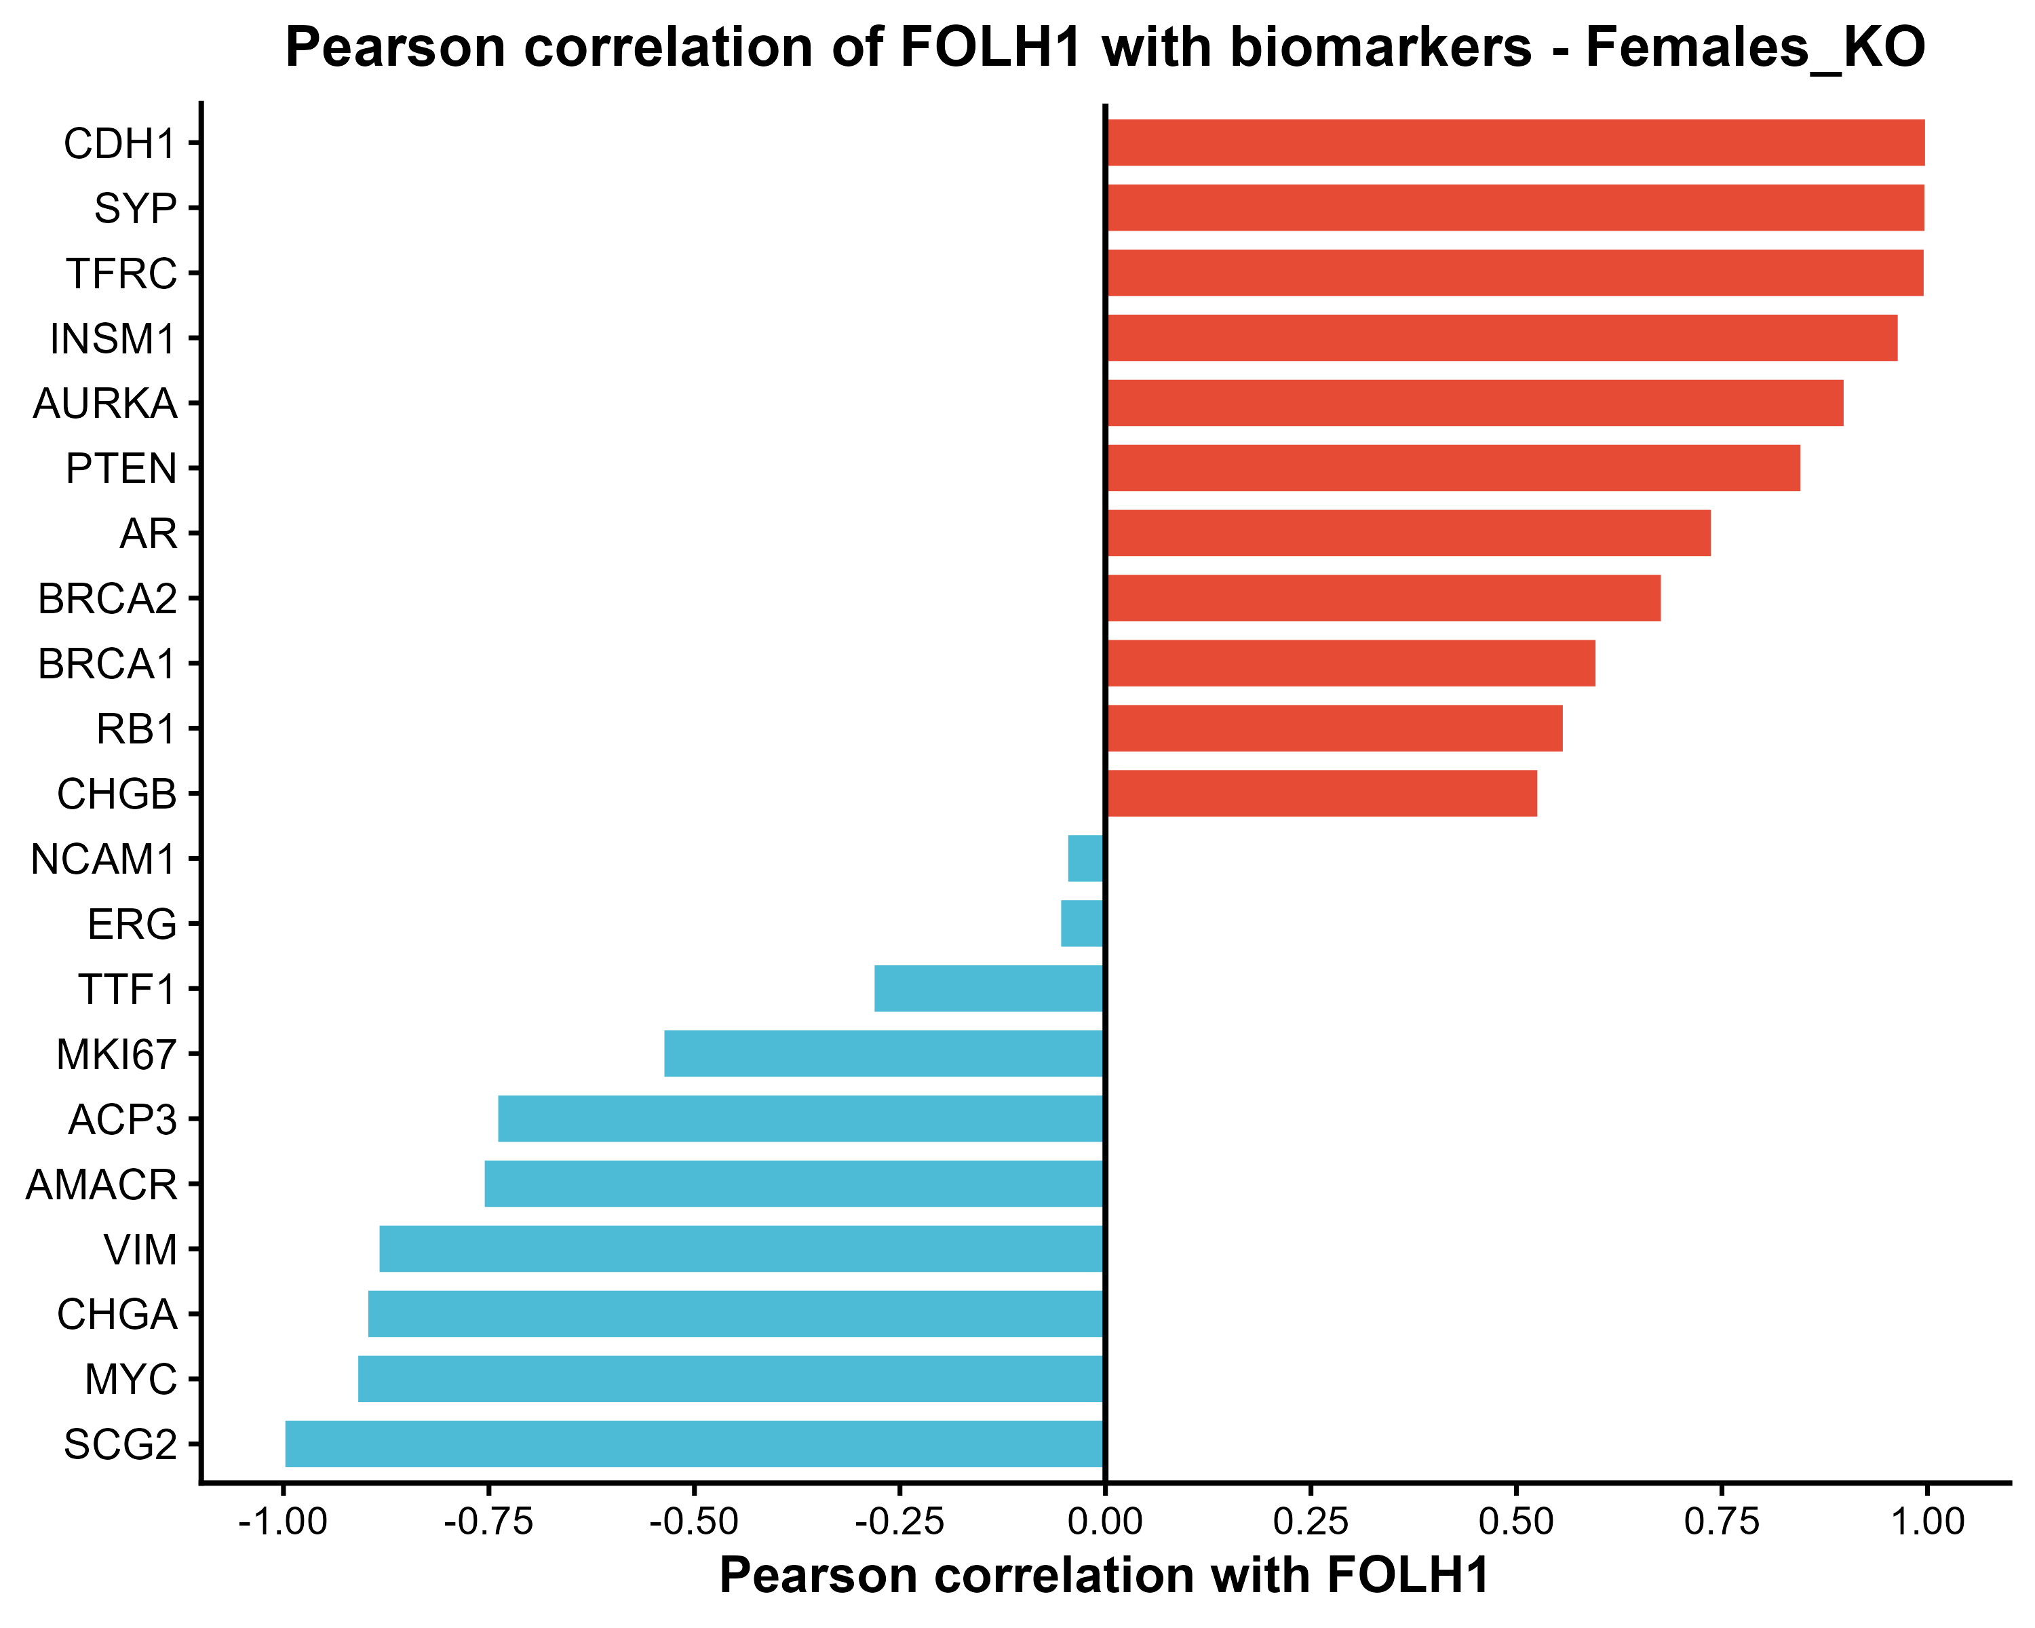
Correlation of Interested biomarkers with FOLH1 (Females)

Slide 30


Correlation of Interested biomarkers with FOLH1 (Males)

Slide 31




MCP counter groups with significant differences
between KO Male and
KO Female

Slide 32





MCP counter groups with significant differences
between KO Male and
WT Male
Almost significant

Slide 33


MCP counter groups with significant differences
between KO Female and WT Female

Slide 34
3. Syngeneic tumor with PIP5K1A WT & KO treated with PINK1-OE

Slide 35



Slide 36


Slide 37


Differential Expressional Analysis in WT (PINK1 treated vs control)

Slide 38


Differential Expressional Analysis in KO (PINK1 treated vs control)

Slide 39


Differential Expressional Analysis in PINK1 treated (WT vs KO)

Slide 40


Differential Expressional Analysis in PINK1 Controls (WT vs KO)

Slide 41

WT (PINK1 treated) vs Control Pathway & Immune enrichment Summary

Slide 42

Pathway analysis WT (PINK1 treated vs control)

Slide 43


Slide 44


Slide 45


Slide 46

KO (PINK1 treated vs Control) Pathway & Immune enrichment Summary

Slide 47


Slide 48


Slide 49
4. Syngeneic tumor with PIP5K1A WT treated with MTK

Slide 50




Slide 51


All 14 significant DEGs
Top 50 DEGs

Slide 52


Slide 53


Slide 54


Slide 55


Slide 56
Expression patterns with Significant differences
between Males and Females in WT
RB1: a tumor suppressor that restrains the G1/S cell cycle transition by binding and inhibiting E2F transcription factors in its hypo-phosphorylated state.
FOLH1: encodes folate hydrolase 1, a type II transmembrane glycoprotein state. Through its folate hydrolase activity, FOLH1 mediates folate absorption in the gut.

Slide 57
5. Syngeneic tumor with PIP5K1A WT & KO (two flanks) treated with MTK

Slide 58



Slide 59


Slide 60


Differential Expressional Analysis of WT (MTK treated vs control)

Slide 61


Differential Expressional Analysis of KO (MTK treated vs control)

Slide 62


Differential Expressional Analysis of MTK treated (WT vs KO)

Slide 63


Differential Expressional Analysis of MTK controls (WT vs KO)

Slide 64


Slide 65


Slide 66


Slide 67


Slide 68


Slide 69


Slide 70


Slide 71


Slide 72
6. Syngeneic tumor with PIP5K1A WT & KO treated with ISA

Slide 73



Slide 74


Slide 75


Differential Expressional Analysis of ISA treated vs control (all sexes)

Slide 76


Differential Expressional Analysis of ISA treated vs control (in female)

Slide 77


Differential Expressional Analysis of ISA treated vs control (in males)

Slide 78


Differential Expressional Analysis of ISA controls (Male vs Female)

Slide 79


Differential Expressional Analysis of ISA treated (Male vs Female)

